Slide 1
Historians Interpretations of the Past
Views on Native Americans

Slide 2
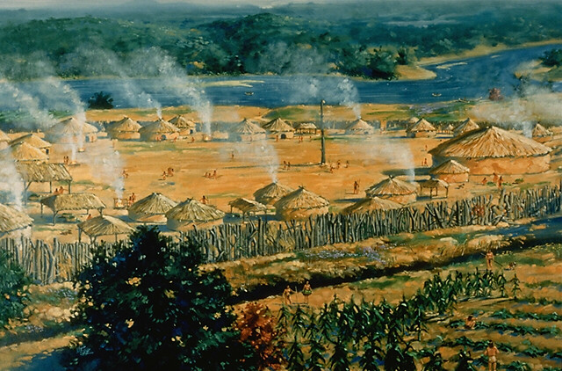
Part 1
Find a partner
Make a list of what you know about Native Americans prior to 1491
What was their relationship to their environment?
What were their relationship between tribes?

Slide 3
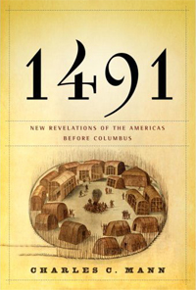
Part 2
Read American Past and Present – Chapter 1
Also read the two article provided (Alan Taylor’s book review of 1491, and The Pristine Myth by Katie Bacon)

Slide 4
Part 3
What are the major similarities and differences found in the textbook and the articles?
Which interpretation of Pre-Columbian Native American History best matches the list you developed and why?

