Slide 2
Carl’s “flipped” Class
The Revolutionary War

Slide 3
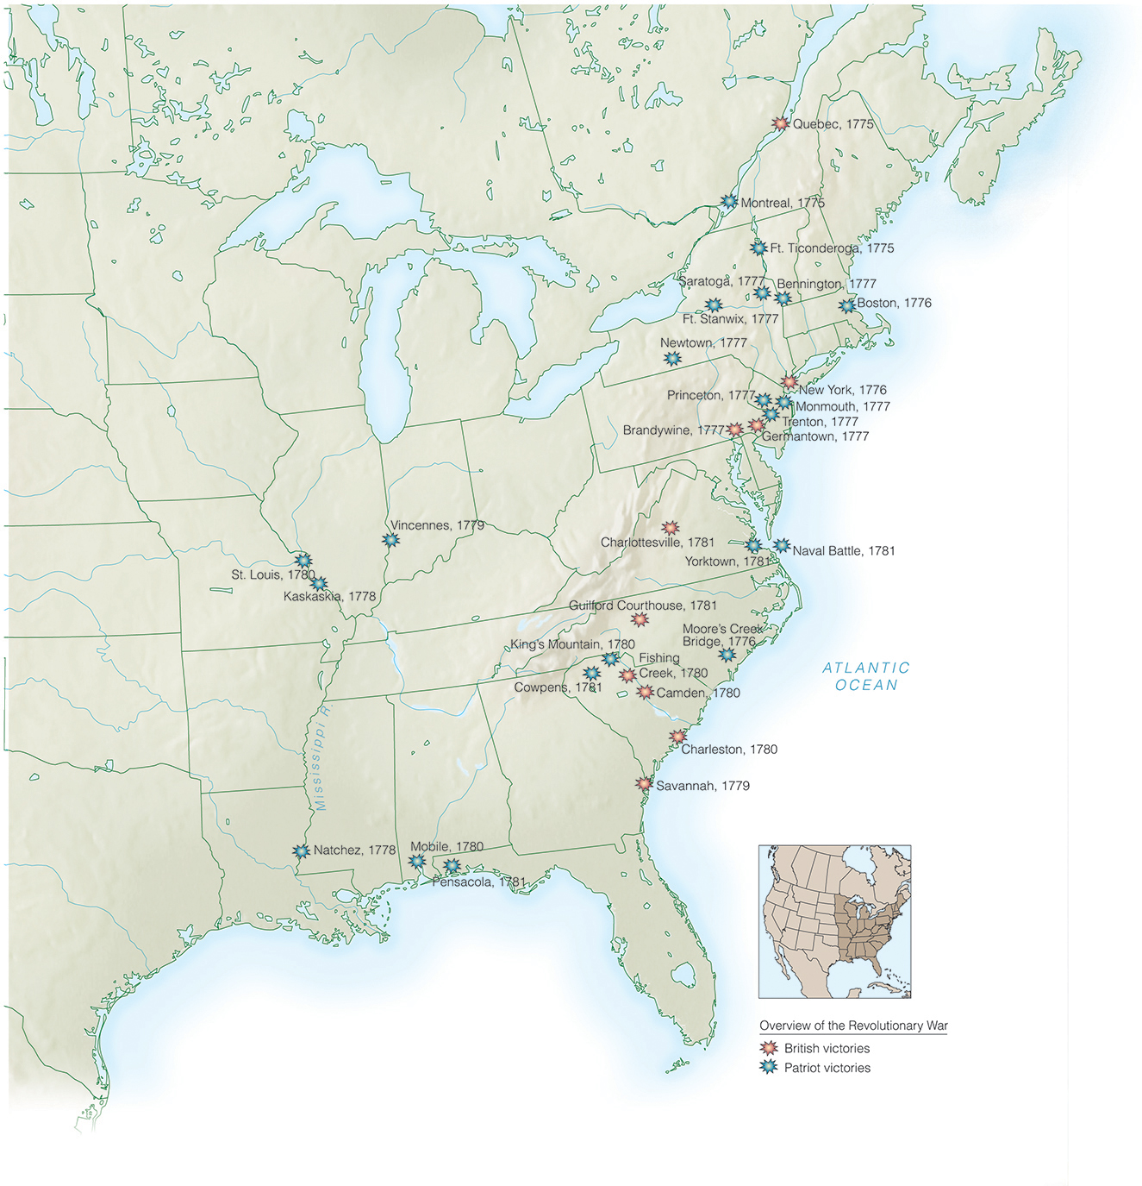
Major Battles of the American Revolution.

Slide 4
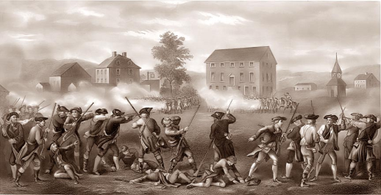
Shots Heard Around the World
April 19, 1775—skirmish breaks out in Lexington, Massachusetts
Fighting spreads along road between Lexington, Concord, and Boston
English retreat to Boston with heavy losses
June 17, 1775—colonists inflict heavy losses on British in Battle of Bunker Hill
Notes:
18

Slide 5
- April 19, 1775 - Shots at Lexington and Concord
July 17, 1775 - Battle of Bunker Hill
March 17, 1776 - British leave Boston
July, 2 & 4, 1776 - Declaration of Independence
Aug. 27, 1776 - Battle of Brooklyn Heights NY
Sept. 16, 1776 - Battle of Harlem Heights, NY
Oct. 28, 1776 - Battle of White Plains, NY
Dec. 26, 1776 - Attack on Trenton, NJ
Jan. 3, 1777 - Attack on Princeton, NJ
Sept. 11, 1777 - Battle of Brandywine, PA
Sept. 26, 1777 - Philadelphia falls to British
Oct. 4, 1777 - Battle of Germantown, PA
Oct. 17, 1777 - John Burgoyne surrenders at Saratoga, NY
June 28, 1778 - Battle of Monmouth, PA
Feb. 25, 1779 -Fort Sackville Falls, (Vincennes IN)
March 1780 - British land at Charlestown, SC
Jan. 17, 1781 - Battle of Cowpens
March 15, 1781 - Battle of Gilford Court House, NC
Aug. – Oct. 1781 - Battle of Yorktown, VA

Slide 7
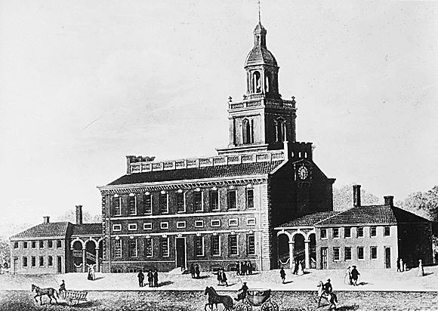
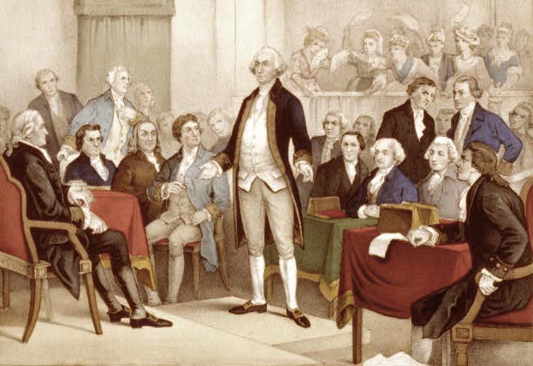
The Colonist Establish a Government
British colonial governments collapse
Second Continental Congress—action and inaction
June 1775—Congress appoints George Washington commander in chief
Congress issues paper money to pay war debts
Debates whether to declare independence
British action that makes compromise unlikely
December 1775 Prohibitory Act—British blockade colonists’ trade
German mercenaries hired to put down rebellion
Virginia Governor Dunmore urges slaves to take up arms against their masters
Notes:
19

Slide 8
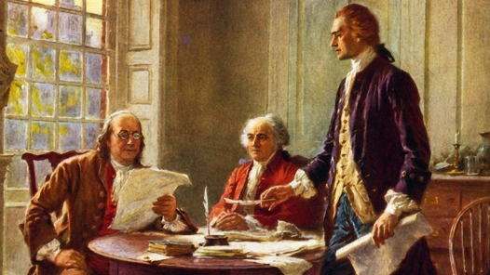
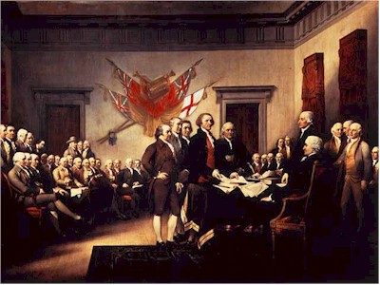
Breaking Ties
January 1776—Thomas Paine’s Common Sense
Convinces ordinary colonists to sever ties with Britain
Europe, not England, “is the parent country of America”
Jefferson writes Declaration of Independence
Acceptance
July 2, 1776—Independence voted by Congress
July 4—Declaration of Independence issued
Notes:
20

Slide 9
- April 19, 1775 - Shots at Lexington and Concord
July 17, 1775 - Battle of Bunker Hill
March 17, 1776 - British leave Boston
July, 2 & 4, 1776 - Declaration of Independence
Aug. 27, 1776 - Battle of Brooklyn Heights NY
Sept. 16, 1776 - Battle of Harlem Heights, NY
Oct. 28, 1776 - Battle of White Plains, NY
Dec. 26, 1776 - Attack on Trenton, NJ
Jan. 3, 1777 - Attack on Princeton, NJ
Sept. 11, 1777 - Battle of Brandywine, PA
Sept. 26, 1777 - Philadelphia falls to British
Oct. 4, 1777 - Battle of Germantown, PA
Oct. 17, 1777 - John Burgoyne surrenders at Saratoga, NY
June 28, 1778 - Battle of Monmouth, PA
Feb. 25, 1779 -Fort Sackville Falls, (Vincennes IN)
March 1780 - British land at Charlestown, SC
Jan. 17, 1781 - Battle of Cowpens
March 15, 1781 - Battle of Gilford Court House, NC
Aug. – Oct. 1781 - Battle of Yorktown, VA

Slide 10
Fighting for Independence
British confident of victory
Larger population, more resources
Naval supremacy
Britain’s tasks
Supply troops an ocean away in hostile territory
Crush the popular spirit of independence
British underestimate Americans’ commitment to their political ideology
Notes:
21

Slide 11
The American Revolution, 1775–1781

Slide 12
George Washington and His Victorious Patchwork Army
Washington understood that though his army could fight, they could not withstand a direct battle with British regulars.
For much of the war, his goal was not a decisive victory, but avoiding a decisive loss.
He knew the British would tire of war.

Slide 13
Building a Professional Army
Washington rejects guerilla warfare strategy
Continental army to be a fighting force and symbol of the republican cause
Militia’s role: compel support for Revolution
African Americans in the Revolution
New England militias attract slaves with promises of emancipation
Southern slaves more likely to side with British

Slide 15
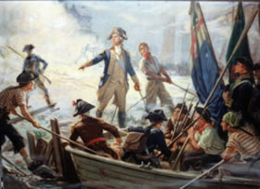
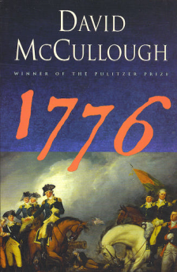
Testing the American Will
General Howe replaces General Gage for British
Summer 1776—fighting shifts to New York
American army routed on Long Island
New York City captured
Washington forced to retreat through New Jersey
British think rebels will soon capitulate
Notes:
22

Slide 16
“Times That Try Men’s Souls”
General Howe issues pardon for all who swear loyalty to Britain
3000 accept
December 25, 1776—Washington captures 900 Hessians in Trenton
January 3, 1777—Washington captures Princeton
Victories re-kindle wartime patriotism
British consolidate forces; leave much of New Jersey in patriot control
Notes:
23

Slide 17
- April 19, 1775 - Shots at Lexington and Concord
July 17, 1775 - Battle of Bunker Hill
March 17, 1776 - British leave Boston
July, 2 & 4, 1776 - Declaration of Independence
Aug. 27, 1776 - Battle of Brooklyn Heights NY
Sept. 16, 1776 - Battle of Harlem Heights, NY
Oct. 28, 1776 - Battle of White Plains, NY
Dec. 26, 1776 - Attack on Trenton, NJ
Jan. 3, 1777 - Attack on Princeton, NJ
Sept. 11, 1777 - Battle of Brandywine, PA
Sept. 26, 1777 - Philadelphia falls to British
Oct. 4, 1777 - Battle of Germantown, PA
Oct. 17, 1777 - John Burgoyne surrenders at Saratoga, NY
June 28, 1778 - Battle of Monmouth, PA
Feb. 25, 1779 - Fort Sackville Falls, (Vincennes IN)
March 1780 - British land at Charlestown, SC
Jan. 17, 1781 - Battle of Cowpens
March 15, 1781 - Battle of Gilford Court House, NC
Aug. – Oct. 1781 - Battle of Yorktown, VA

Slide 18
Victory in a Year of Defeat
British strategy
Cut off New England from other colonies
Lure Continental army into decisive battle
The plan for cutting off New England
Burgoyne’s army moves in from Canada
Howe’s army moves up from New York
They meet in Albany
Burgoyne defeated at Saratoga
Howe takes Philadelphia instead
Washington’s army winters at Valley Forge, Pennsylvania
Notes:
24

Slide 19
- April 19, 1775 - Shots at Lexington and Concord
July 17, 1775 - Battle of Bunker Hill
March 17, 1776 - British leave Boston
July, 2 & 4, 1776 - Declaration of Independence
Aug. 27, 1776 - Battle of Brooklyn Heights NY
Sept. 16, 1776 - Battle of Harlem Heights, NY
Oct. 28, 1776 - Battle of White Plains, NY
Dec. 26, 1776 - Attack on Trenton, NJ
Jan. 3, 1777 - Attack on Princeton, NJ
Sept. 11, 1777 - Battle of Brandywine, PA
Sept. 26, 1777 - Philadelphia falls to British
Oct. 4, 1777 - Battle of Germantown, PA
Oct. 17, 1777 - John Burgoyne surrenders at Saratoga, NY
June 28, 1778 - Battle of Monmouth, PA
Feb. 25, 1779 - Fort Sackville Falls, (Vincennes IN)
March 1780 - British land at Charlestown, SC
Jan. 17, 1781 - Battle of Cowpens
March 15, 1781 - Battle of Gilford Court House, NC
Aug. – Oct. 1781 - Battle of Yorktown, VA

Slide 20
The French Alliance
French help colonists to get back at Britain for defeat in Seven Years’ War
Effects of Saratoga
Convinces France that colonists are serious enough to become formal allies
British sue for peace to prevent Franco-American alliance
British offer repeal of all laws since 1763, respect for colonial taxation rights
February 1778—Alliance with France concluded
Notes:
25

Slide 21
- April 19, 1775 - Shots at Lexington and Concord
July 17, 1775 - Battle of Bunker Hill
March 17, 1776 - British leave Boston
July, 2 & 4, 1776 - Declaration of Independence
Aug. 27, 1776 - Battle of Brooklyn Heights NY
Sept. 16, 1776 - Battle of Harlem Heights, NY
Oct. 28, 1776 - Battle of White Plains, NY
Dec. 26, 1776 - Attack on Trenton, NJ
Jan. 3, 1777 - Attack on Princeton, NJ
Sept. 11, 1777 - Battle of Brandywine, PA
Sept. 26, 1777 - Philadelphia falls to British
Oct. 4, 1777 - Battle of Germantown, PA
Oct. 17, 1777 - John Burgoyne surrenders at Saratoga, NY
June 28, 1778 - Battle of Monmouth, PA
Feb. 25, 1779 -Fort Sackville Falls, (Vincennes IN)
March 1780 - British land at Charlestown, SC
Jan. 17, 1781 - Battle of Cowpens
March 15, 1781 - Battle of Gilford Court House, NC
Aug. – Oct. 1781 - Battle of Yorktown, VA

Slide 22
Revolutionary War in “Indiana”
George Rogers Clark will lead an expedition into the west to stop Indian attacks and secure the west for the colonies.
He will leave “Louisville” and take Vincennes, capturing Fort Sackville and the British Governor or Detroit, Henry Hamilton.

Slide 23
- April 19, 1775 - Shots at Lexington and Concord
July 17, 1775 - Battle of Bunker Hill
March 17, 1776 - British leave Boston
July, 2 & 4, 1776 - Declaration of Independence
Aug. 27, 1776 - Battle of Brooklyn Heights NY
Sept. 16, 1776 - Battle of Harlem Heights, NY
Oct. 28, 1776 - Battle of White Plains, NY
Dec. 26, 1776 - Attack on Trenton, NJ
Jan. 3, 1777 - Attack on Princeton, NJ
Sept. 11, 1777 - Battle of Brandywine, PA
Sept. 26, 1777 - Philadelphia falls to British
Oct. 4, 1777 - Battle of Germantown, PA
Oct. 17, 1777 - John Burgoyne surrenders at Saratoga, NY
June 28, 1778 - Battle of Monmouth, PA
Feb. 25, 1779 - Fort Sackville Falls, (Vincennes IN)
March 1780 - British land at Charlestown, SC
Jan. 17, 1781 - Battle of Cowpens
March 15, 1781 - Battle of Gilford Court House, NC
Aug. – Oct. 1781 - Battle of Yorktown, VA

Slide 24
The Final Campaign
British believe Loyalists stronger in southern colonies, so fighting shifts there
Spring 1780—English capture Savannah and Charleston
August 1780—American army routed at Camden, South Carolina
Continental army rallies under Nathaniel Greene
Cornwallis moves British into Virginia, 1781
October 19, 1781—Cornwallis surrenders to Washington’s combined French and American forces
Notes:
26

Slide 25
The Loyalist Dilemma
More than 100,000 Loyalists leave U.S. at war’s end
Loyalists share basic ideology with Patriots
Loyalists see rebellion as endangering “life, liberty, and property”
Loyalists treated poorly by both sides
British never fully trust Loyalists
Patriots seize property, imprison, execute some
Notes:
27

Slide 26
Loyalist Strongholds

Slide 27
Winning the Peace
American negotiators are John Jay, Ben Franklin, and John Adams
They play France against England to get best terms
Peace Treaty of 1783
U.S. independence recognized
U.S. gets all territory east of Mississippi River, between Canada and Florida
U.S. secures fishing rights in North Atlantic
U.S. will help British merchants and Loyalists collect debts
Notes:
28

Slide 28
Preserving Independence
The American Revolution begins construction of new form of government
Question remains: a government of the elite or a government of the people?
Notes:
29

