Slide 1
Fraser Chap. 9
Canal Mania – Missouri Compromise

Slide 2
A Revolution in Transportation
Primitive land transportation in the East was offset by shipping via the coastal waterways
After the War of 1812, political leaders recognized the need to improve the country’s transportation network
National leaders like Madison and Calhoun called for “internal improvements”
Actual federal role less than anticipated in those calls for internal improvements

Slide 3
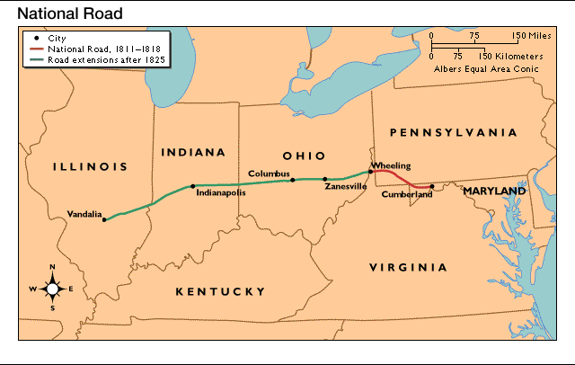
Roads and Steamboats
National Road from Cumberland, Maryland, eventually to Vandalia, Illinois
Turnpikes—privately owned toll roads chartered by states
Roads useful for travelers, but too expensive for transportation of bulk goods
Water most efficient for bulk cargo transportation

Slide 4
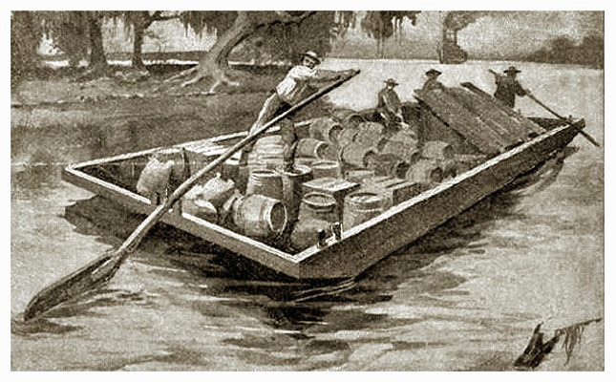
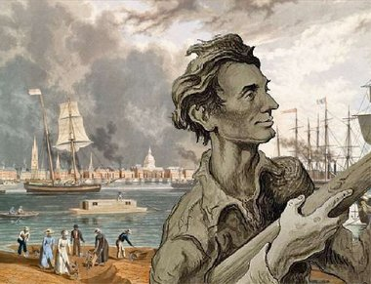
Roads and Steamboats
Network of rivers encouraged economic development
Flatboats transported downriver in early times
Steamboats transported upriver after 1811
Upriver capabilities reduced costs
Steamboats catered to passengers with luxury hotel atmosphere
Steamboat accidents stimulated Ante-Bellum Congressional effort to establish safety regulations

Slide 5
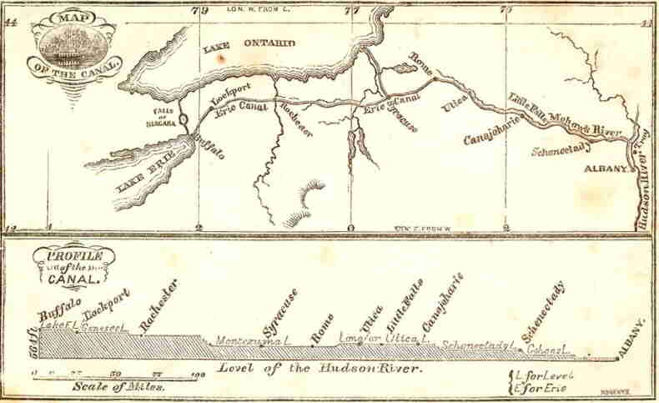
The Canal Boom
Canals needed to link West with coast
Erie Canal, 1825
New York Governor Dewitt Clinton got state funding
Canal linked New York City to Great Lakes at Buffalo, through Albany
Canal cut east-west transportation costs dramatically
Canal stimulated commercial growth of New York City

Slide 6
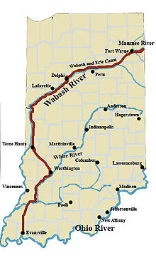
Canal Mania in Indiana
Other states followed until 1840s, when canal deemed unprofitable, but useful
In 1828, The Wabash and Erie Canal began in Indiana.
It was to link Toledo Ohio to Evansville Indiana
Evansville was gripped with Canal Mania when it was announced in 1828 but by the time the canal reached Evansville in 1853, the era of the Canals had passed.

Slide 7
Commerce and Banking
Old style farmer sold crop directly
New style farmer sold to local merchant; local merchant sold to final market
System required farmers and local merchants to have credit
Use of credit stimulated banking
Federal government issued too little money, private banks issued bank notes

Slide 8
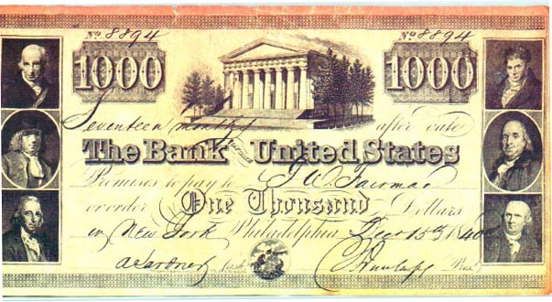
Commerce and Banking
State banks increased after 1812
1816—Second Bank of the United States created to check state banks
Bank’s easy credit sparked Panic of 1819

Slide 9
The Republicans in Power
Federalists died as national party after 1812, but Republicans adopted some of their ideas
Henry Clay’s American System, 1816
High tariffs to protect industries that sprang up in embargo and war
Second Bank of the U.S.
Federal aid for internal improvements
Aid for internal improvements controversial
Sectional conflict over who benefited
Madison, Monroe saw constitutional conflicts

Slide 10
Monroe as President
Madison picked fellow Virginian James Monroe as his successor in 1816
Monroe sought national harmony, an “era of good feelings”
Took no action in Panic of 1819, believed president above such matters
Provided no leadership controversy over Missouri
Voters accepted Monroe’s view of leadership, he is re-elected in 1820

Slide 11
The Missouri Compromise: The Issues
1817—Missouri applied for statehood as slave state
Northerners believed South over-represented in House of Representatives, despite their own decisive majority
Tallmadge Amendment called for gradual elimination of slavery if Missouri admitted, passes House
South wished to preserve balance of power between slave states and free states

Slide 12
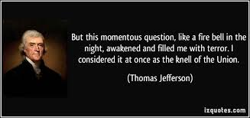
The Missouri Compromise: The Solution
Missouri admitted as slave state
Maine separated from Massachusetts, admitted as free state
Slavery banned elsewhere in Louisiana Purchase above the latitude of 36º30'
Missouri controversy exposed deep rift between North and South
Jefferson called it “a fire bell in the night”

Slide 13
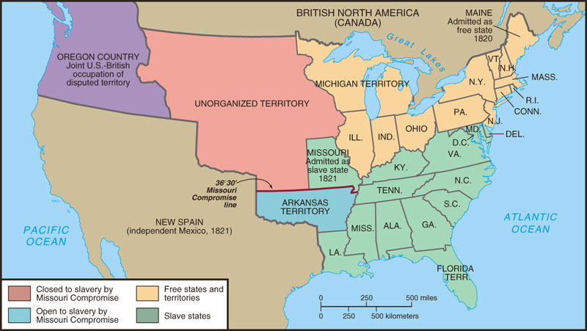
The Missouri Compromise, 1820-1821

