Slide 1
Chapter 5 THE AMERICAN REVOLUTION The Road to Revolution

Slide 2
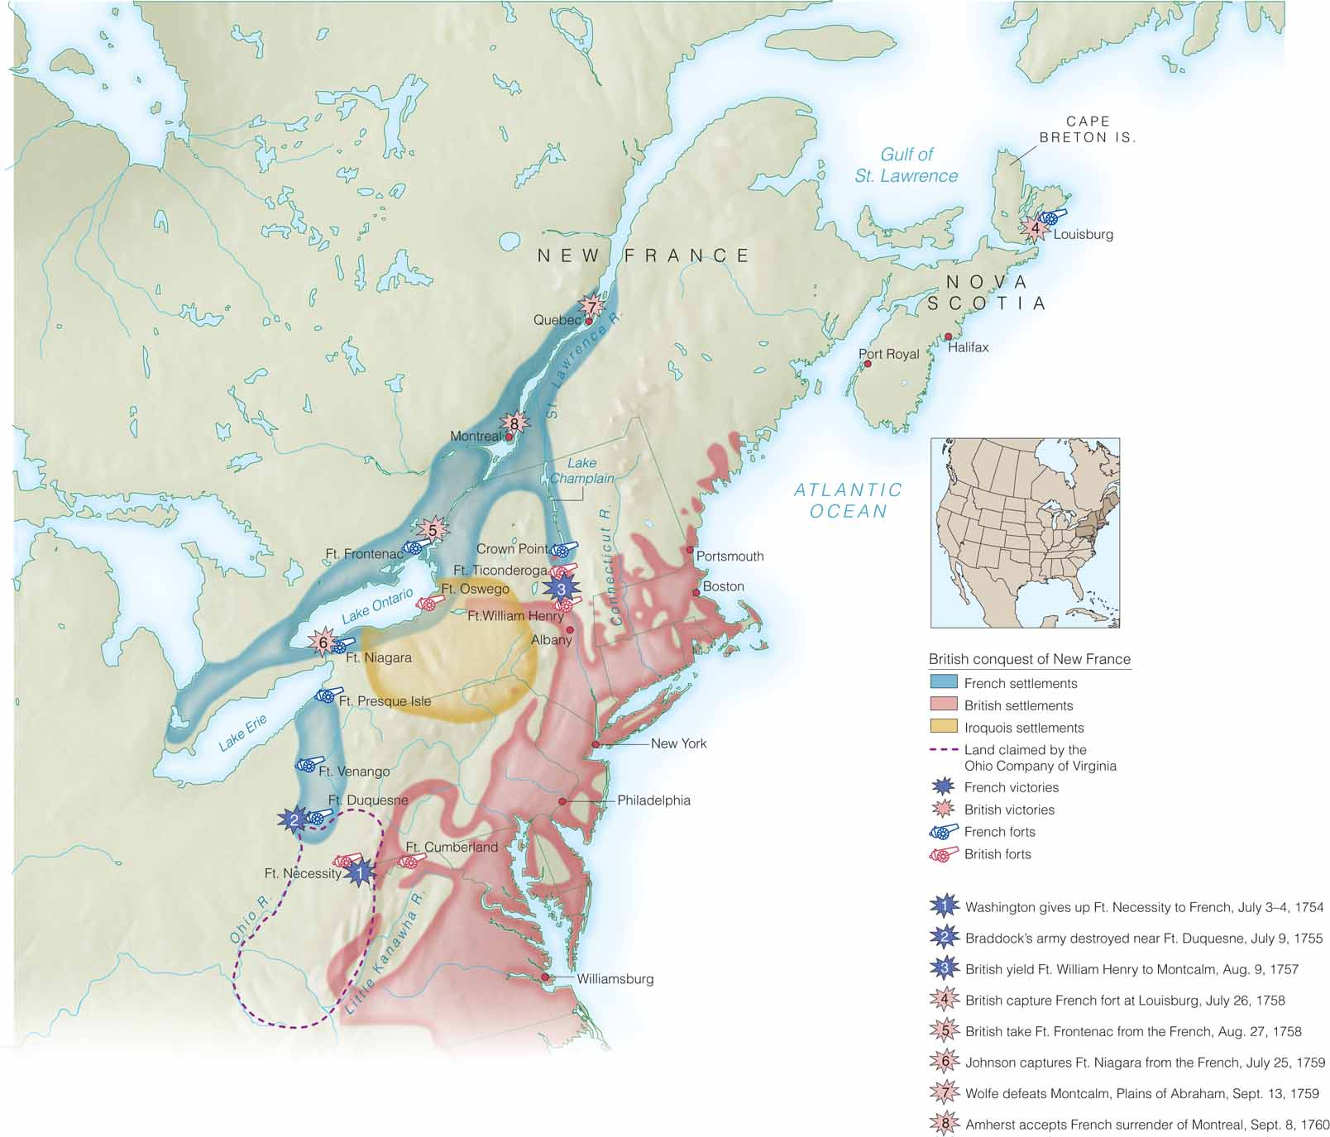
Preludes to a Revolution

Slide 3
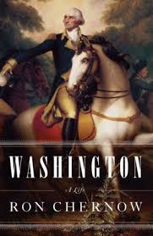
Ron Chernow’s Washington
1. Who seemed more determined to control the Ohio River Valley? Explain the justification for your opinion?
2. What overall impression do you have of young George Washington?
3. Describe the terrain of the French camp were Jumonville was killed. What does the location of their camp lead you to believe their mission was?
4. Which version of the event at the French camp do you believe and why?

Slide 4
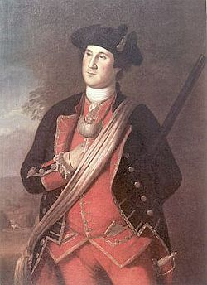
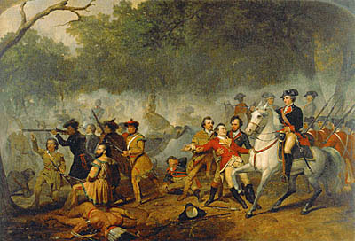
The French and Indian War, 1754–1763
The war changed the landscape of North America.
After the British victory, France ceded Canada and the land east of the Mississippi River to the British.
French and Indian War
British/Colonial view of each other

Slide 5
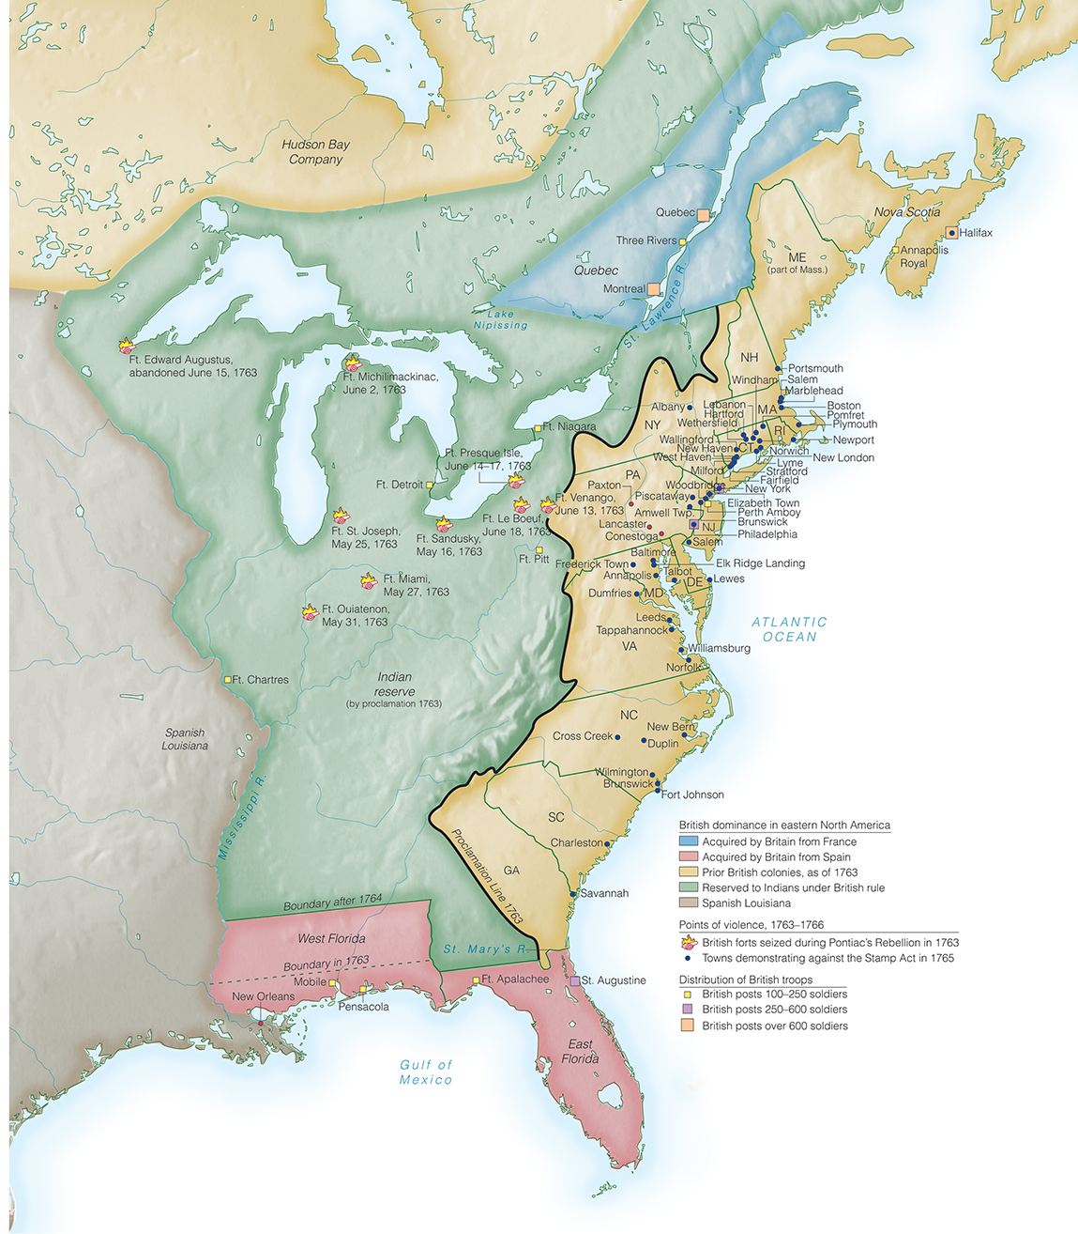
North America Before and After the French and Indian War

Slide 6
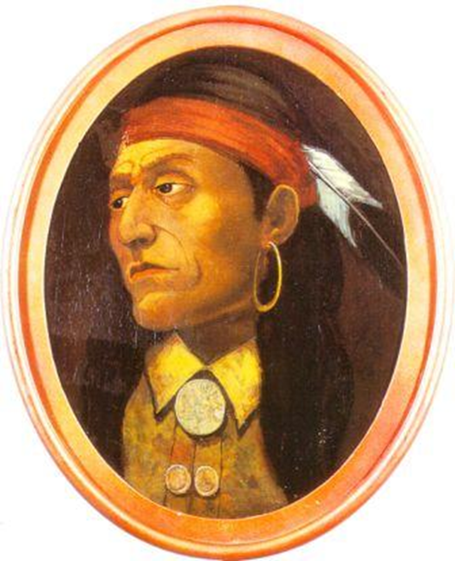
Pontiac and Indian Responses
1763 – Pontiac’s Rebellion
Pontiac and his followers attacked British forts across the region.
In July 1766 Pontiac signed a treaty of peace.
Results
- Exposes the British army’s weakness
- Reveals the desperate situation of Native Americans after withdrawal of French

Slide 7
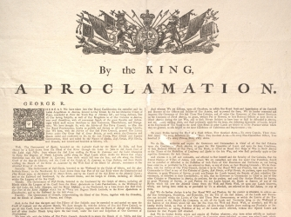
The Proclamation Line of 1763
In October 1763, the king issued a proclamation that there should be no British settlement west of the crest of the Appalachian Mountains and that Indian rights to western lands would be protected forever.
The line infuriated the British colonists.

Slide 8
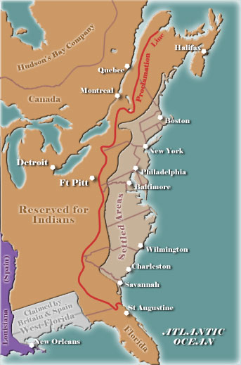
Halting Expansion - Proclamation of 1763
Colonists determined to settle trans-Appalachian West
Proclamation of 1763 bans settlement in trans-Appalachian West
Colonists see post-war army as there to enforce proclamation

Slide 9
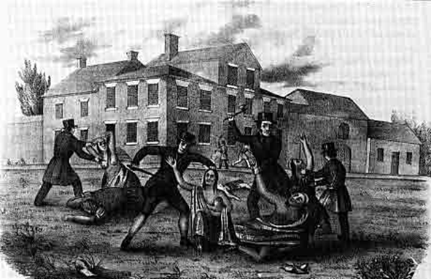
The Paxton Boys and Rural White Responses
The Paxton Boys decided to eliminate Indians.
In December 1763, the Paxton Boys attacked a Delaware village, killed six people, and burned the town.
Hatred of Indians would haunt the inhabitants of North America for a long time to come.

Slide 10
Threats of New Taxes
Victory in the war had virtually drained the kingdom’s treasury.
In 1764, George Grenville and the majority in Parliament asked Britain’s North American colonists to pay what the authorities in London thought was a fair share of the war’s cost.

Slide 11
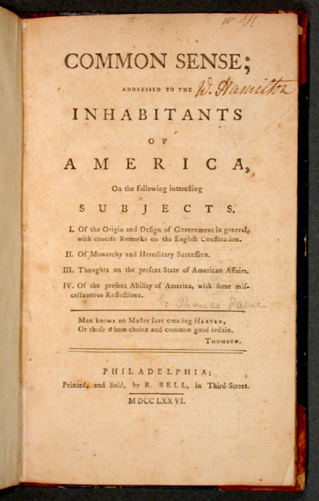
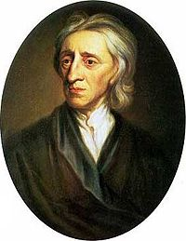
Ideas About Power and Virtue
John Locke and “Commonwealthmen" shape colonial political thought
Rebellion against arbitrary government justified
Power must be countered by virtue
Bad government reflects sin and corruption
Colonists see British officials as sinful and corrupt
Newspapers ensure wide dissemination of political confrontations
Notes:
5

Slide 12
Transition from the “Rights of Man” to Revolt
Throughout the 1770s, Locke’s ideas guided some of the Revolution’s most articulate advocates such as Thomas Jefferson, John Adams, and Benjamin Franklin.
They also believed in the need to overthrow unjust authorities.

Slide 13
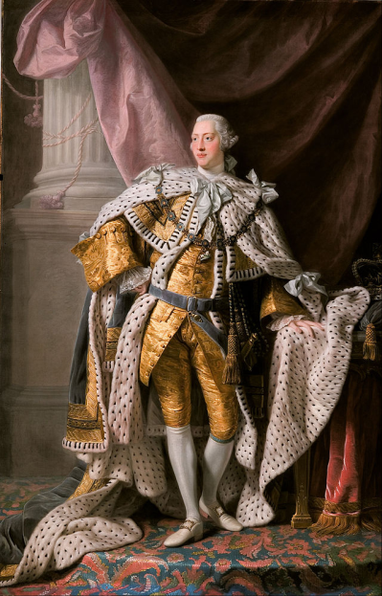
Breakdown of Political Trust
1760—George III ascends throne
Despite limited ability, wants to take more active role in government
Upsets Whigs by ignoring their role
High turnover among top ministers
Hard for Parliament to get adequate information on colonies
Parliamentary sovereignty
English officials assume that Parliament must have ultimate authority
Notes:
3

Slide 14
No Taxation without Representation: The American Perspective
Colonists try to reserve internal colonial authority for their own legislatures
Colonists assume their legislatures equal in some ways to Parliament
Americans not represented at all in Parliament
British officials espouse “virtual representation”
Colonists insist only colonial assemblies should represent Americans
Notes:
4

Slide 15
Sugar Act of 1764
Prime Minister George Grenville attempts to reduce England’s war debt
Revenue Act of 1764 (the Sugar Act)
Merchants and gentry protest; most colonists ignore

Slide 16
Colonial Products and Trade

Slide 17
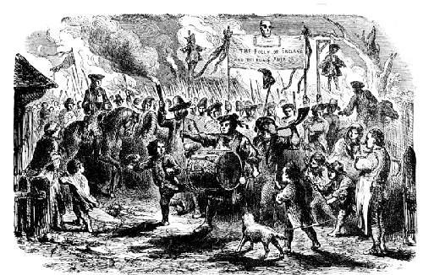
Stamp Act of 1765
1765—Stamp Act requires that colonists purchase stamps to validate documents
Patrick Henry and the Virginia Resolves, unites the gentry and the mass of the population in protest
Stamp Act Congress petitions the king and Parliament for repeal
Sons of Liberty protest includes riots, mob violence, and boycotts
Notes:
7

Slide 18
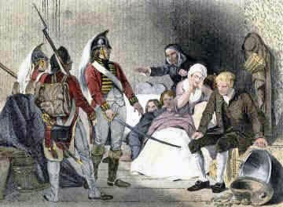
Quartering Act - 1765
Required the colonies to provide housing and food for British Soldiers
Originally, the soldiers were to protect the colonies after the French and Indian War but they came to be seen as an occupation force by the colonials.

Slide 19
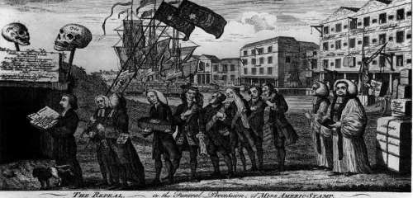
Declaratory Act of 1766
1766—Rockingham ministry favors repeal of Stamp Act
Repeal tied to Declaratory Act of 1766
Parliament sovereign over America “in all cases whatsoever”
Controversy estranges colonists from English officials
Notes:
8

Slide 20
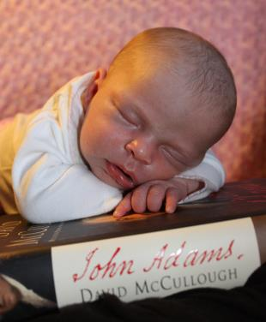
David McCullough – John Adams

Slide 21
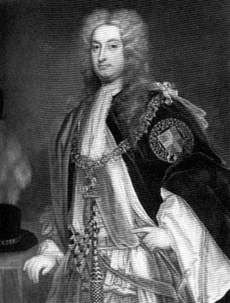
The Townshend Duties - 1767
Charles Townshend: chancellor
1767—Townshend Duties tax American imports of paper, lead, glass, and tea
American Board of Customs Commissioners created to collect duties
Notes:
9

Slide 22
Fueling the Crisis: Response to the Townshend Duties
Sons of Liberty organize boycott of English goods
Circular letter from Massachusetts House of Representatives urges protest
Ninety-two Massachusetts representatives defy government order to rescind letter
Notes:
10

Slide 23
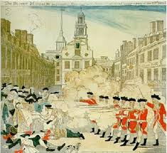
Boston Massacre
English government moves 4000 troops to Boston
Troops clash with Boston’s population
March 5, 1770—English soldiers fire on civilian crowd, kill five Americans
Incident labeled the “Boston Massacre”
Victims seen as martyrs
Paul Revere engraving a best seller
Townsend Duties repealed 1770, except tea
Notes:
11

Slide 24
Last Days of the Old Order, 1770–1773
Customs collectors antagonize colonists, even wealthy members of the elite, such as John Hancock
Radicals like Samuel Adams protest tea tax as violation of American rights
Committees of correspondence build up alternative political structure
Notes:
12

Slide 25
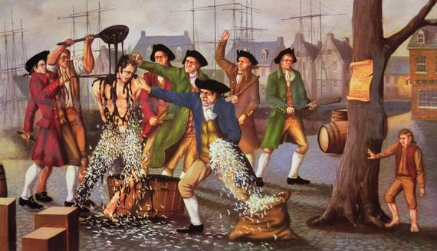
Tarring and Feathering

Slide 26
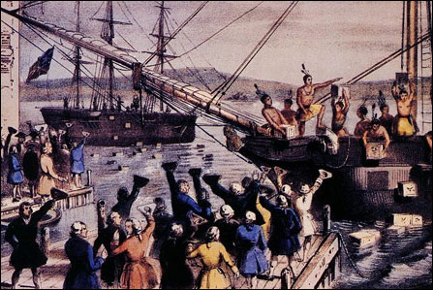
The Tea Act - 1773 The Boston Tea Party
1773—Parliament passes Tea Act
Designed to help the East India Company by making the sale of its tea cheaper in America
Americans interpret this as a subtle ploy to get them to consume taxed tea
December 1773—Boston protestors dump the tea into the harbor
Notes:
13

Slide 27
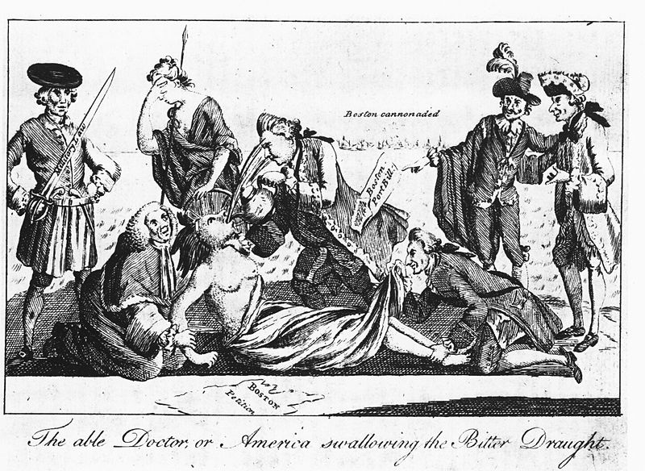
The Coercive Acts
Port of Boston closed until tea paid for
Massachusetts government re-structured
Upper house made appointive body
Town meetings permitted only once a year
Accused officials to be tried in England, not America
Army authorized to quarter troops wherever needed
Notes:
14

Slide 28
The Final Provocation: The Québec Act
Québec Act establishes authoritarian government for Canada
Gives control over settlement north of Ohio River to Québec government
Colonists interpret act as final proof of Parliamentary plot to enslave America
Provides unifying threat to colonies
Notes:
15

Slide 30
Steps Toward Independence
September 1774—First Continental Congress in response to Coercive Acts
Congress commends “Suffolk Resolves” urging forcible resistance
Intercolonial “Association” halts commerce with Britain until Coercive Acts repealed
Notes:
17

Slide 31
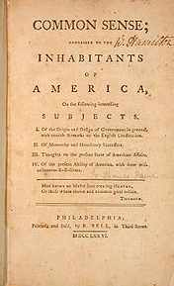
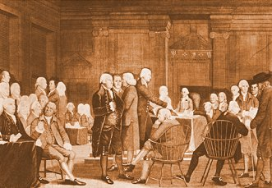
Moving Toward Independence
May 1775 – Second Continental Congress meets in Philadelphia
Thomas Paine’s Common Sense

