Slide 1
Chapter 4
Creating the Culture of British North America
1689-1754

Slide 2
England’s Glorious Revolution and “The Rights of Englishmen,” 1689
The English Parliament came to distrust King James II who they believed was centralizing too much authority and who they suspected of privately supporting Catholicism.
They ousted him in 1689 in what was known as the Glorious Revolution.

Slide 3
Parliament’s Decision to “Elect” a New King and Queen
Parliament invited James’s Protestant daughter, Mary, and her husband, Prince William of Orange, rulers of the Netherlands, to come to England as joint sovereigns.
This move by Parliament was a dramatic change that would have far-reaching effects.

Slide 4
John Locke—Defending the Right to Revolution
John Locke, justified the revolution by insisting that all government rested on the natural rights of the governed.
In his Second Treatise on Government, Locke described civil society as a social contract made by free people to live together.

Slide 5
North American Responses
In England’s American colonies, news of the Glorious Revolution brought rejoicing.
In the Americas, the Glorious Revolution produced winners and losers.

Slide 6
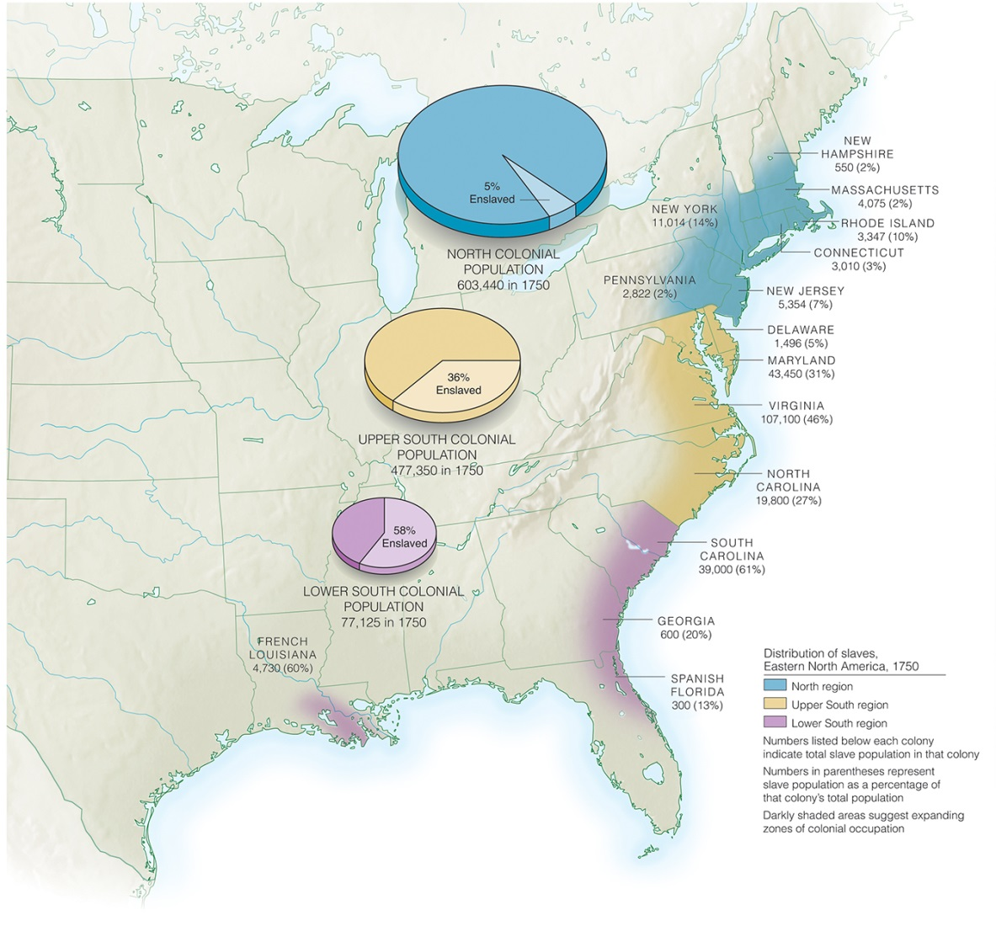
The Plantation World: From a Society with Slaves to a Slave Society

Slide 7
Seeking Stability by Creating a Slave Society
As the institution of slavery came to be more rigidly defined, it also came to be linked more closely to race.
Africans were seen as slaves.
Europeans, even the poorest Europeans, were seen as free.

Slide 8
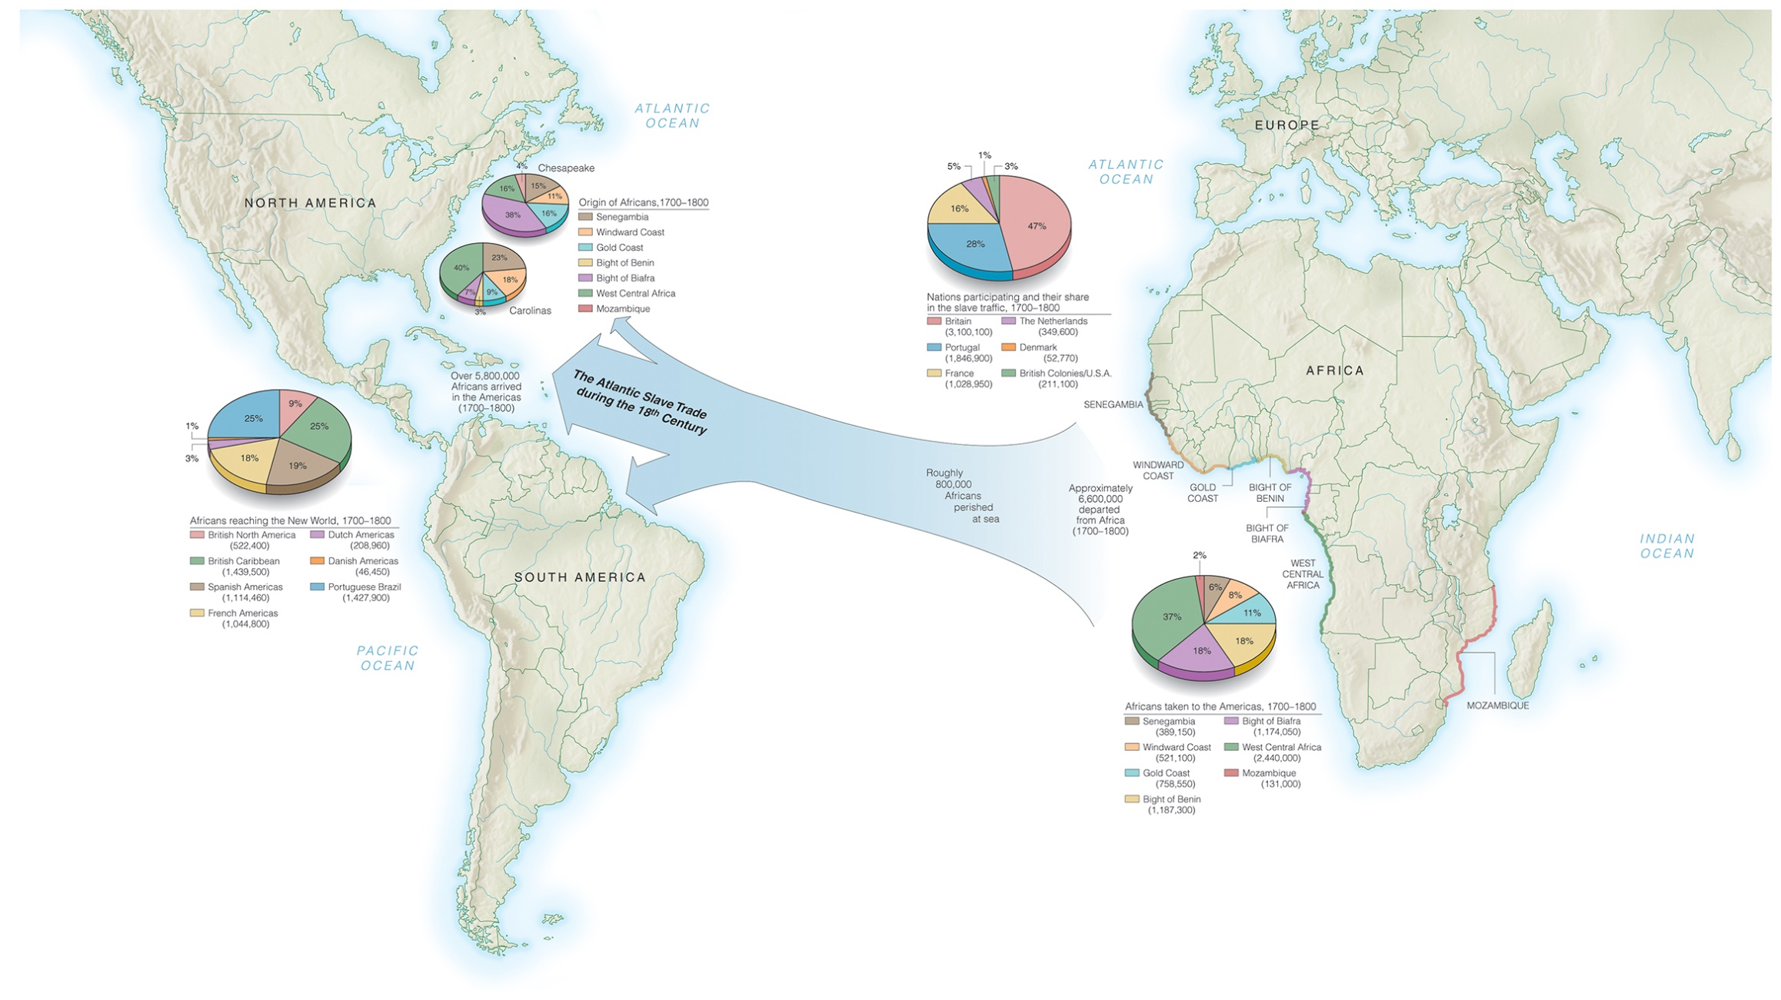

Slide 9
The Atlantic Slave Trade, the Middle Passage, and the Nature of Colonial Slavery
North American slavery was always a relatively small part of the Atlantic slave trade.
The Middle Passage—the transit of slaves from Africa to the Americas—was a horrifying experience.
Most Africans faced a lifetime of slavery.

Slide 10
The Fear of Slave Revolts: South Carolina and New York
1739 - Stono Rebellion, largest slave uprising in the colonies before the American Revolution.
1741 - fires swept New York, destroying businesses and homes. Governor George Clarke became convinced that “The Negros are rising.”

Slide 11
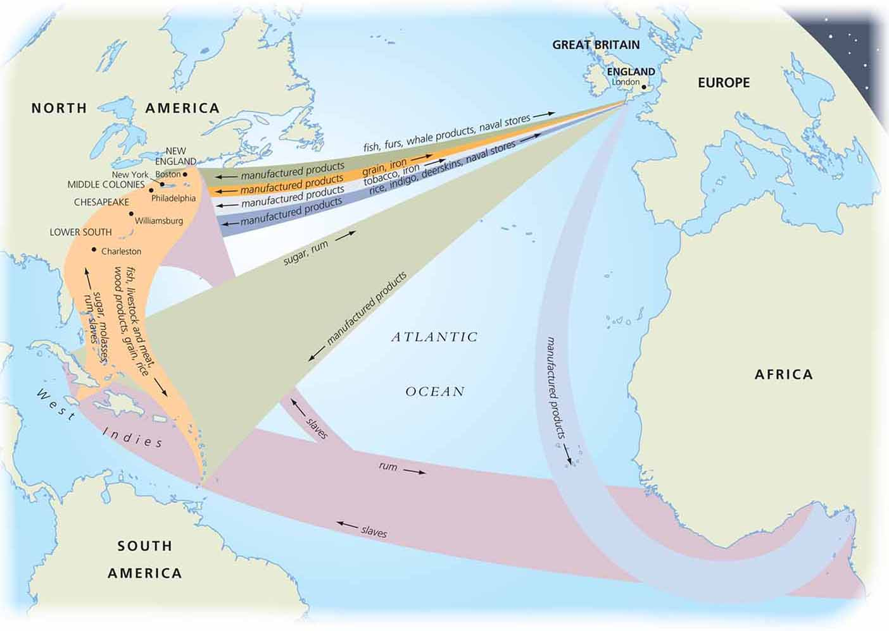

Slide 12
The Salem Witch Trials of 1692
Two young girls in the home of the Reverend Samuel Parris of Salem Village began to suffer fits.
The town doctor wondered if their disease might be a result of witchcraft.
Thus began the Salem witch trials, one of the best-known episodes of mass hysteria in the English colonies.

Slide 13
Women’s Lives
Because women were generally relegated to the private realm, many of them lived cut off from society.
Women were limited by the physical demands of pregnancy, birth, nursing, and child rearing as well as by the daily chores of a farm.
At the bottom of the social hierarchy were enslaved women.

Slide 14
The Growth of Cities: Philadelphia, New York, Boston, Charleston
In the early 1700s, New York City, Philadelphia, Boston, and Charleston all emerged as significant trading centers for the British world.
The ocean-based commerce of these cities was based on their good harbors, Britain’s growing dominance of the world’s oceans, and industries.

Slide 15
Commercial Attitudes, Commercial Success—Mercantilism and the New Trading Economy
Mercantilism – the colonies be used only to produce raw materials that would enrich the Mother country and be a consumer of manufactured goods.
The Triangle Trade involved the shipment of slaves from Africa to the West Indies and North America in exchange for rum.

Slide 16
Commercial Attitudes, Commercial Success—Mercantilism and the New Trading Economy
Mercantilism – the colonies be used only to produce raw materials that would enrich the Mother country and be a consumer of manufactured goods.
The Triangle Trade involved the shipment of slaves from Africa to the West Indies and North America in exchange for rum.

Slide 17
Changing Social Systems
As the economic systems gradually shifted, starting in the 1730s, social systems in British North America also began to change.
By the 1720s, however, some of the mechanics and farmers were beginning to recognize a new social class.
This would become the middle class.

Slide 18
The First Great Awakening, a series of religious revivals that swept all of the North American colonies in the 1730s
Jonathan Edwards and George Whitefield leaders
The Great Awakening changed American society

Slide 19
Ongoing Wars in Europe and British North America
Between 1689 and 1815, England and France were engaged in more or less continual war with each other for control of global empires.
The many wars between 1689 and 1763 disrupted life in North America.

