Slide 1
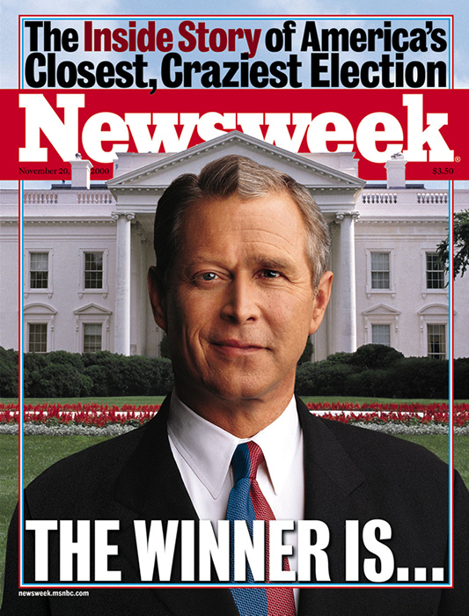
Entering a New Time – Your Life
Chapter 30

Slide 2
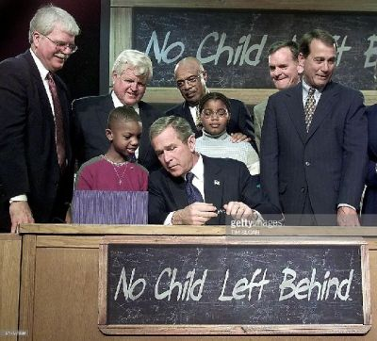
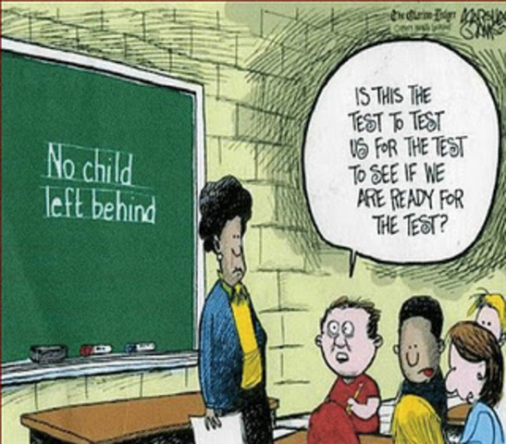
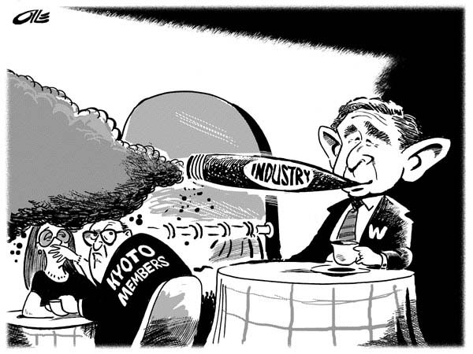
The George W. Bush Presidential Agenda
No Child Left Behind
Tax cuts
“Faith-based initiatives”
Reform Social Security
Did not move on environmental issues

Slide 3
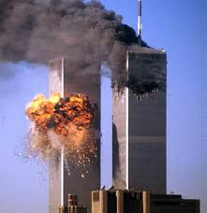
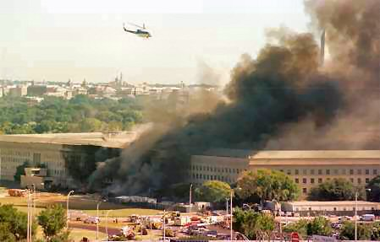
The Impact of September 11, 2001
Nearly 3,000 people died—246 passengers on the planes; 2,600 at the World Trade Center
125 people at the Pentagon
The fear, loss, anger, and fortitude generated from that day would shape a new reality for the nation

Slide 4
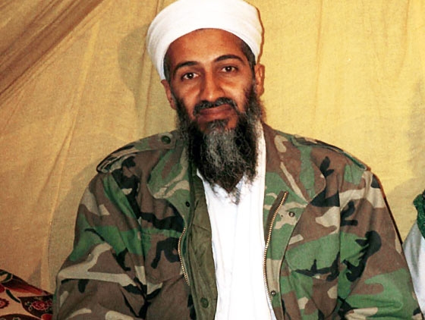
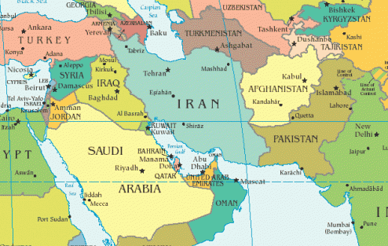
Finding the Terrorists — al-Qaeda, the Taliban, Afghanistan
Evidence pointed to an attack by al-Qaeda, ordered by its leader Osama bin Laden
Prepared for an attack on Afghanistan, whose Taliban government was protecting bin Laden and al-Qaeda

Slide 5
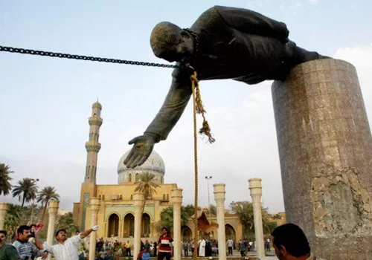
The War in Afghanistan and Iraq
After considerable debate, Congress voted to authorize the use of military force in Iraq.
On March 19, 2003, U.S. forces began “shock and awe”
After the air attack, ground forces moved across the country
Baghdad fell to U.S.-led troops and U.S. tanks roared into the capital city

Slide 6
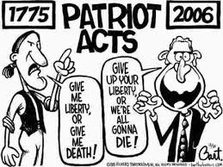
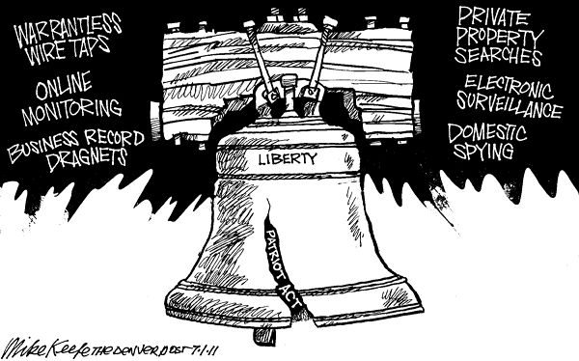
The War on Terror at Home
USA PATRIOT Act
The act expanded authority of the Department of Justice to search telephone, e-mail, medical, financial, and library records without a court order
It also gave the Treasury the right to monitor financial records and bank transactions

Slide 7
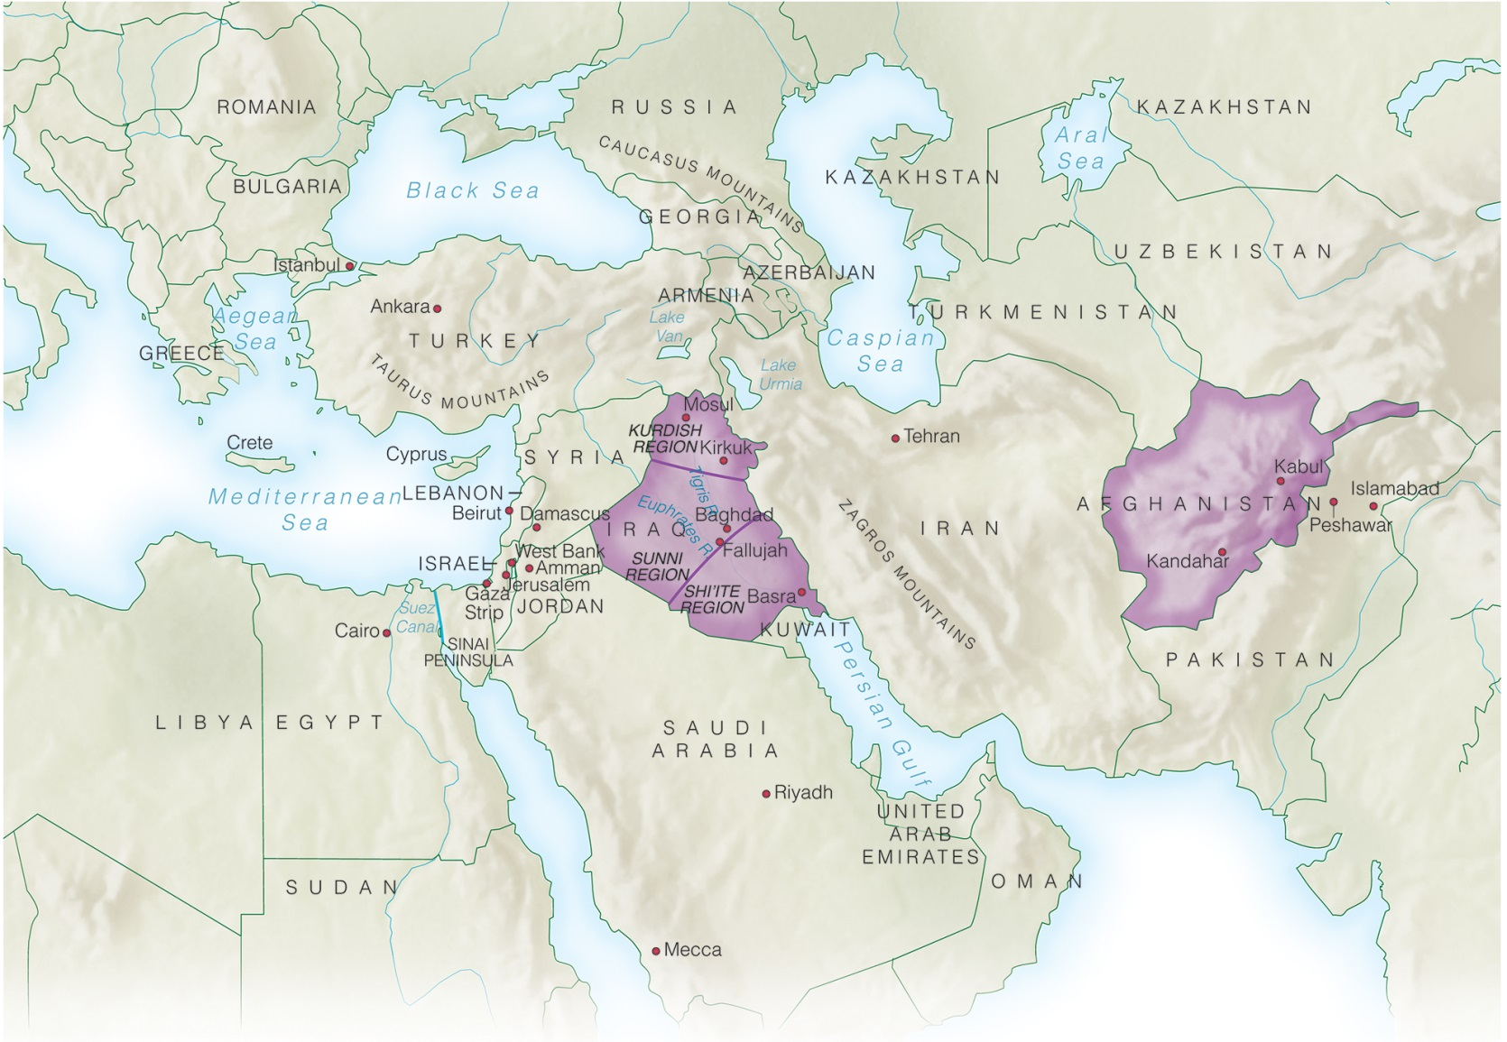
Afghanistan and Iraq

Slide 8
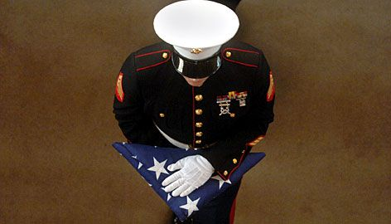
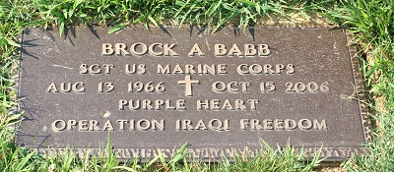
Oct. 15, 2006

Slide 9
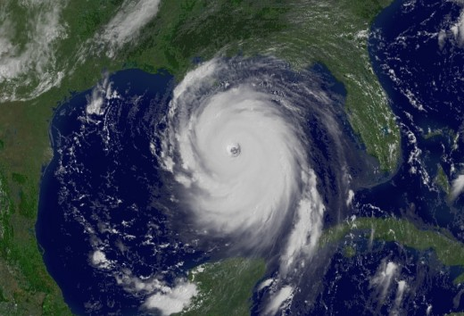
Hurricane Katrina and Its Aftermath
Early Monday morning August 29, 2005, Hurricane Katrina, one of the most powerful and deadly hurricanes in American history, hit New Orleans and the Gulf Coast of Louisiana, Mississippi, and Alabama.
The result was days of anguish for many, over 1,800 deaths, and more than $75 billion in damage.

Slide 10
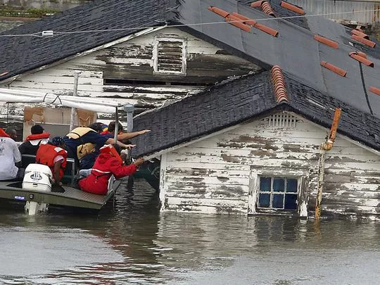
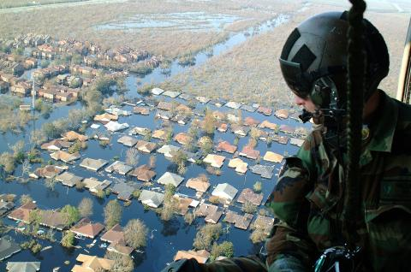
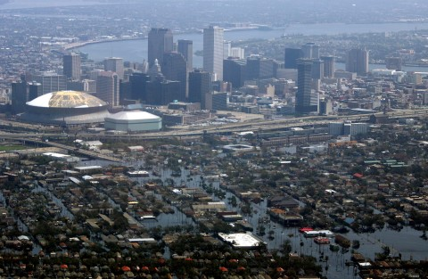
The Failure to Prepare
New Orleans vulnerable to storms coming from the Gulf of Mexico
As Hurricane Katrina began to strengthen in late August 2005, more immediate failures added dangerously to the already vulnerable area.

Slide 11
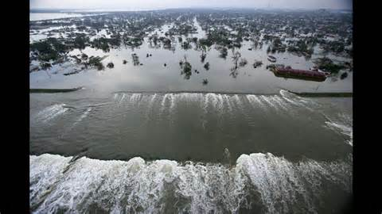
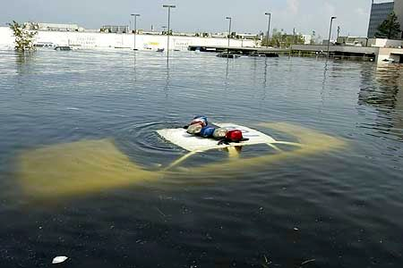
The Storm
The hurricane’s winds splintered buildings, toppled power lines, collapsed highway bridges, tore off part of the roof of the New Orleans Superdome, and stirred up waves on Lake Pontchartrain that weakened the levees.
The weakened levees failed and a wall of water poured into neighborhoods.

Slide 12
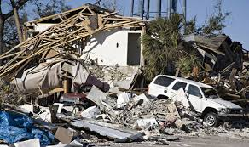
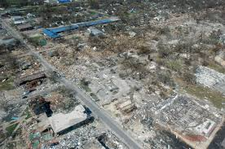
The Cleanup
Few failed to notice that the worst scenes of suffering and death were in African- American communities.
New Orleans never returned to its pre-Katrina population, and a year after the storm, whole neighborhoods were virtually abandoned.

Slide 13
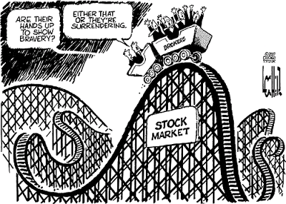
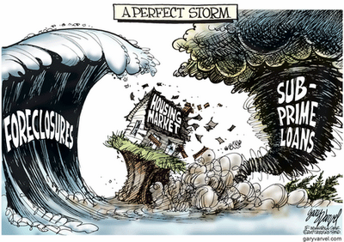
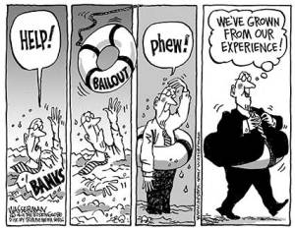
The Financial Crisis of 2008
Housing bubble collapsed
Jobs were lost
Unemployment rates stayed high
Economy seemed not to recover

Slide 14
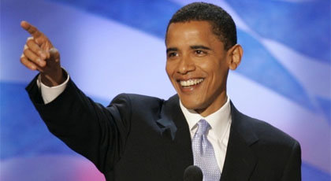
New Liberals, New Conservatives
George W. Bush won a second term in 2004
Barack Obama elected as a U.S. Senator from Illinois

Slide 15
The Unprecedented Election of 2008
Obama wanted a digital campaign
Vietnam vet and Arizona Senator John McCain, the Republican nominee
The September financial crisis played to Obama’s strengths
First African-American president

Slide 16
Obama’s Agenda — Stimulus and a Health Plan
Recovery and Reinvestment Act
Pumped money into the economy
Health care reform
“Obamacare”

Slide 17
The Rise of the Tea Party, Occupy Wall Street, and Divided Government
Tea Party – a protest group that objected to the rising federal debt, Obamacare, and most government regulation
Occupy Wall Street - “We are the 99%”
Occupy was a response to the financial crisis and the growing gap between rich and poor in the country.

Slide 18
The Election of 2012
As President Obama and the Democrats looked to the 2012 election, they did so with considerable optimism.
Mitt Romney, the Republican nominee
Obama won reelection
Congress remained divided

Slide 19
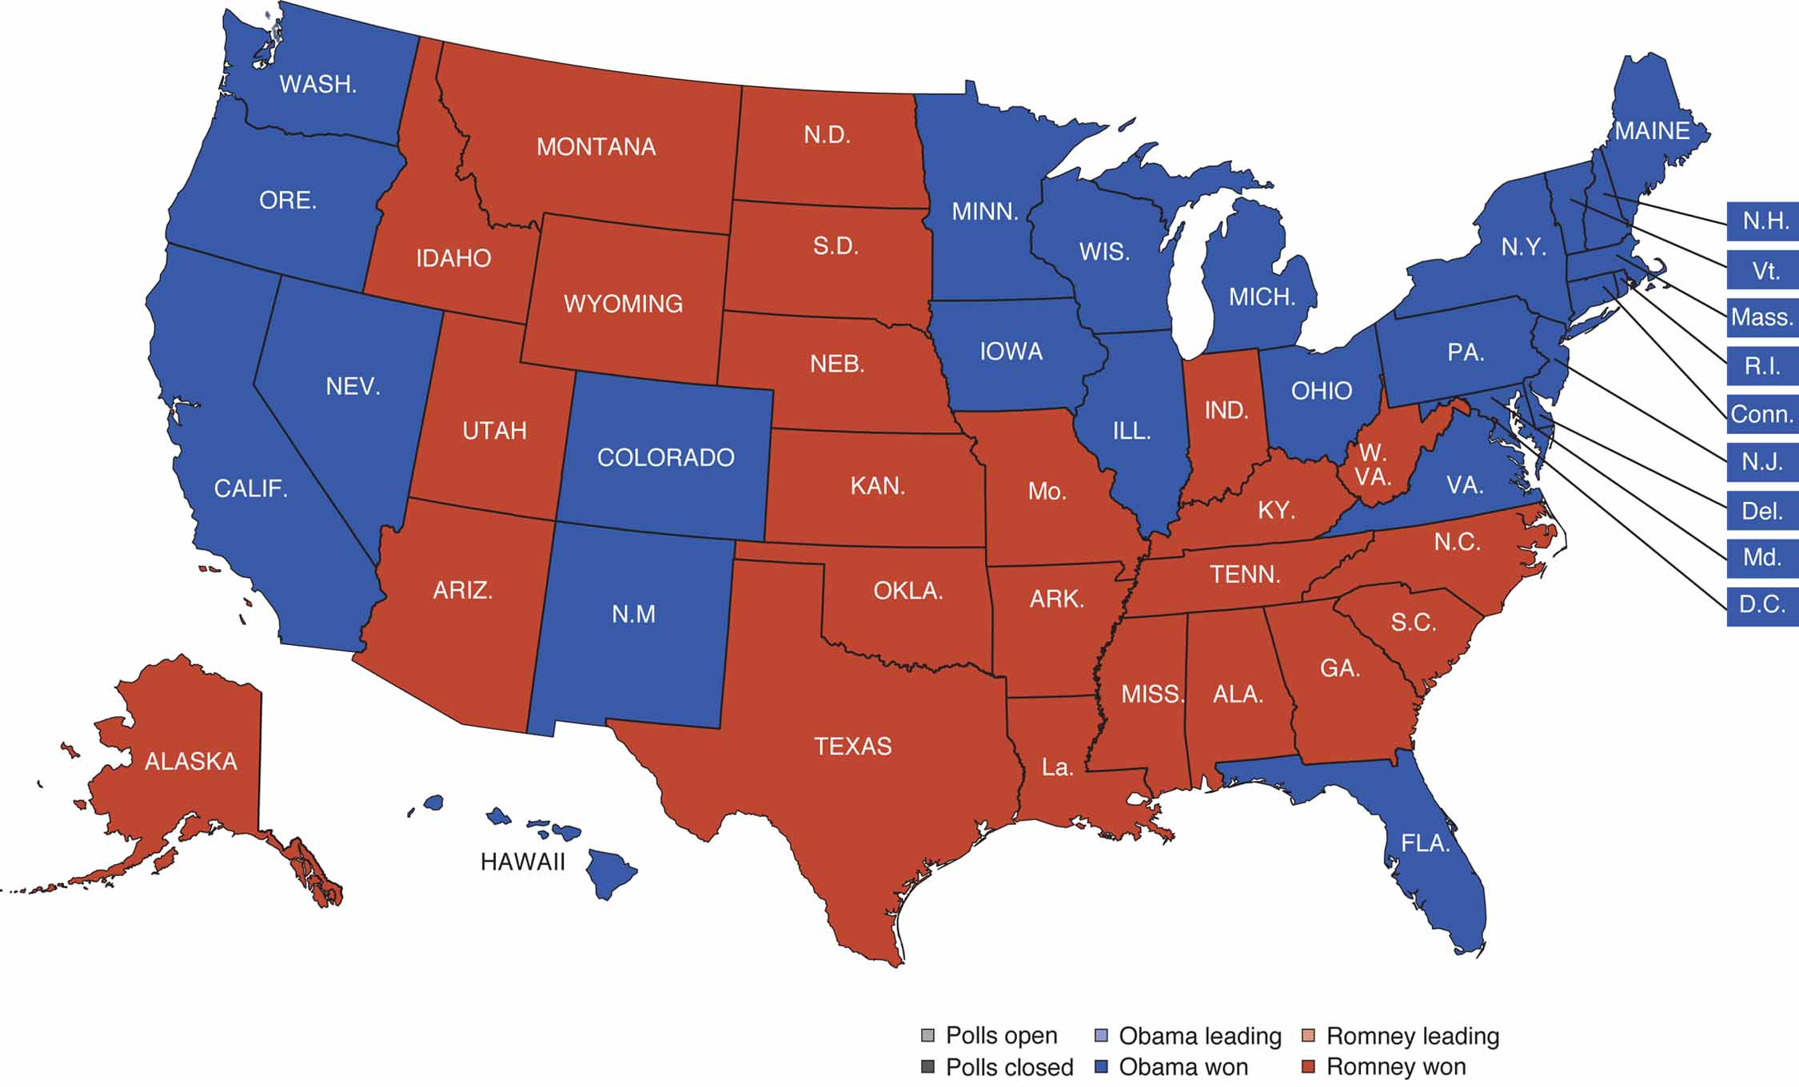
The Election of 2012
MAP 30-2, The Election of 2012

