Slide 1
Chapter 3

Slide 2
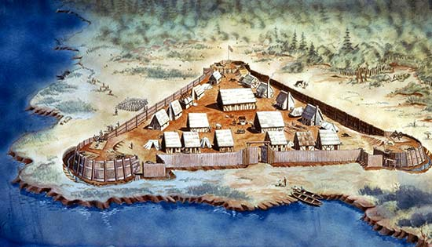
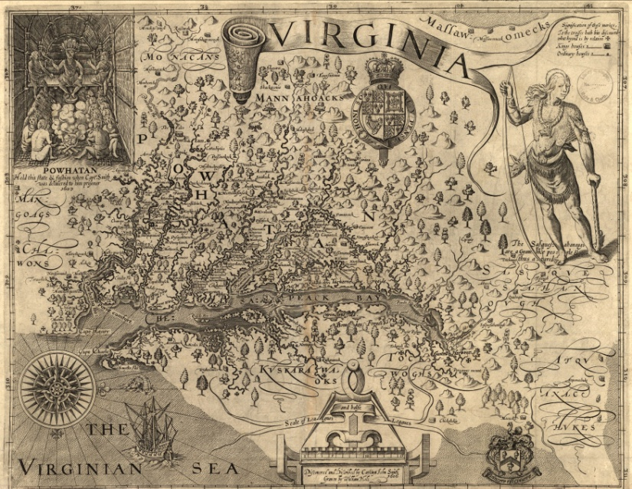
Colonizing Virginia: Jamestown
1607 - Jamestown became the first permanent English settlement in North America
One ruler, Powhatan, controlled virtually all of the Indians nearby.
Jamestown built on a swamp - mosquitoes and malaria

Slide 3
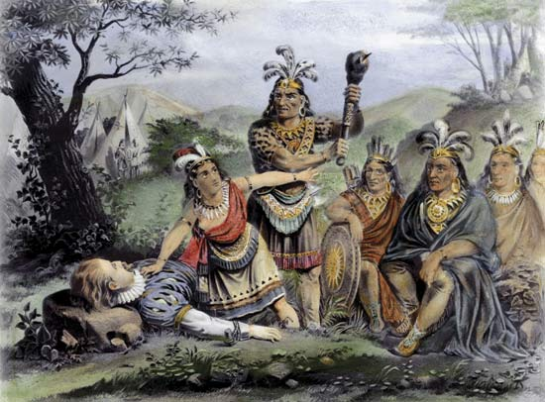
Colonizing Virginia: Jamestown
Capt. John Smith rallied the settlers at Jamestown
Captured by Powhatan and threatened with execution
Smith saved by Powhatan’s daughter Pocahontas
Smith returned to England in 1609

Slide 4
Colonizing Virginia: Jamestown
Winter of 1609-1610 “starving time” - over 80% of 500 settlers died
1613 – tobacco imported to Jamestown
Developed a pleasant smoking strain
Tobacco would become the feature cash crop of Virginia

Slide 5
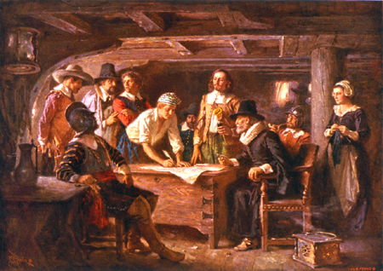
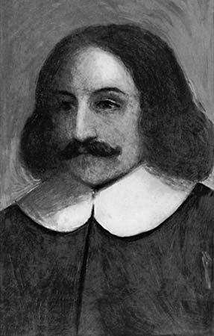
The Massachusetts Colonies: Plymouth, Boston, and Beyond
Pilgrims = Separatists
Left on the Mayflower, Sept. 16, 1620
Mayflower Compact - laws for the new community
1621 - only half of the 101 who had crossed were still alive
William Bradford - governor

Slide 6
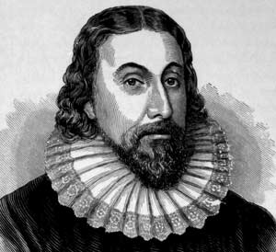
The Massachusetts Colonies: Plymouth, Boston, and Beyond
Puritans - wanted to “purify” the Church of England
Began to consider New England for colonization
First colonists arrived in 1630, building in what they called Salem.
John Winthrop – Puritan leader

Slide 7
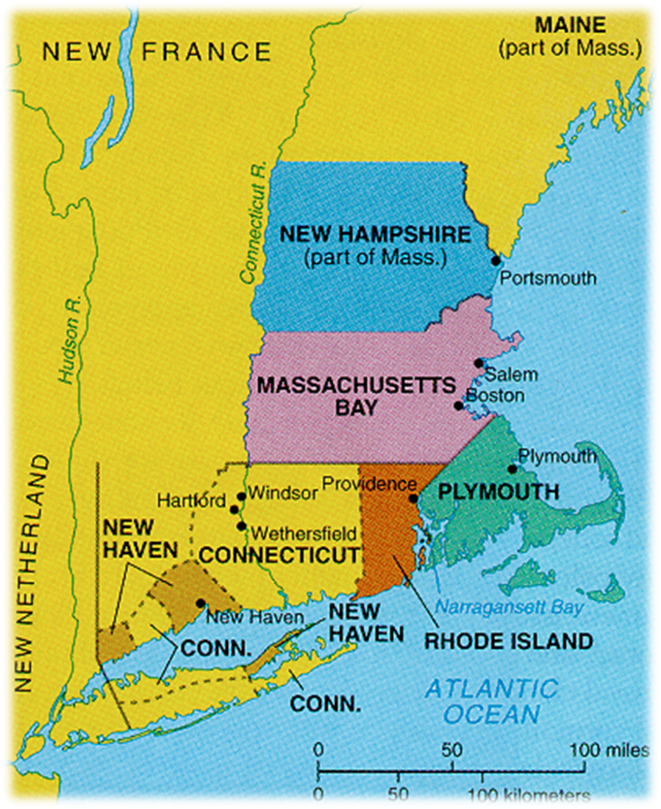
The Massachusetts Colonies: Plymouth, Boston, and Beyond
Thomas Hooker - led followers to Connecticut in 1636
Roger Williams - banished to Rhode Island in 1636
Anne Hutchinson - excommunicated by Winthrop in 1637, ended up in Rhode Island

Slide 8
Maryland
The colony was the vision of Sir George Calvert (Lord Baltimore)
Sought a refuge for Catholics in America
1632 - granted a charter for Maryland
He died, but his son Cecilius took over

Slide 9
Additional Colonies: Continued Settlement and Development
Carolinas - most settlers were former indentured servants from Virginia and Maryland or Barbados
New York - was originally New Netherland, founded by the Dutch
Pennsylvania - the colony was largely the work of one man - William Penn, Quakers

Slide 10
Ivytech.edu/dualcreditapplication

Slide 11
Additional Colonies: Continued Settlement and Development
Carolinas - most settlers were former indentured servants from Virginia and Maryland or Barbados
New York - was originally New Netherland, founded by the Dutch
Pennsylvania - the colony was largely the work of one man - William Penn, Quakers

Slide 12
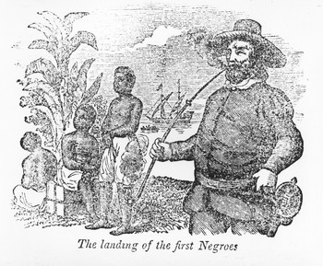
Africans and Indentured Servants in England’s Colonies
1619 - John Rolfe reports that a Dutch ship brought the first African slaves
At first, the Africans/slaves were treated as indentured servants and could gain their freedom as whites did
1650-1700 the Virginia population tripled
More labor needed

Slide 13
Wessell Webling Contract
Additional questions
In your opinion, what kind of people would sign an indenture?
Why may land owners in Virginia move away from using Indentured Servants to African Slaves?

Slide 14
Civil War and Revolution in England
By 1642, England was in a civil war
Parliament’s army defeated the king, who was executed in 1649
General Oliver Cromwell, ruled England as a Puritan Commonwealth from 1649 to 1658
In 1660, Parliament invited King Charles II (r. 1660–1685)

Slide 16
Pequot War – Questions for Reading
What first united the Pilgrims and the Puritans and what drove them apart?
What motivated the Mohegans to join the English in the Pequot war?
What role did the Narragansetts play in the war. Do you think they had regrets? Why or Why not?
How does the Pequot War change relations in the North East?

Slide 17
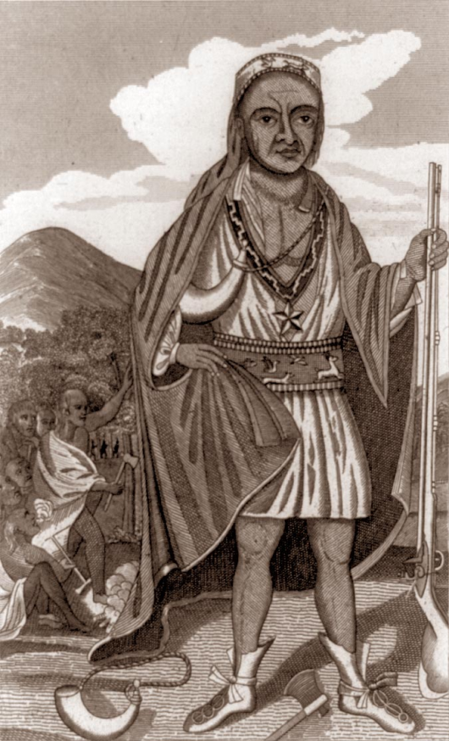
Rebellion in New England—King Philip’s War, 1675–76
In 1671, a chief named Metacom (called King Philip by the English) determined that his people must be free from the English
War erupted in 1675
Puritans wiped out Metacom and put his head on a stake
Per capita, deadliest war in American history

Slide 18
Bacon’s Rebellion in Virginia, 1676
Tensions arose between settlers and Indians living on the frontier of western Virginia
Bacon organized his own militia of hundreds of runaway servants and some slaves
Summer of 1676 - Bacon marches on Jamestown and burns the city

Slide 19
France Takes Control of the Heart of a Continent

Slide 20
Early French Settlement—Quebec, Montreal, and the Fur Trade
Samuel de Champlain, “Father of New France,” established Quebec 1608
Deeply Catholic
Catholic Jesuits effective in converting Native Americans
The French establish the fur trade
New France grows slowly, only 14,000 people by 1700

Slide 21
Exploring and Claiming the Mississippi River Valley
1673 - Louis Joilet and Jacques Marquette explore the Mississippi River as far south as the Arkansas River
1682 - Rene-Robert Cavelier, sieur de La Salle, follows the Mississippi from the Great Lakes to the Gulf of Mexico
Claimed all lands for France and named it Louisiana for King Louis XIV

Slide 22
Creating the French Gulf Coast—Biloxi, Mobile, and New Orleans
1698 - Pierre d’Ibreville landed on the east bank of the Mississippi River and established Biloxi
1713 – Mobile is established
In 1718, Jean-Baptiste de Bienville built a colony that he called New Orleans on the land between the Mississippi and Lake Pontchartrain

Slide 23
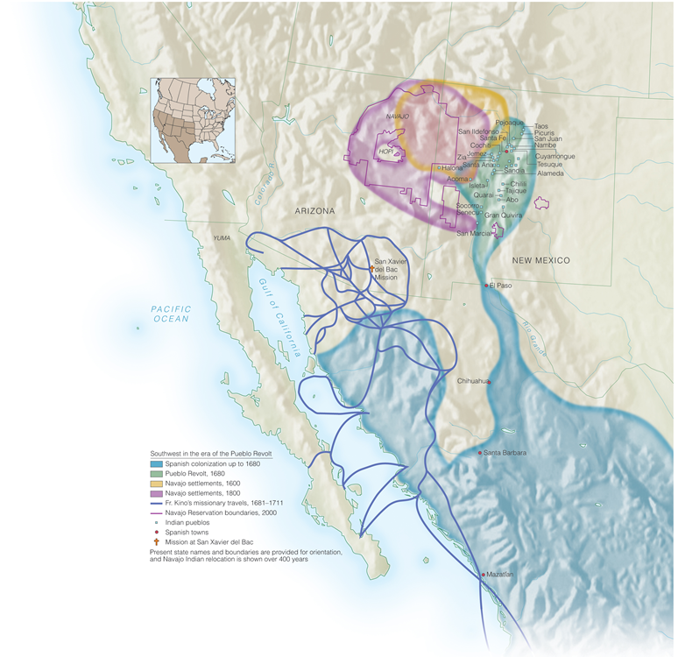
Developments in Spanish Colonies North of Mexico

Slide 24
The Pueblo Revolt—New Mexico, 1680
In August 1680, the Pueblo Indians of northern New Mexico, led by Popé, revolted against Spanish rule.
In the Pueblo Revolt, nearly all of the Spanish who lived on isolated ranches and farms were killed.

Slide 25
Spain’s Response to France and England—San Antonio, Texas, and the Missions of California
When the French founded New Orleans in 1718, the Spanish built a new city of their own, San Antonio.
By 1769, the Spanish were also worried about English explorations and Russian fur-trading activities on the Pacific coast.
In response, the Spanish established a fort and then a mission in San Diego.

