Slide 1
Chapter 29
A New World Order
1989-2001
© 2015 Pearson Education, Inc. All rights reserved.

Slide 2
Culture Wars — The Christian Coalition and other Critics
The Religious Right was made up of people who were increasingly angry at many of the cultural trends of the 1980s and 1990s.
Pat Robertson
Ralph Reed - Christian Coalition
Americans were becoming individualistic and consumption-oriented and were losing their ability to work together.

Slide 3
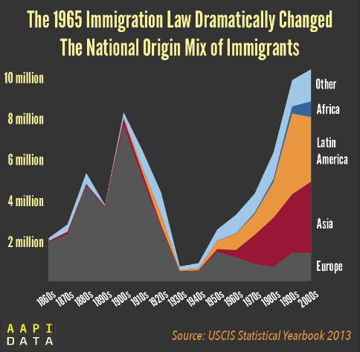
New Immigrants, New Diversities
Immigration increased – After the Hart-Cellar Act in 1965
After 1980, most new immigrants came from Latin America and Asia
Immigrants moved to every part of the United States
Debates about immigration became intense

Slide 4
AIDS and the Gay Community
Acquired Immune Deficiency Syndrome
As HIV-AIDS spread—the CDC confirmed 98,835 cases by 1988—the famous and the unknown were afflicted.
Gay activists became increasingly militant
Eventually in 1992, Congress appropriated approximately $2 billion for AIDS research

Slide 5
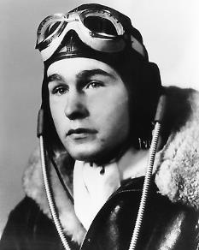
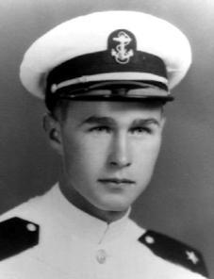
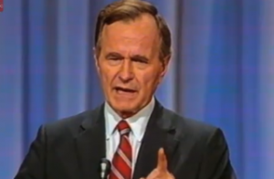
The Bush Administration, 1989-1993
Bush well prepared
Knew the key players
Less prepared to deal with domestic issues

Slide 6
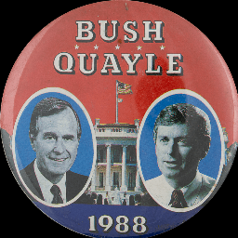
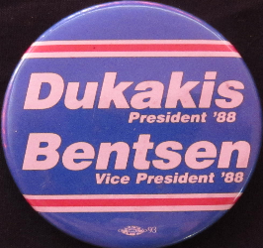
The Election of 1988

Slide 7
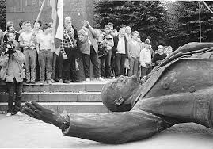
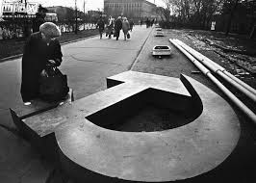
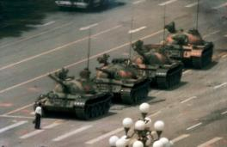
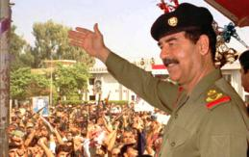
Foreign Policy Between 1989 and 1993
Fall of the Soviet Union (December 25, 1991)
Resulted in the end of the Cold War
1989 - Tiananmen Square
Iraq invades Kuwait
Operation Desert Storm
NAFTA

Slide 8
Ending the Cold War
June, 1989: Tiananmen Square
Bush publicly critical, privately sought to maintain relations
Fall 1989: Communism collapsed in Eastern Europe
Solidarity government replaced Communists in Poland
Berlin Wall torn down
1991–1992: U.S.S.R. dissolved, Communist Party outlawed in Russian Republic
Cautious, but encouraging response by Bush

Slide 9
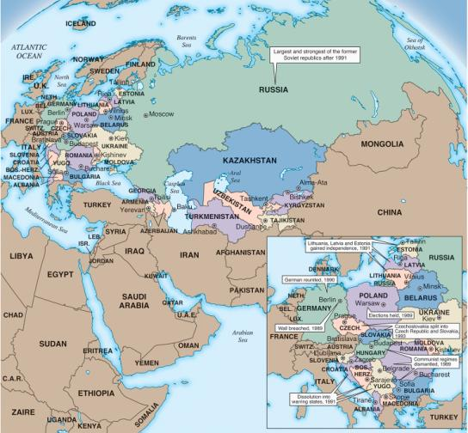
Europe After Communism

Slide 10
The Gulf War
Iraq occupied Kuwait in August 1990
Operation Desert Shield, U.S. forces protected Saudi Arabia, prepared for war with Iraq
Bush built international coalition supportive of repealing aggression, but not necessarily removing Saddam
January 1991: With Congressional and UN support, Operation Desert Storm launched, military force to drive Iraq from Kuwait
Operation successful in short term, but failure to remove Saddam led to future problems

Slide 11
Education, Legislation, and the Supreme Court
Clean Air Act
Americans with Disabilities Act (ADA)
Clarence Thomas, Supreme Court

Slide 12
Republicans at home
Americans With Disabilities Act only real expansion of domestic policy
Collapsing Savings and Loan industry restructured and bailed out by government
Budget deficits soared
High expenses like Savings and Loan bailout
Economic recession increased deficit
Bush’s deficit reduction
Raised taxes, broke “no new taxes” campaign promise
Cut military expenditures
Didn’t work, national debt went to $1 trillion by end of Bush Presidency

Slide 13
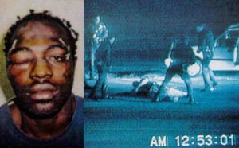
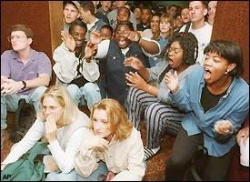
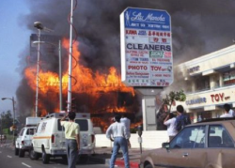
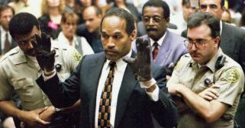
Race: From Rodney King to O.J. Simpson
Rodney King
Los Angeles Riots
October 1995 – O.J. Simpson acquitted of murder charges

Slide 14
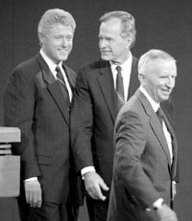
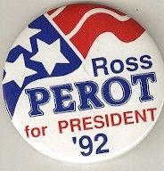
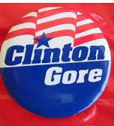
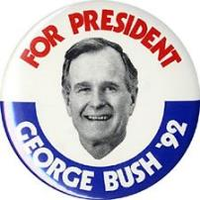
Economic Troubles and the Election of 1992
Bush’s greatest political failure was his inability to manage the U.S. economy
Despite pledge, Bush raised taxes
1992 – 3-way race: Bush, Clinton, and Perot
Clinton wins

Slide 15
The Clinton Presidency
Clinton came in with high hopes
First baby boomer president
Clinton did cut the federal deficit, dramatically
Success on other fronts, however, was more elusive

Slide 16
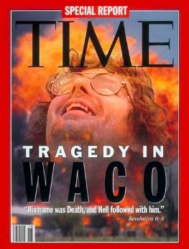
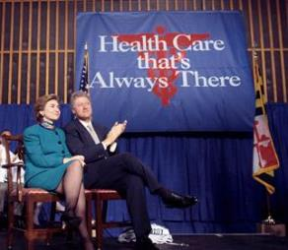
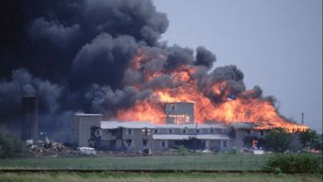
The Early Clinton Agenda: It’s Still—Mostly—The Economy
First Lady, Hillary Clinton, was charged with redesigning the nation’s health care policy
It failed
David Koresh, Waco, Texas March 1993
Family and Medical Leave Act
Balance the federal budget and lower the federal debt

Slide 17
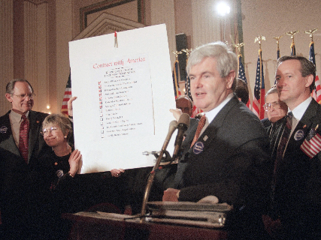
1994 Mid Term elections – Republican Revolution
Newt Gingrich crafts a national strategy for Republicans running for congress in the mid-terms.
The Contract with America – a list of proposed bills that Republicans would bring to a vote
Included term limits for congress
Tax cuts for families and small businesses
A balanced budget amendment
Legal reform
Republicans will win both houses with many first time members in the House

Slide 18
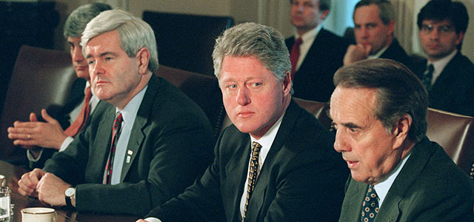
“The Era of Big Government Is Over”
After several months of budget battles, Congress passed a budget that included cuts in social programs
Clinton vetoed the budget
Clinton signed the Defense of Marriage Act

Slide 19
Small Wars and Dangerous Terrorists — Clinton’s Foreign Policy
Somalia
Haiti
Yugoslavia fell apart
Clinton ordered the bombing of Serbian positions
Dayton Peace Accords

Slide 20
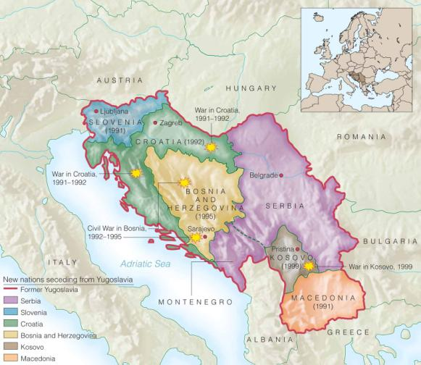
Yugoslavia Comes Apart
MAP 29-2, Yugoslavia Comes Apart

Slide 21
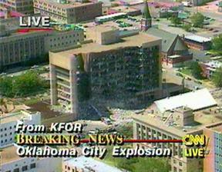
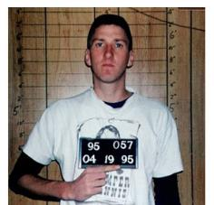
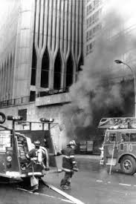
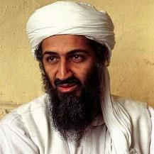
Terrorism
Domestic Terrorism
April 19, 1995 – Oklahoma City blast
Columbine, Colorado
Foreign Terrorism
Terrorists bombed the World Trade Center in 1993
Bombing of USS Cole 2000
Terrorists were trained by al-Qaeda, their leader was a rich Saudi, Osama bin Laden

Slide 22
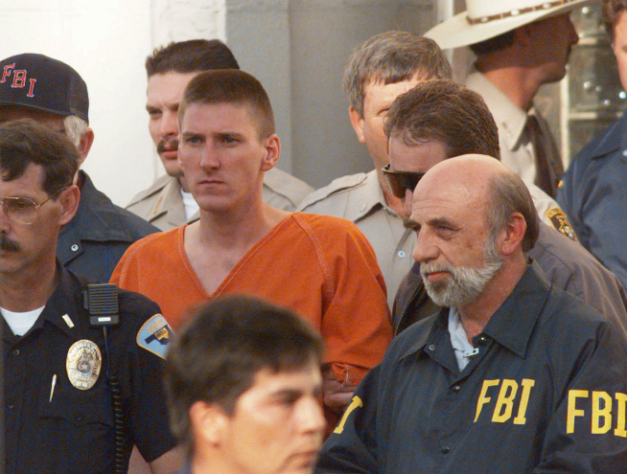

Slide 23
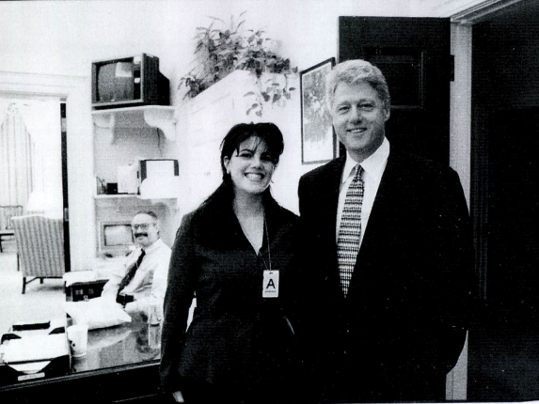
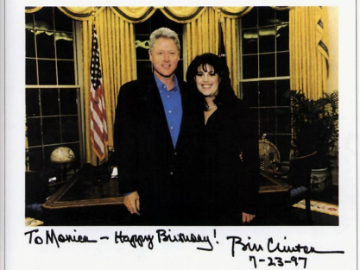
Scandal and Impeachment
The president of the United States had been involved in an affair with a young White House intern and had lied about it to his wife, to his administration, to the press, and under oath.
Led to impeachment charges
Clinton survives impeachment

Slide 24
The Prosperous 1990s
Although an economic downturn brought Clinton to office, an economic upsurge kept him there.
After Clinton’s second year in office, the U.S. economy started to grow, and it did not stop growing for the next 6 years.

Slide 25
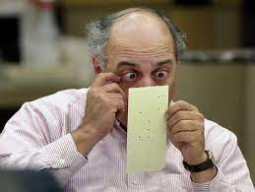
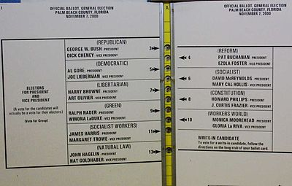
Bush v. Gore — The Election and the Court Case of 2000
Vote came down to one state – Florida
Recounts
Supreme Court orders an end to the recounts
Bush elected, despite losing the popular vote

Slide 26
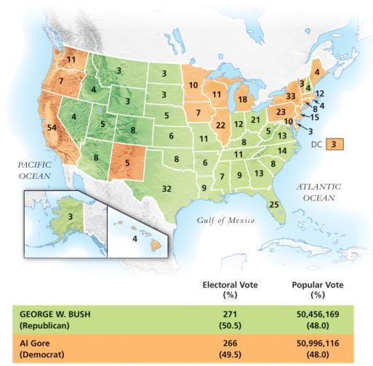
The Election of 2000
MAP 29-3, The Election of 2000

Slide 27
Technology Dominates an Era
Americans were transforming the world in a very different way
In the 1990s, computer use and technological innovation became widespread in the United States

Slide 28
The Birth of New Technologies
Desktop computers
IBM
Apple
Steve Jobs
Microsoft
Bill Gates

Slide 29
The Y2K Scare of January 1, 2000
The Y2K problem was relatively simple
Two digit codes were used for years
Worried they would reset to “00” in 2000
Very few problems actually occurred

Slide 30
A Connected Nation
Internet
World Wide Web (WWW)
E-mail

Slide 31
The Dot.com Bubble and Its Eventual Burst
Just as the world of electronic communications was being born in the 1990s, many people decided that the key to making a fortune was investing in the enterprise.
In 2000, stocks in high technology companies fell dramatically.

Slide 32
Google Becomes a Verb
Started in 1998, Google quickly became the leading search engine for the Internet.
By 2001, they had scanned or indexed 80 percent of the webpages in existence.

Slide 33
The Latest Technology — Winners, Losers, and Change Agents
Sony Walkman
Napster and music sharing
Newspapers
Loss of privacy

