Slide 1
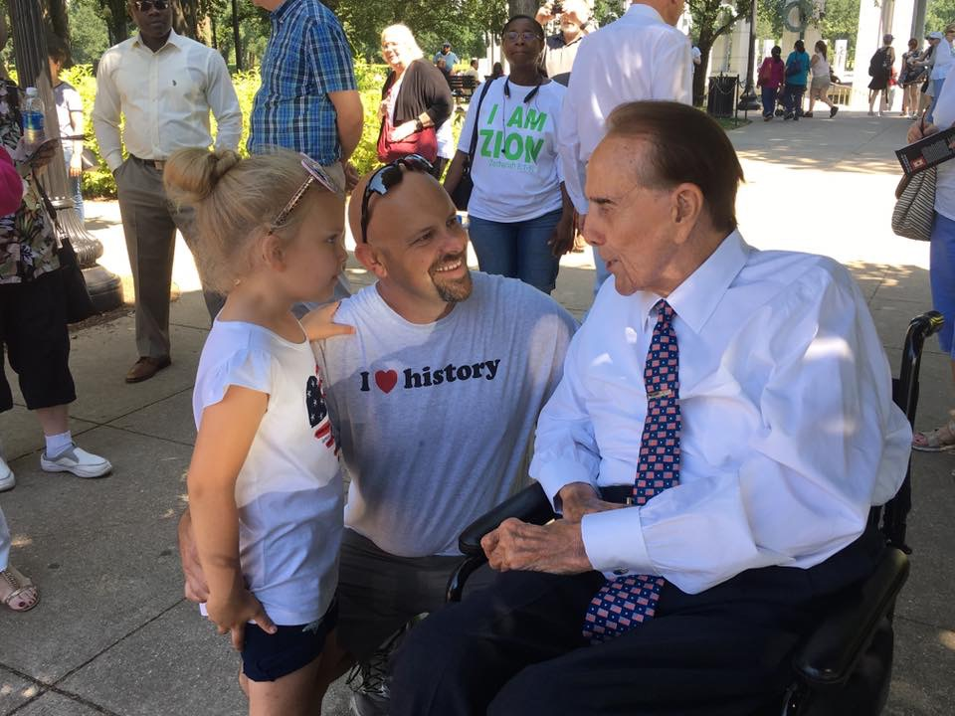

Slide 2
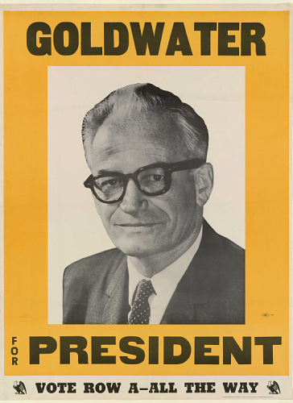
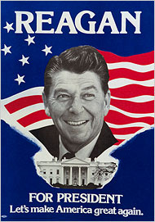
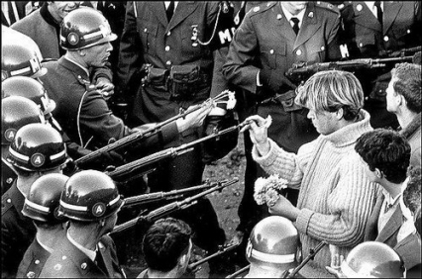
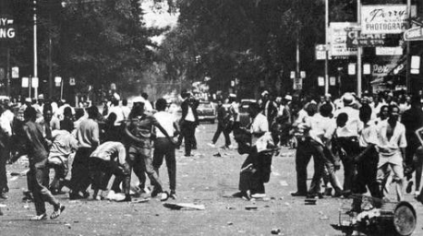
The Reagan Revolution
Turmoil of the 1960s and economic problems of 1970s made conservative turn inevitable
Watergate bought Democrats more time
Reagan was the attractive candidate Republicans needed to assure decisive victory

Slide 3
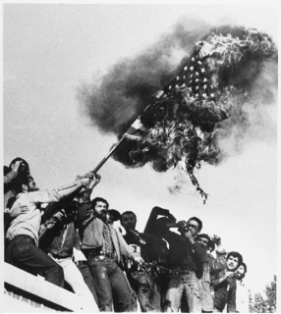
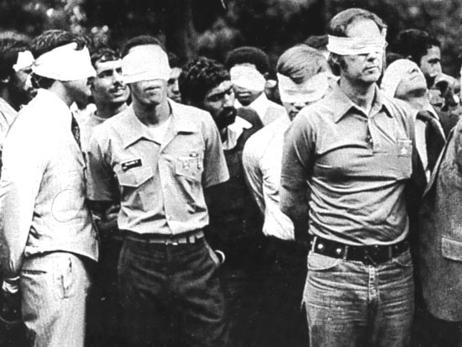

Slide 4
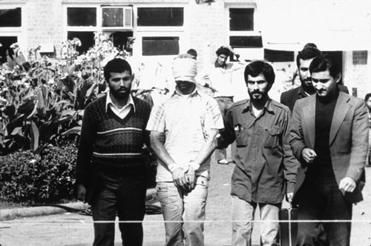

Slide 5
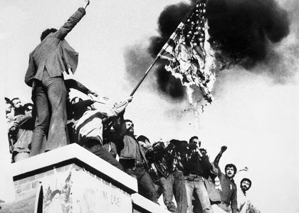
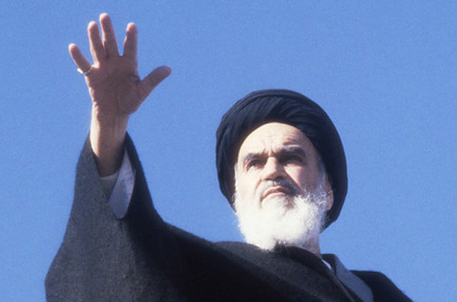
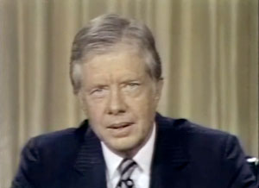

Slide 6
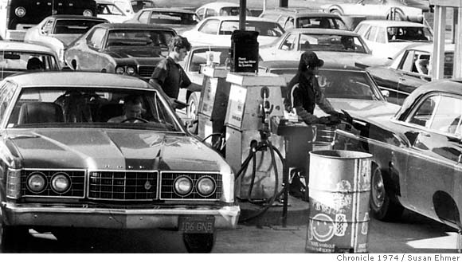
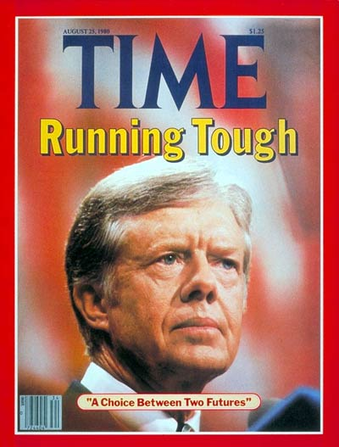
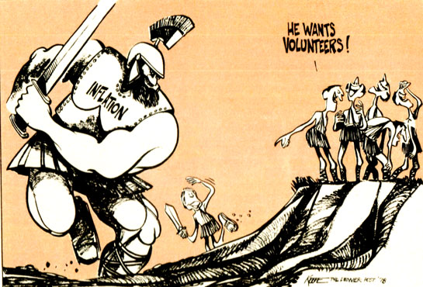

Slide 7
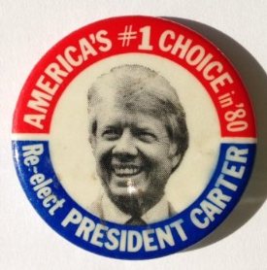
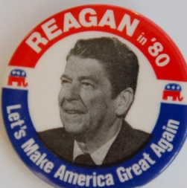
The Election of 1980
Carter’s troubles
High inflation and high unemployment
Hostage crisis and Soviet invasion of Afghanistan made Carter look naïve and helpless
Reagan: “Are you better off now than you were 4 years ago?”
Reagan won in a landslide
Won all Southern states but Georgia
Made inroads into traditional New Deal groups
Republicans retook the Senate

Slide 8
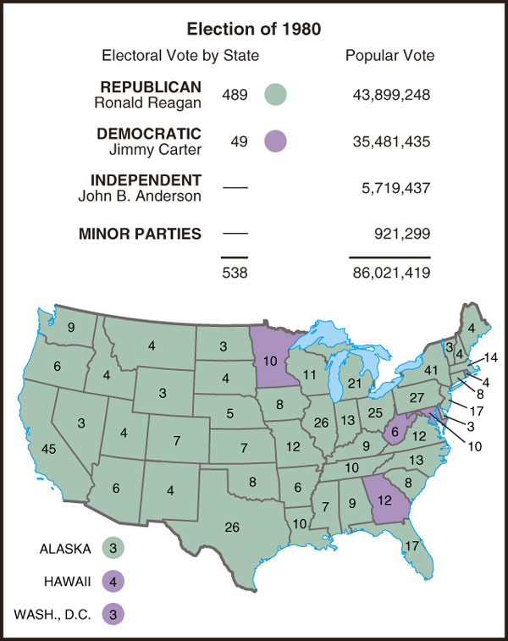

Slide 9
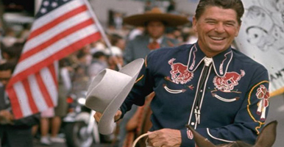
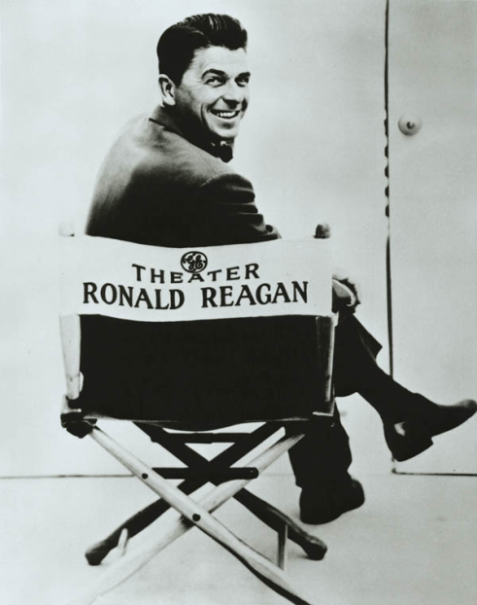
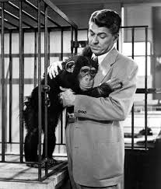
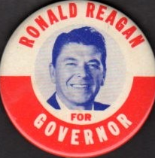
Ronald Reagan and the Reagan Coalition
Former actor
President Screen Actors Guild
Once a New Deal Democrat, he became a Republican, represented the “New Right”
Governor of California

Slide 10
A Rapidly Changing U.S. Government
The Reagan Revolution
Taxes took less of people’s incomes, the federal debt ballooned, and a 50-year period in which labor unions could rely on a friendly government came to an end.
The Cold War ended

Slide 11
Reaganomics — Supply-Side Tax Cuts, Military Growth, and Electoral Politics
By the 1980s, the public had grown tired of the New Deal and Great Society and were ready to slash bills
Cut taxes
Social programs cut
Increasing disparity between rich and poor

Slide 12
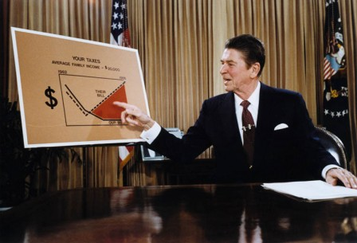
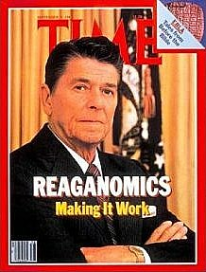
Cutting Taxes and Spending
Reagan blamed country’s economic problems on high government spending
Supply-side economics—cut taxes to encourage productive private investment
Reagan cut over three years
Federal spending by more than $40 billion
Social services included in cuts
Taxes cut by 25%

Slide 13
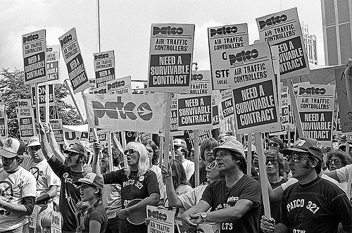
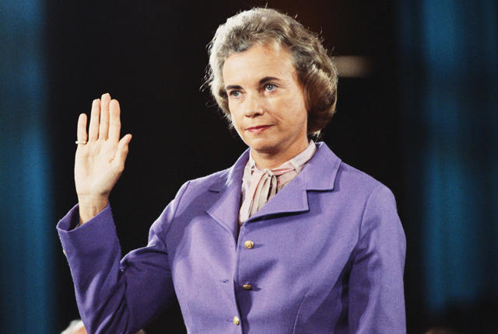
Unleashing the Private Sector
Deregulation: Many environmental regulations reduced
Japan agreed to voluntary export limits on automobiles
Reagan fired striking air traffic controllers
Social Security changes cut costs
Despite appointment of Sandra Day O’Connor, Reagan appointed only 3 other women and 1 African American male out of 73 judges

Slide 14
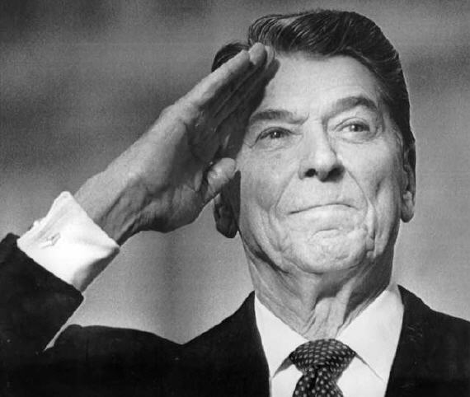
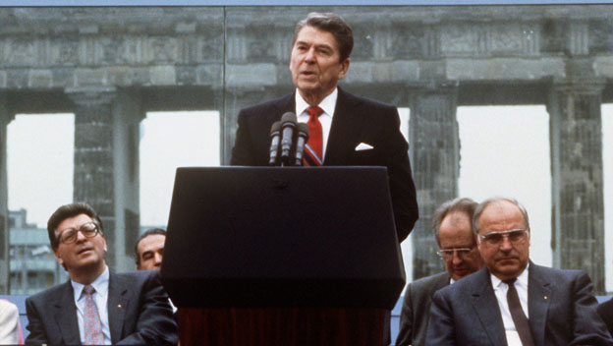
Reagan and the World
Reagan determined to restore America's international position
Strong defense
Gained world supremacy over Soviets

Slide 15
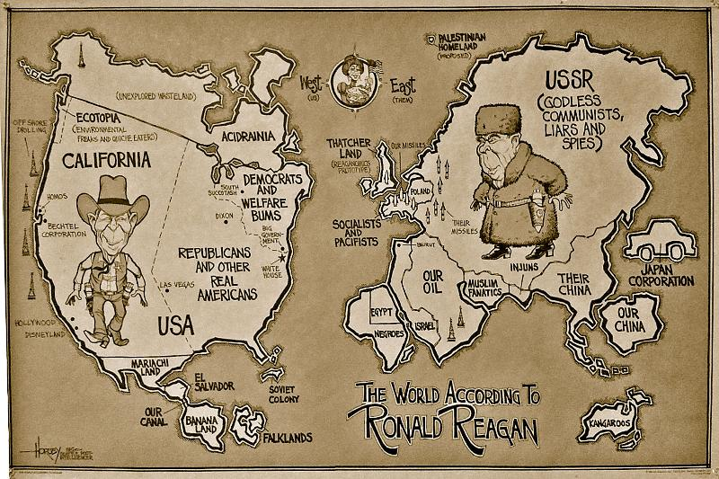
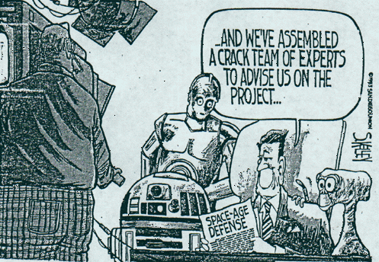
Challenging the "Evil Empire"
Major military expansion under Reagan
Reagan: Soviet Union the "focus of evil in the modern world"
Reagan escalates arms race
Deployment of cruise missiles in Europe
Development of Strategic Defense Initiative

Slide 16
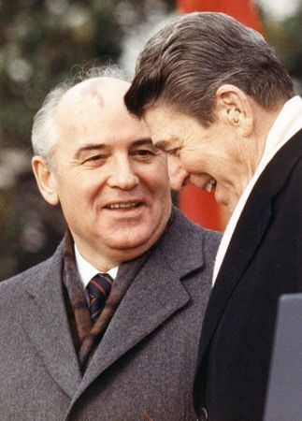
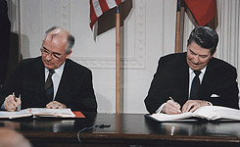
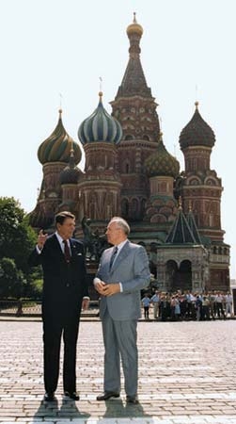
Ending the Cold War
1985 - Mikhail Gorbachev becomes the reform-minded leader of the Soviet Union
Glasnost, or “openness,” which aimed to introduce free speech and political liberty to the Soviet Union
Perestroika, or “restructuring,” which meant that the Soviets would adopt free-market economies similar to those in the West

Slide 17
Reagan the Peacemaker
1985–1988: Reagan-Gorbachev summits
1987: Destroyed intermediate range missiles
1988: Afghanistan evacuated
Foreign policy triumphs with Soviets, offsets Iran-Contra scandal

Slide 18
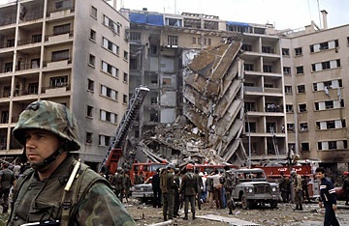
More trouble in the Middle East
1982: With U.S. encouragement, Israel invaded Lebanon
International response
U.S., France send troops to maintain order
PLO evacuated to Tunisia
1984: 200 U.S. Marines killed in terrorist bombing
U.S. evacuation of Lebanon
Notes:
Lft off hre

Slide 19
Trouble Spots in Central America and the Caribbean

Slide 20
The Election of 1984

Slide 21
Confrontation in Central America
Lack of moderate, middle-class regimes led U.S. to support oppressive right-wing dictatorships
This put U.S. at odds with reform movements, whom U.S. saw as linked to Communism
Reagan reversed Carter support for Sandinistas, driving them to Soviets
Reagan began covert support for Contras after Congress rejects overt support

Slide 22
Trading Arms for Hostages
Iranian-backed Lebanese militants seized 6 Americans hostage
Advanced weapons sold to Iran for influence in freeing American hostages
Oliver North’s plan: Iran-Contra scandal
Profit from Iran arms sales to Contras
Funding clearly violates Boland Amendment
Reagan escaped impeachment, North and others were jailed

Slide 23
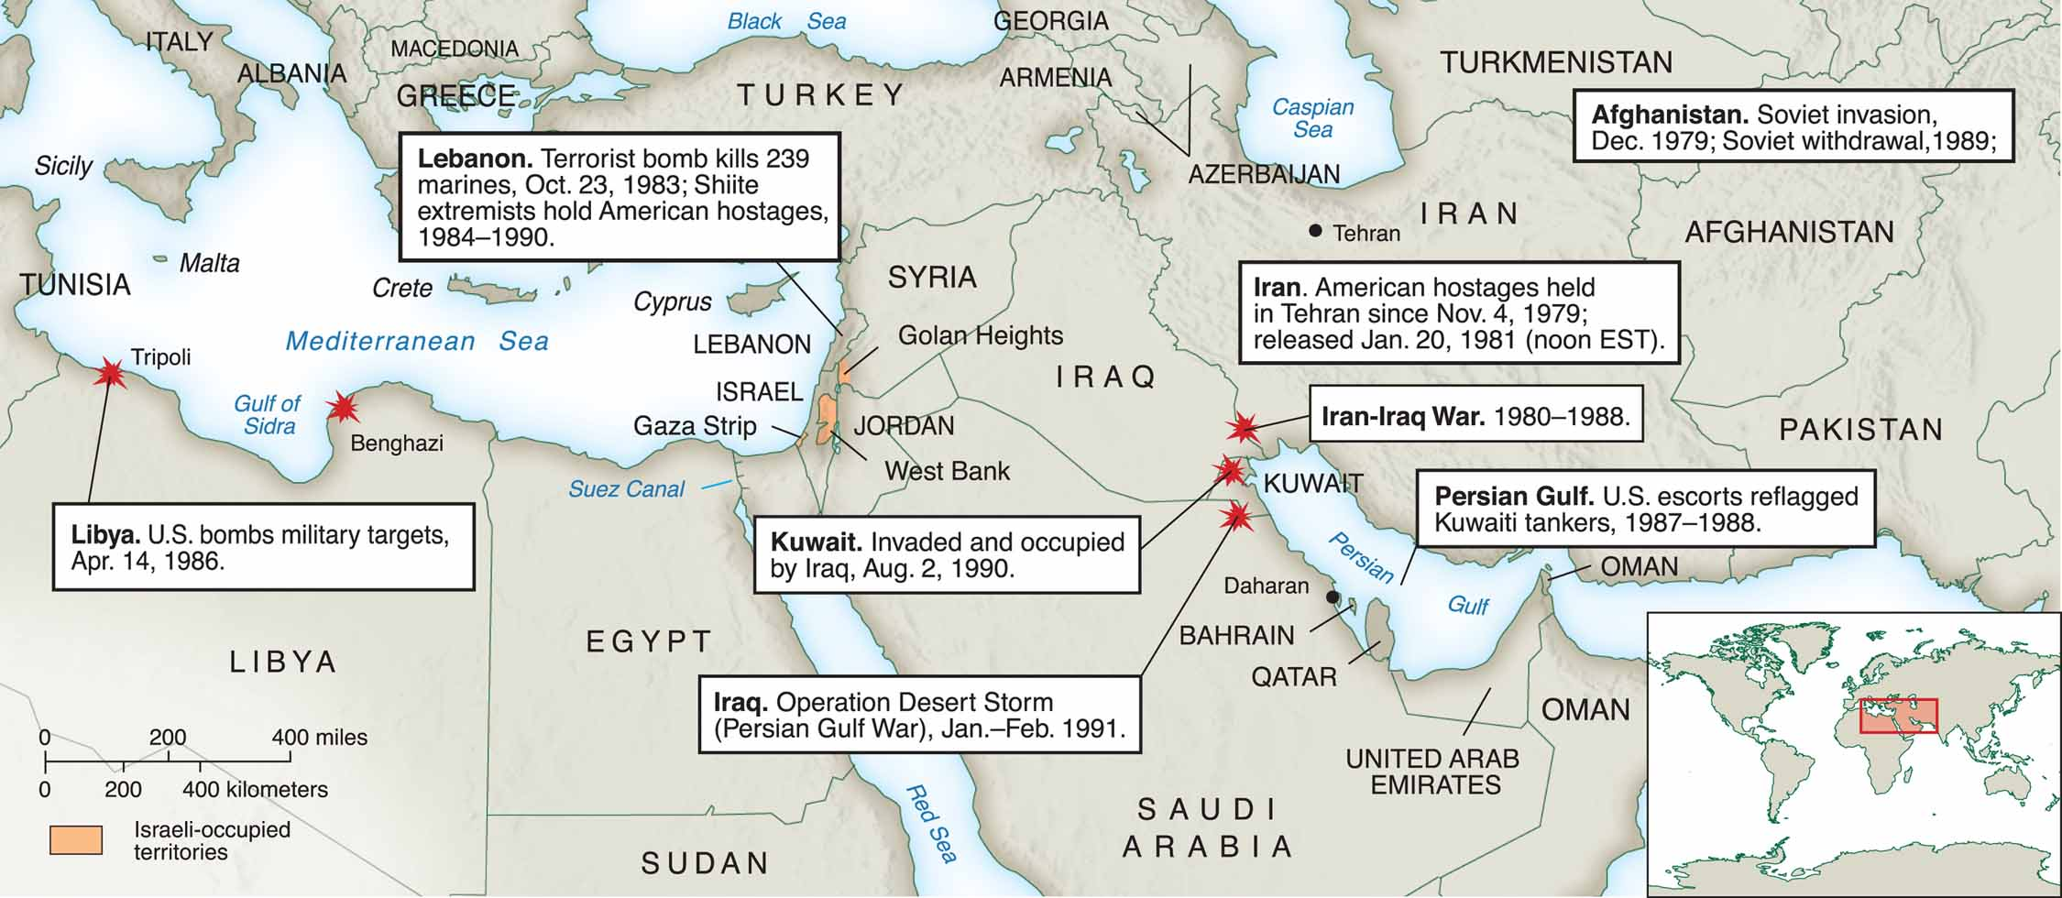
The United States and the Middle East

Slide 24
Challenging the New Deal
Reagan’s Presidency saw breakup of Democratic New Deal Coalition
New Deal premises challenged by Reagan view that the private sector rather than government should be source of remedy for America’s ills
Popular centerpieces of welfare state left intact
Small government conservatism was wave of the future

