Slide 1
Chapter 25
Complacency and Change

Slide 2
Key Points
Eisenhower's “new” approach
Massive Retaliation
Brinksmanship
CIA and how it “fought” the Cold War

Slide 3
Eisenhower’s America, America’s World
The successful test of a U.S. hydrogen bomb meant that Eisenhower and every subsequent president would govern in a world that was different from any of his predecessors.
The Cold War between the United States and the Soviet Union was a daunting reality for every person on the planet in the 1950s and for a long time thereafter.

Slide 4
Eisenhower Wages the Cold War
Eisenhower prefers to work behind-the scenes
Eisenhower wanted to relax tensions with Soviets
Debt imposed by defense spending
Possibility of atomic warfare
Eisenhower “new look” policy relied on massive retaliation to deter Soviet attacks
Brinkmanship
CIA
SEATO
Notes:
21
21

Slide 5
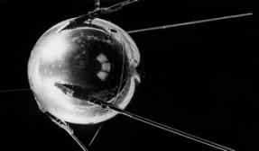
The Reaction to Sputnik
1957: Russians launched Sputnik
American response
National Aeronautics and Space Administration (NASA)
National Defense Education Act—upgrade the teaching of science
Sense of failure, declined by 1960
National Defense Education Act

Slide 6
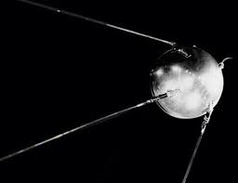
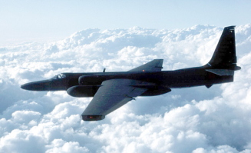
Waging Peace
Nuclear test ban treaty
U.S. and U.S.S.R. agreed to suspend nuclear testing in the atmosphere
Eisenhower & Khrushchev planned a summit in Paris, May 1960
May 1, 1960: U-2 incident cancelled plans for summit on new Berlin Crisis
Notes:
26
26

Slide 7
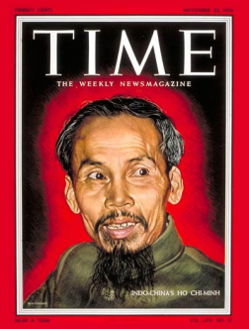
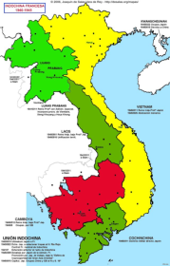
Entanglement in Indochina
Eisenhower refused military aid for French retention of colonial Indochina
Victory of Communist Ho Chi Minh prompted intervention to prevent election
Vietnam divided, election postponed
South Vietnam under U.S. puppet regime
Notes:
22
22

Slide 8
Containing China
Tough line against China
Drove wedge between China, Russia
Strategy ultimately worked
Effects not immediately apparent
Notes:
23
23

Slide 9
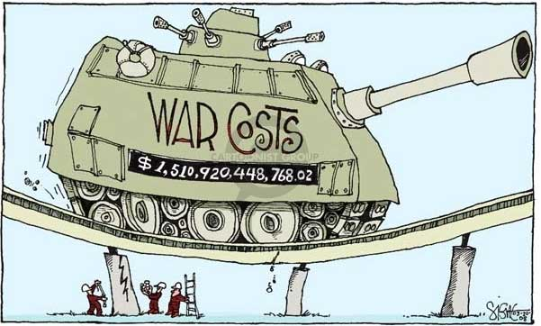
The Continuing Cold War
January, 1961: Eisenhower warned against growing military-industrial complex
Post-war era marked by Cold War rather than peace and tranquility
Notes:
27
27

Slide 10
A Culture on the Move
In 1960, the average family income of $5,620 was 30 percent higher than it had been in 1950.
The decade of the 1950s was also, as the writer Morris Dickstein noted, “a fertile period, a seedbed of ideas that would burgeon and live in the more activist, less reflective climate that followed.”

Slide 11
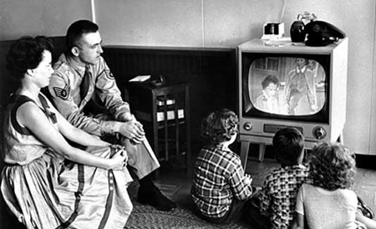
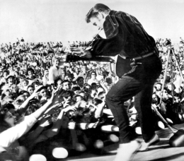
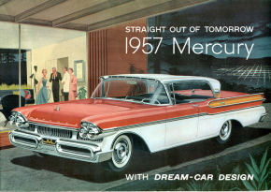
Economic Boom
The 1950’s

Slide 12
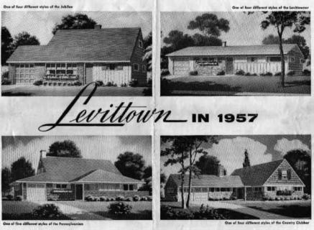

Slide 13
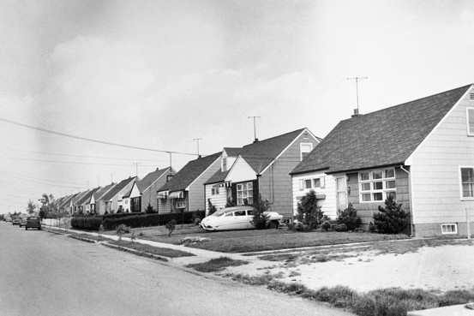

Slide 14
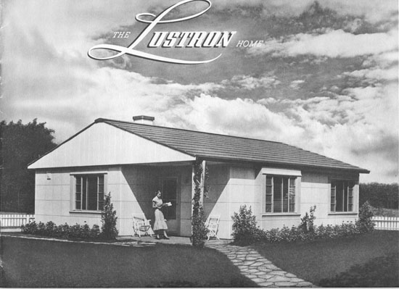
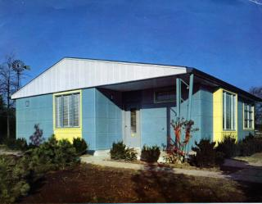
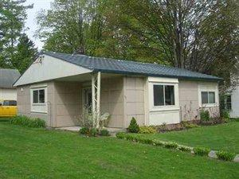

Slide 15
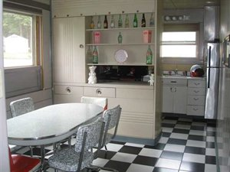
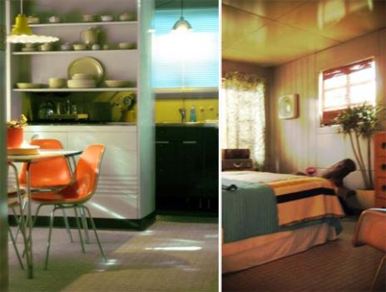

Slide 16
The Growing Impact of Television
From 104 commercial stations broadcasting to 5 million homes in 1950, television expanded to almost 600 stations received in 45,750,000 homes in 1960.
Television news programs were usually 15 minutes long
Shows ranged from dramas to comedy

Slide 17
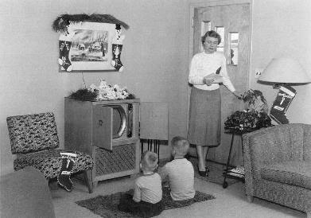
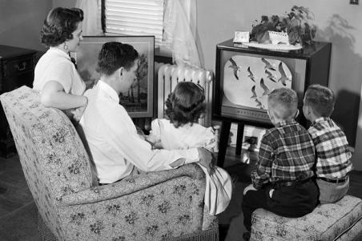

Slide 18
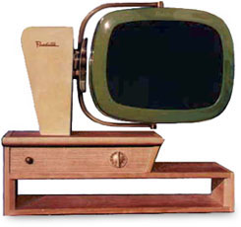

Slide 19
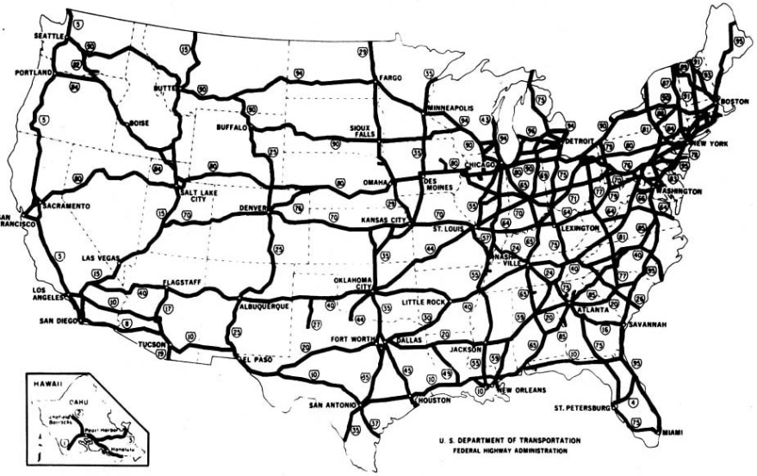
Interstate Highway System

Slide 20
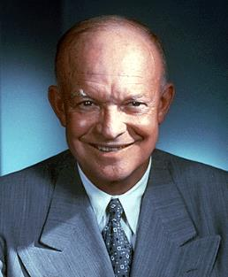
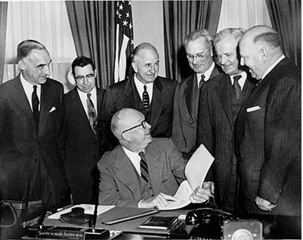
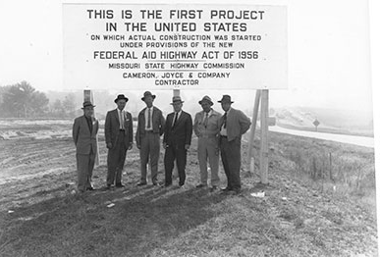

Slide 21
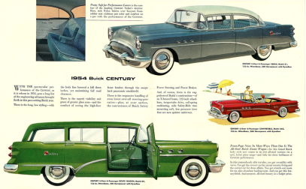
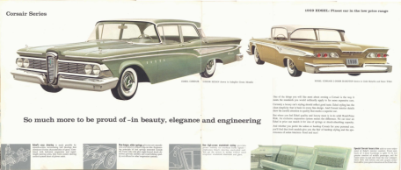
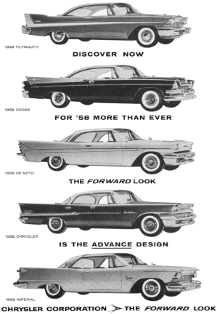
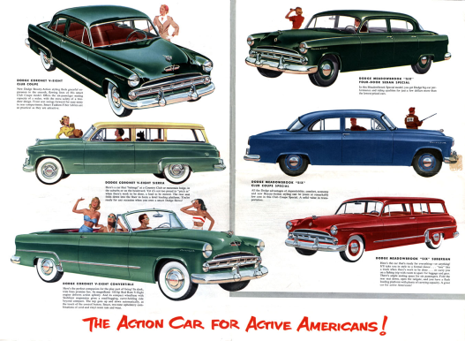

Slide 22
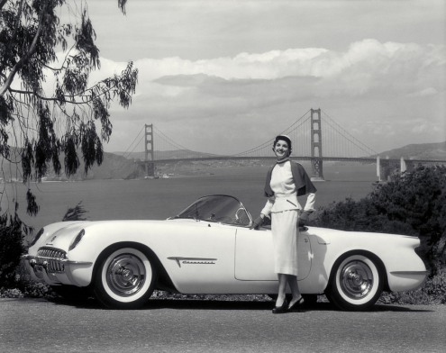
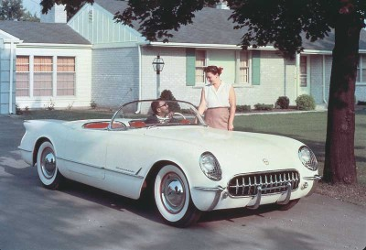

Slide 23
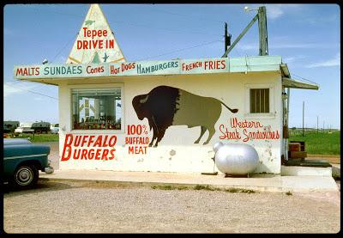
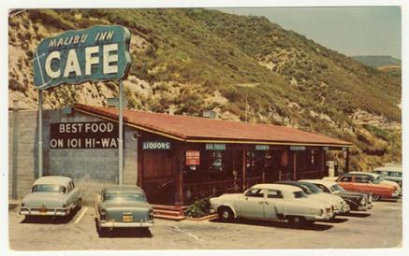
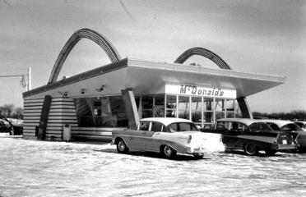

Slide 24
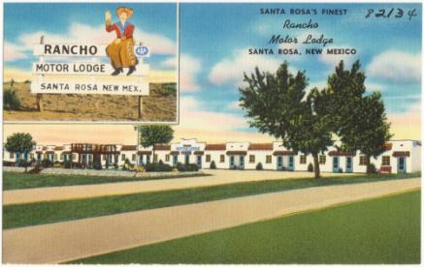
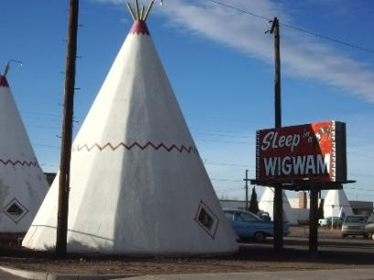

Slide 25
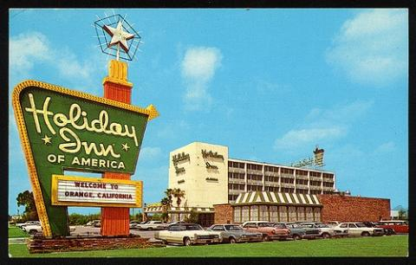
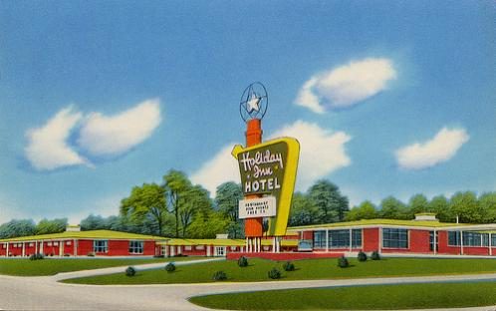

Slide 26
1950’s Big Ideas
Conformity
Dissent

Slide 27
The Good Life?
Consumerism the dominant social theme of the 1950s
Quality of life left Americans anxious and dissatisfied
“Little Boxes” Pete Seeger
Thinking Historically – page 736

Slide 28
Big Words from Halberstam
Languid - (of a person, manner, or gesture) displaying or having a disinclination for physical exertion or effort; slow and relaxed
Placid - (of a person or animal) not easily upset or excited
Saccharine - excessively sweet or sentimental.
Burgeoning - begin to grow or increase rapidly; flourish.
Benevolent - well meaning and kindly.
Affluence - the state of having a great deal of money; wealth.
Quiescent - in a state or period of inactivity or dormancy.
Dissidence - protest against official policy; dissent.

Slide 29
Main Idea / Support Details
As we read the Preface from David Halberstam’s The 50’s, I want you to identify the central idea.
Identify 3 specific pieces of evidence to support your conclusion

Slide 30
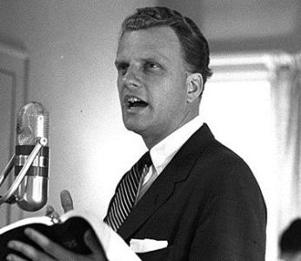
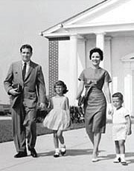
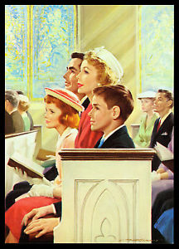
The Boom of Religion
1950s – 2/3 of the population went to church
Billy Graham became a nationally known religious figure
American Catholics larger than any single Protestant denomination

Slide 31
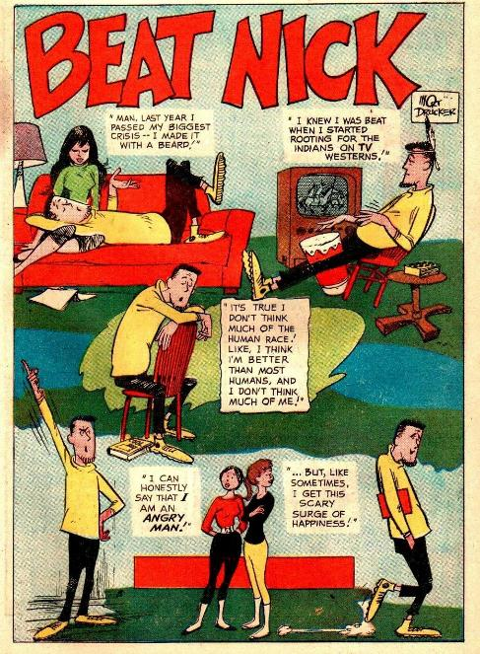
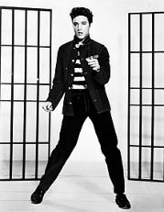
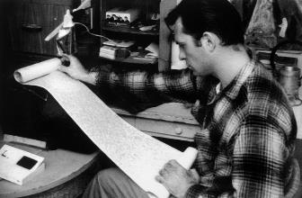
Dissent
Critics of Conformity & Consumer Society
Inhibited independence
People constantly changed to “fit in”
Beginnings of rebellion
Cleared the way for the youth rebellions of the 1960s
Elvis Presley and Rock ‘n’ Roll

Slide 32
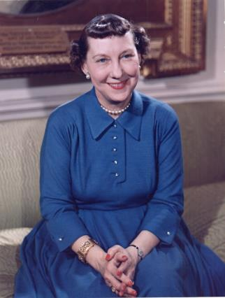
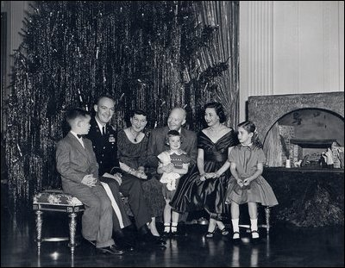
3 words to describe IKE & Mamie

Slide 33
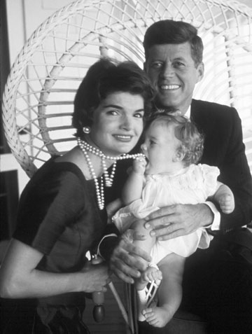
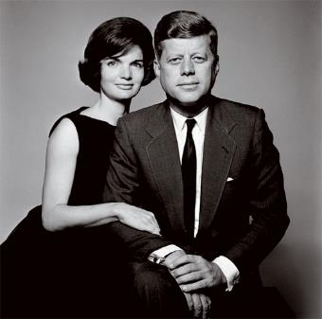
3 words to describe JFK & Jackie

Slide 34
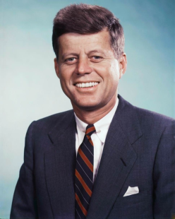
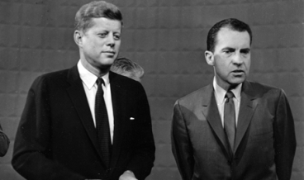
From Oldest to Youngest — The Transition to the Next President
Republicans - Richard M. Nixon
Democrats - John F. Kennedy
Kennedy wins closest election in history (difference in pop. vote was 49.7% to 49.6%)
Kennedy first Catholic president

Slide 35
Key points
Brown v. Board of Education of Topeka, Kansas
No violent civil disobedience – (Boycotts, sit-ins, marches)
MLK, Rosa Parks, John Lewis, SNCC, SCLC, NAACP, CORE
Civil Rights Act 1964 & Voting Rights Act 1965

Slide 36
WEBEX test
Go to https://evsc.webex.com/meet/jon.carl
Password 8fTD325VuwZ

Slide 37
A Picture is worth…….
Research your group’s picture and tell the story. Your story should include the following information.
Explain the event is it associated with your picture
What is the significance of the event, person, campaign, etc.
When was it taken
Who are the subjects in the photo and who took it.

Slide 39
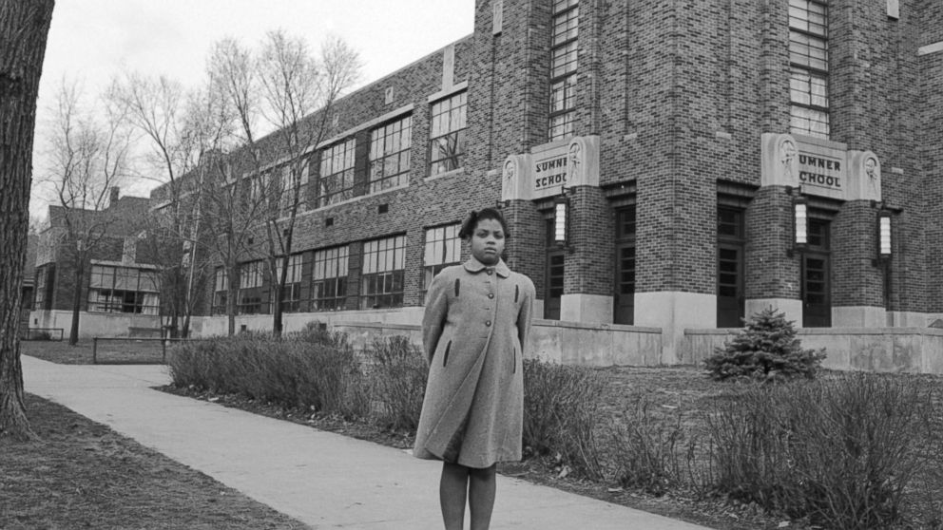

Slide 40
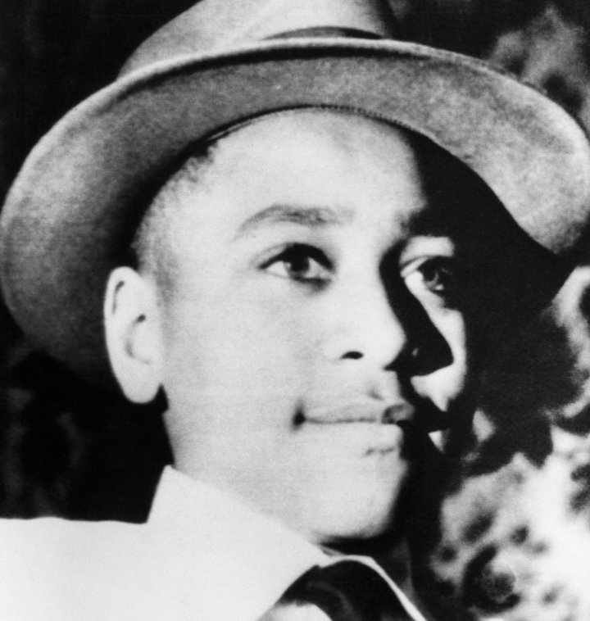

Slide 52
The Long Road to Brown v. Board of Education
Thurgood Marshall, NAACP lawyer, addressed the Supreme Court
May 17, 1954 - “Separate educational facilities are inherently unequal.”
1957 - Little Rock, Arkansas
Eisenhower orders 1,000 troops to Little Rock to protect the students

Slide 53
Civil Rights Events, 1953–1963

Slide 54
Montgomery, Alabama
1955 – Rosa Parks arrested for refusing to give up her seat to a white man on a city bus
Montgomery Bus Boycott
Led by Rev. Martin Luther King, Jr.
SCLC - Southern Christian Leadership Conference

Slide 55
Students and Sit-Ins
1960 - four African-American freshmen at North Carolina A&T College sat down at the whites-only lunch counter of the Woolworth’s store in Greensboro, North Carolina
Beginning of the “sit-in” movement

Slide 56
From Freedom Rides to Birmingham to Washington — “I Have a Dream,”1963
1961 - integrate buses and bus terminals throughout the South
Birmingham - closed all public facilities to avoid desegregation
1963 - “toughest nut to crack”
March on Washington, August 28, 1963
MLK’s “I Have a Dream” speech

Slide 57
The Student Nonviolent Coordinating Committee and Mississippi
SNCC - Student Nonviolent Coordinating Committee
CORE - Congress of Racial Equality
Freedom Summer - 1964 - attempt to register as many African-American voters as possible in Mississippi, which up to that time had almost totally excluded black voters.

Slide 58
The North and Malcolm X
Malcolm X – born Malcolm Little in Omaha, Nebraska in 1925
Joins the Nation of Islam
Travels to Mecca
Breaks with the Nation of Islam
Assassinated by Nation of Islam followers in February 1965

Slide 59
Voting Rights Act of 1965
The Act banned literacy test and gave the Federal Government the power to oversee elections in states that discriminated.
In the north, many blacks were still frustrated and angry
After the act, there was terrible rioting in urban centers.

Slide 60
Last Days of Dr. King
By the late 1960’s, Dr. was speaking out against the war in Vietnam
He also was starting to focus on poverty.
Purposed “Poor Peoples Campaign”

Slide 61
Memphis Sanitation workers strike
Garbage men in Memphis were on strike.
King saw this issue as part of his campaign against poverty.
Went several time to support the workers

Slide 62
The last day
When King was in Memphis, he usually stayed at the black owned Lorraine Motel. He was staying here on his visit in April 1968.

Slide 63
April 4, 1968

Slide 65
The shooters window

Slide 68
Election of 1968
There was a Presidential election going on in 1968
One of the candidates was Robert Kennedy, John Kennedy’s little brother.
He was campaigning in Indiana for the Democrat Primary

