Slide 1
Fraser Chapter 24
Life after the war

Slide 2
Soldiers Return Home
NBC Looks Back
The GI Bill
Levittown Revisited

Slide 3
The United States in 1945
Those who had been fighting are anxious to get home.
Some stayed in new locations.
Government leaders dealt with the aftermath of the war.

Slide 4
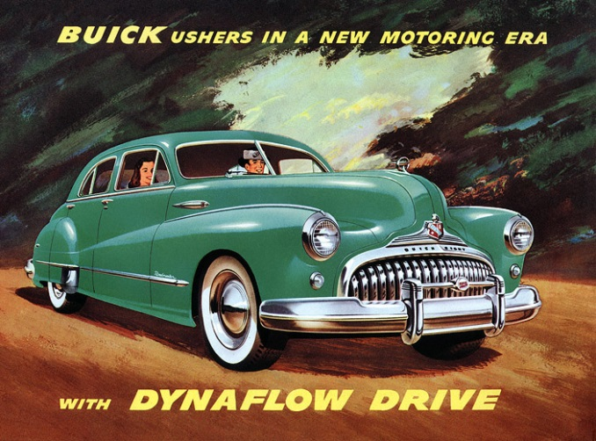
Science, Medicine, Technology, and the Bomb
New technologies
New vaccines
Television
Automobiles
Atomic bomb

Slide 5
Soldiers Return Home
NBC Looks Back
The GI Bill
Levittown Revisited

Slide 6
Big Words from Halberstam
Languid - (of a person, manner, or gesture) displaying or having a disinclination for physical exertion or effort; slow and relaxed
Placid - (of a person or animal) not easily upset or excited
Saccharine - excessively sweet or sentimental.
Burgeoning - begin to grow or increase rapidly; flourish.
Benevolent - well meaning and kindly.
Affluence - the state of having a great deal of money; wealth.
Quiescent - in a state or period of inactivity or dormancy.
Dissidence - protest against official policy; dissent.

Slide 7
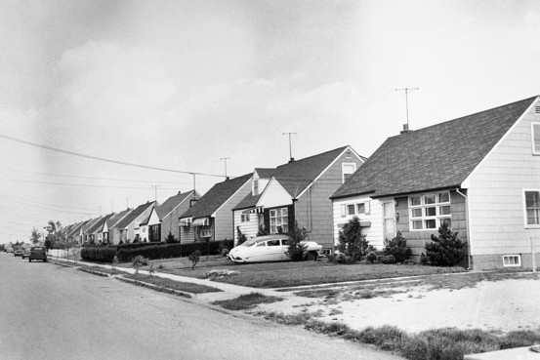
The Postwar Boom
1945–1960: Rapid economic growth
1960: Fear of another depression wanes

Slide 8
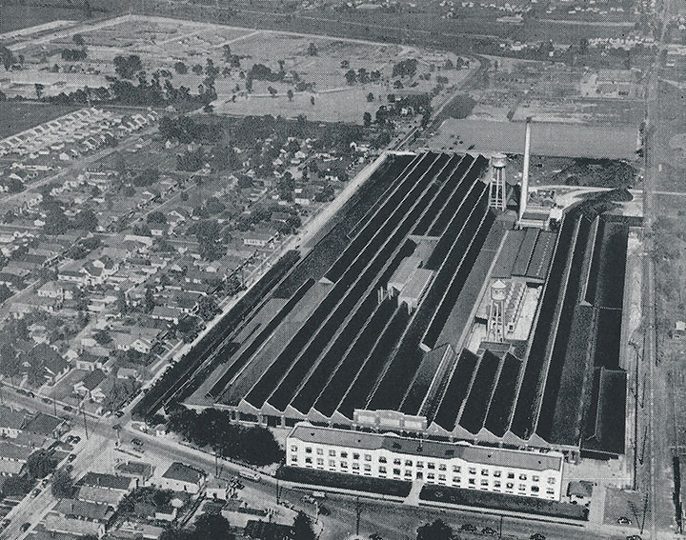
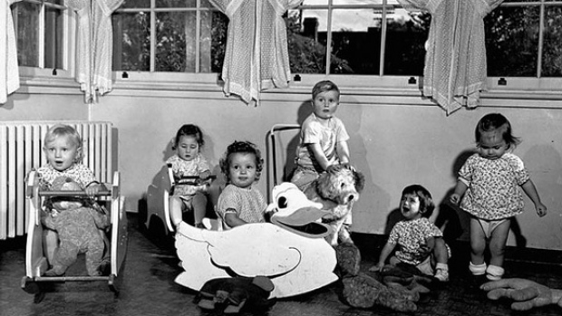
Postwar Prosperity
Stimuli to consumer goods industry
Baby boom
Population shift to suburbia
Increased defense spending
Increase in capital investments
Employment expands

Slide 9
Returning Veterans, the Baby Boom, and Suburban Homes
GI Bill - 5 million used it to buy homes
8 million used to attend college
Pent-up consumer demand
Baby Boom
Federal spending
Americans move to the ‘burbs

Slide 10
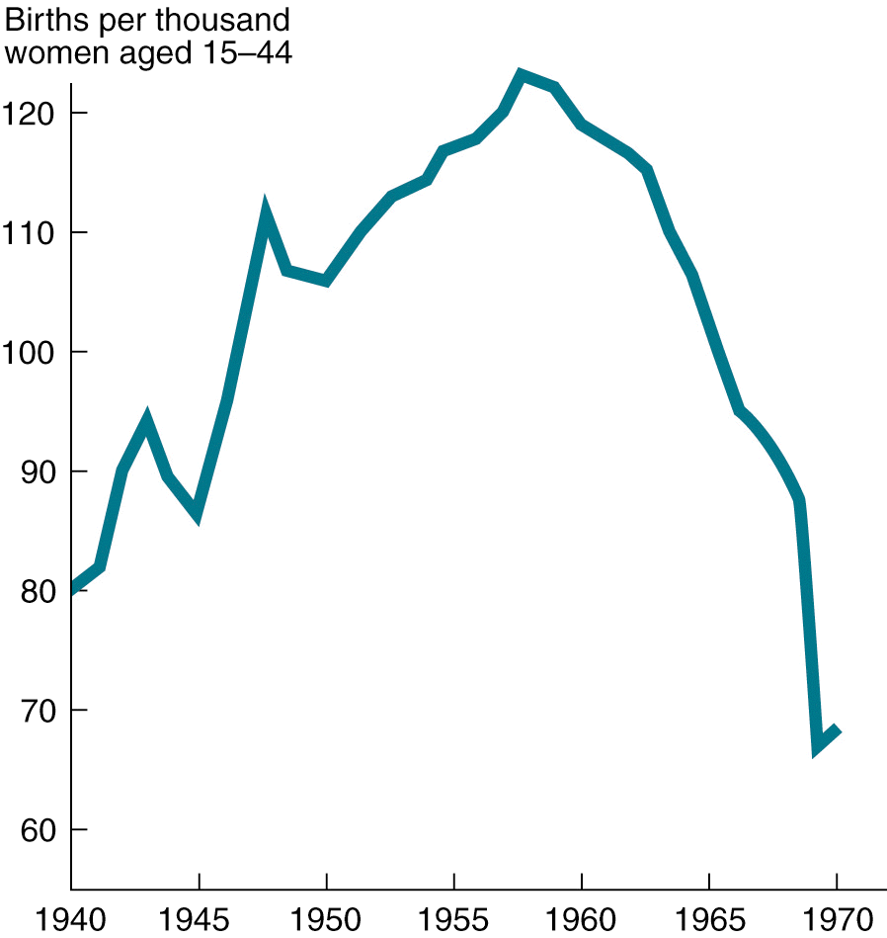
Birthrate, 1940–1970

Slide 11
Soldiers Return Home
NBC Looks Back
The GI Bill
Levittown Revisited

Slide 12
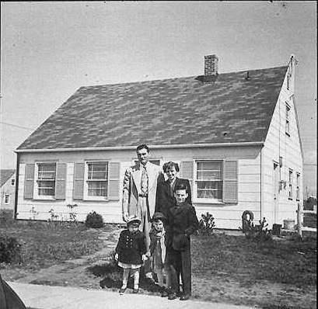
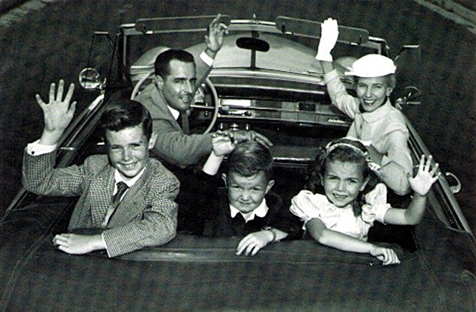
Life in the Suburbs
Suburbia inhabited by middle class
Characteristics of suburbs
Dependence on the automobile
Family togetherness
Traditional feminism discouraged
Entrance of more women into workplace stimulated new feminism

Slide 13
The Good Life?
Consumerism the dominant social theme of the 1950s
Quality of life left Americans anxious and dissatisfied

Slide 14
The Great Migration — African-Americans Move North
A new generation of African-Americans moved from the South to the North.
During and after World War II, the rate of migration exploded.
By 1960, half of the nation’s African-Americans lived in northern cities.

Slide 15
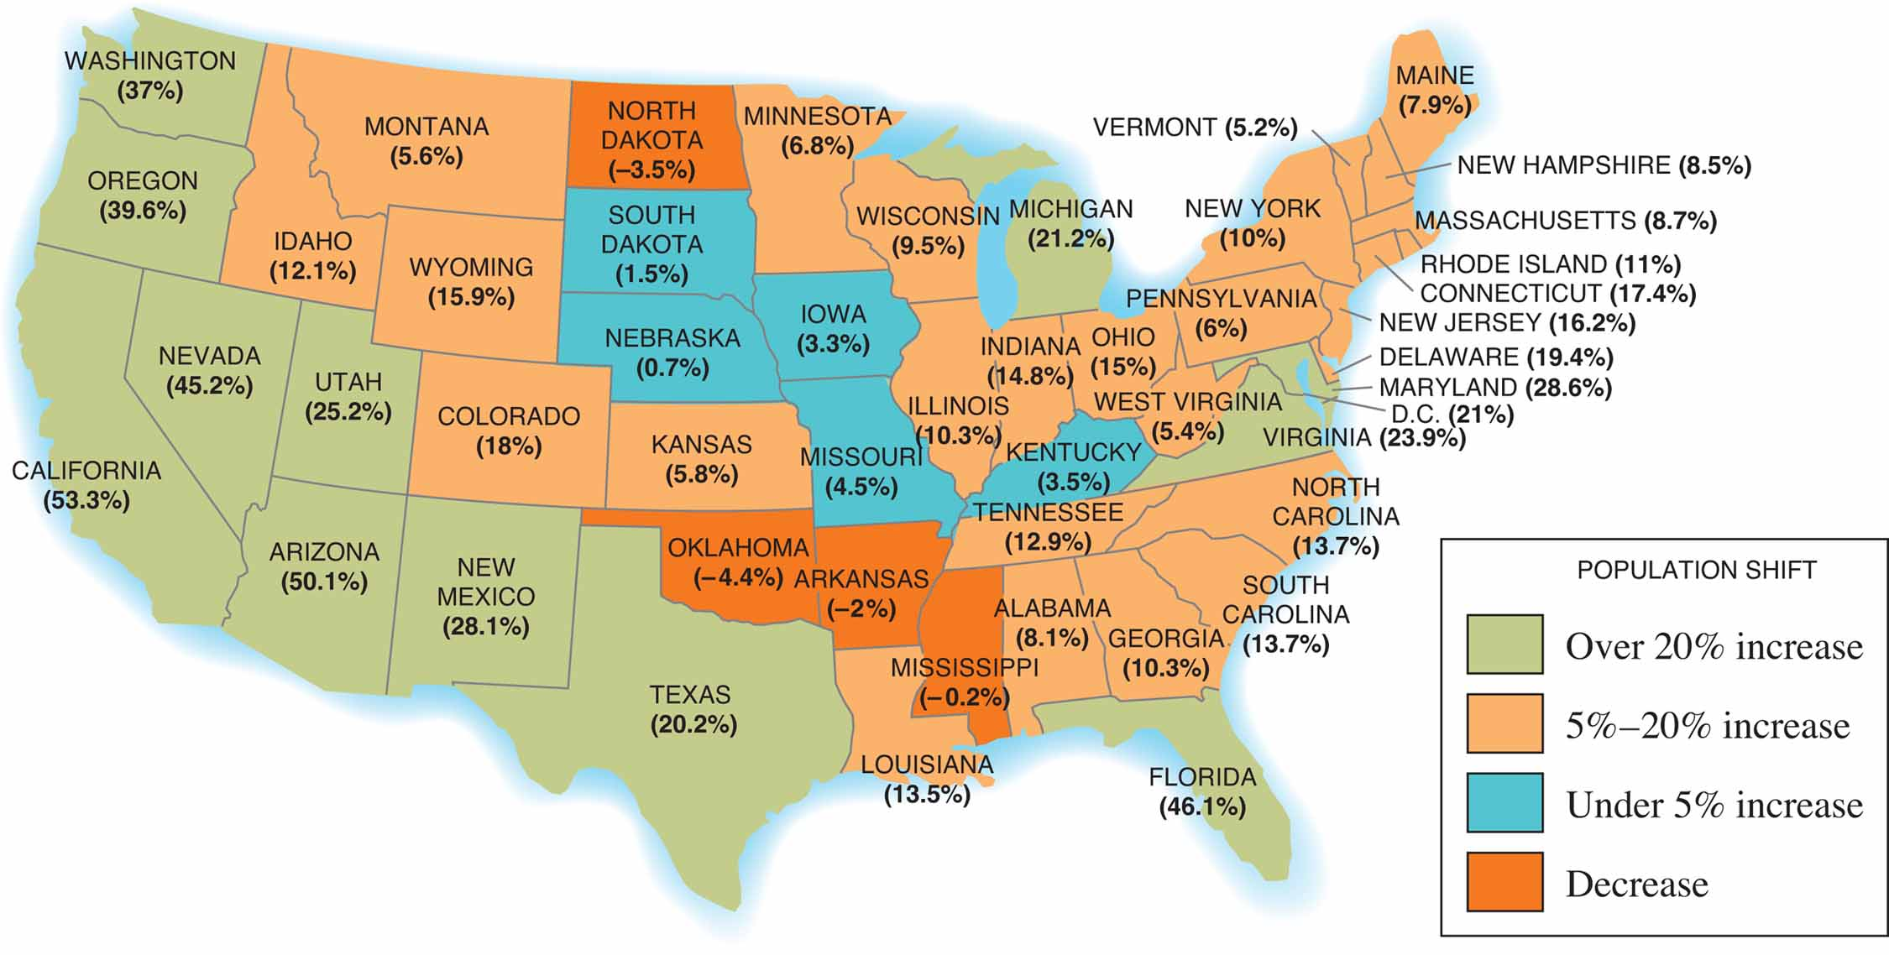
Americans on the Move
MAP 24-1, Americans on the Move

Slide 16
Latino Migrations from Puerto Rico and Mexico
After World War II, more Spanish-speaking citizens began moving from Puerto Rico to the U.S. mainland, especially New York City.
In addition, the U.S. population included about 1.2 million Americans of Mexican background, and this group also grew rapidly after World War II.

Slide 17
The Cold War Begins
The Soviet Union establishes communist governments in Eastern Europe.
U.S. desired free governments
Disagreements on Germany, economic aid, & atomic weapons split the U.S. and Soviet Union

Slide 18
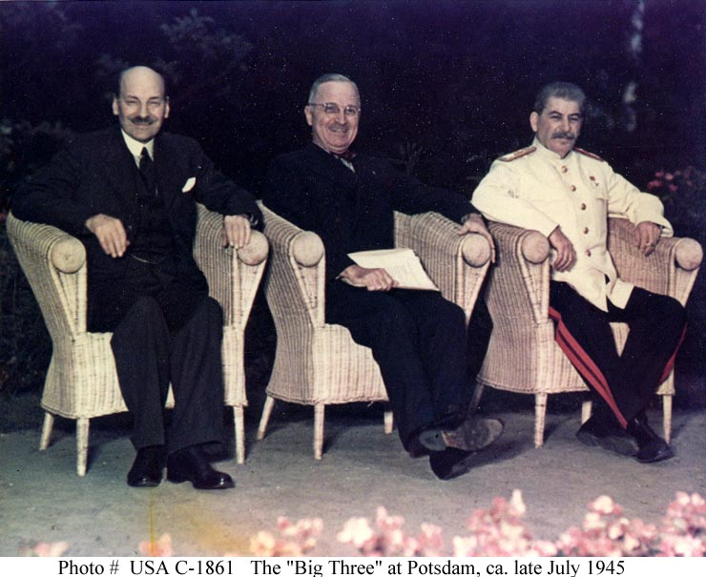
The Cold War Begins: Issues Dividing U.S., U.S.S.R.
Potsdam Conference
Control of postwar Europe
Economic aid
Nuclear disarmament
Notes:
2
2

Slide 19
The Hardening of Positions: Containment, the Truman Doctrine, the Marshall Plan, and the Berlin Airlift
U.S. President Harry S. Truman would back a policy of “containment” in regard to Soviet expansion.
Truman Doctrine: “I believe it must be the policy of the U.S. to support free peoples.”
Berlin Airlift 1948-1949

Slide 20
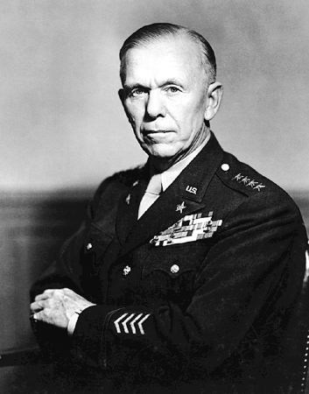
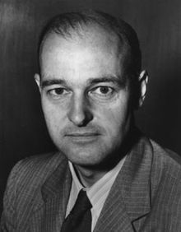
Containment
1947: George C. Marshall appointed Secretary of State
George Kennan: Called for “containment of Russia’s expansive tendencies”
Notes:
6
6

Slide 21
The Truman Doctrine
1947: Truman sought funds to keep Greece, Turkey in Western sphere of influence
Truman Doctrine: “Support free peoples who are resisting attempted subjugation by armed minorities or outside pressure”
Doctrine an informal declaration of cold war against the Soviet Union
Notes:
7
7

Slide 22
The Marshall Plan
1947: George Marshall proposed aid for rebuilding European industries
Russia refused aid
1948: Marshall Plan adopted by Congress
Plan fostered western European prosperity
Notes:
8
8

Slide 23
Marshall Plan to Aid Europe, 1948–1952

Slide 24
The Division of Europe
1945: Russians occupied eastern Europe, American troops occupied western Europe
Soviet Union sought eastern European buffer
U.S. demanded national self-determination through free elections throughout Europe
Stalin converted eastern Europe into a system of satellite nations
Notes:
3
3

Slide 25
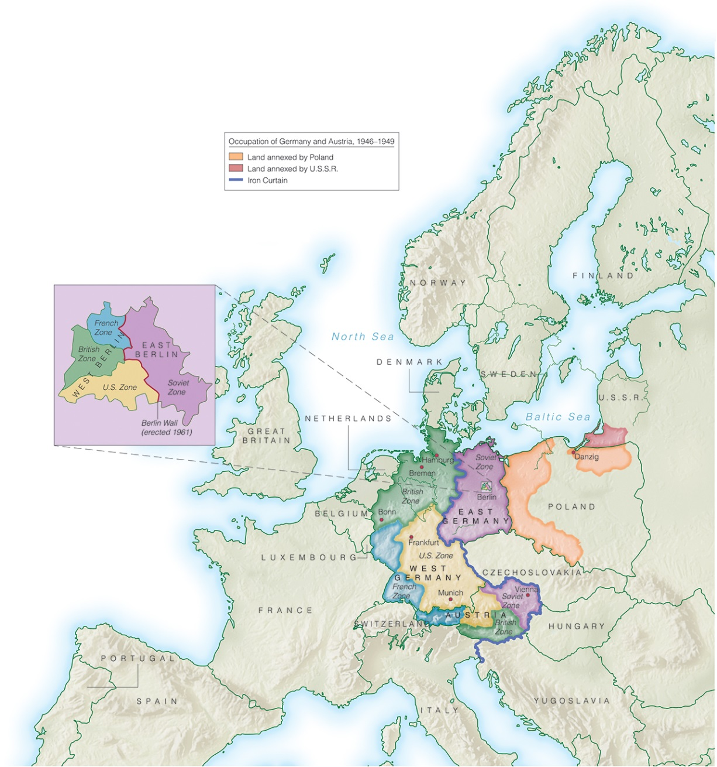
A Divided Germany

Slide 26
The Western Military Alliance
1949: North Atlantic Treaty Organization
Military alliance included U.S., Canada, most of western Europe
U.S. troops stationed in Europe
NATO intensified Russia's fear of the West
Notes:
9
9

Slide 27
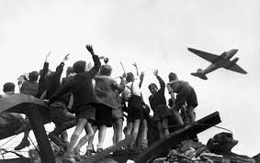
The Berlin Blockade
June, 1948: Russians blockade of Berlin
Truman ordered airlift to supply the city
1949: Russians end blockade
U.S. political victory dramatized division
Notes:
10
10

Slide 28
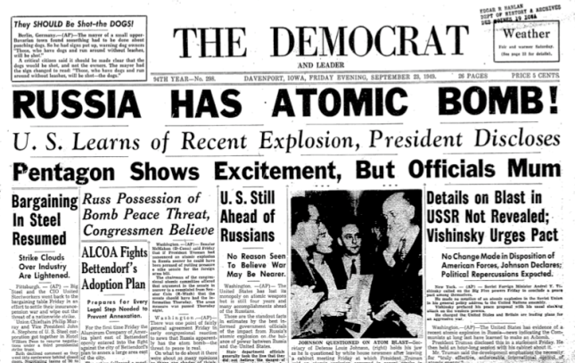
The Cold War Expands
1947: U.S.-Russian arms race accelerated
1949: First Russian atomic bomb exploded, U.S. began hydrogen bomb development
Conflict expanded to Asia
Notes:
11
11

Slide 29
1949 — The Soviet Atom Bomb and the Fall of China
1949 – The Soviets have an atom bomb
1949 - Communist victory in China
Containment’s first failure
NATO
Warsaw Pact

Slide 30
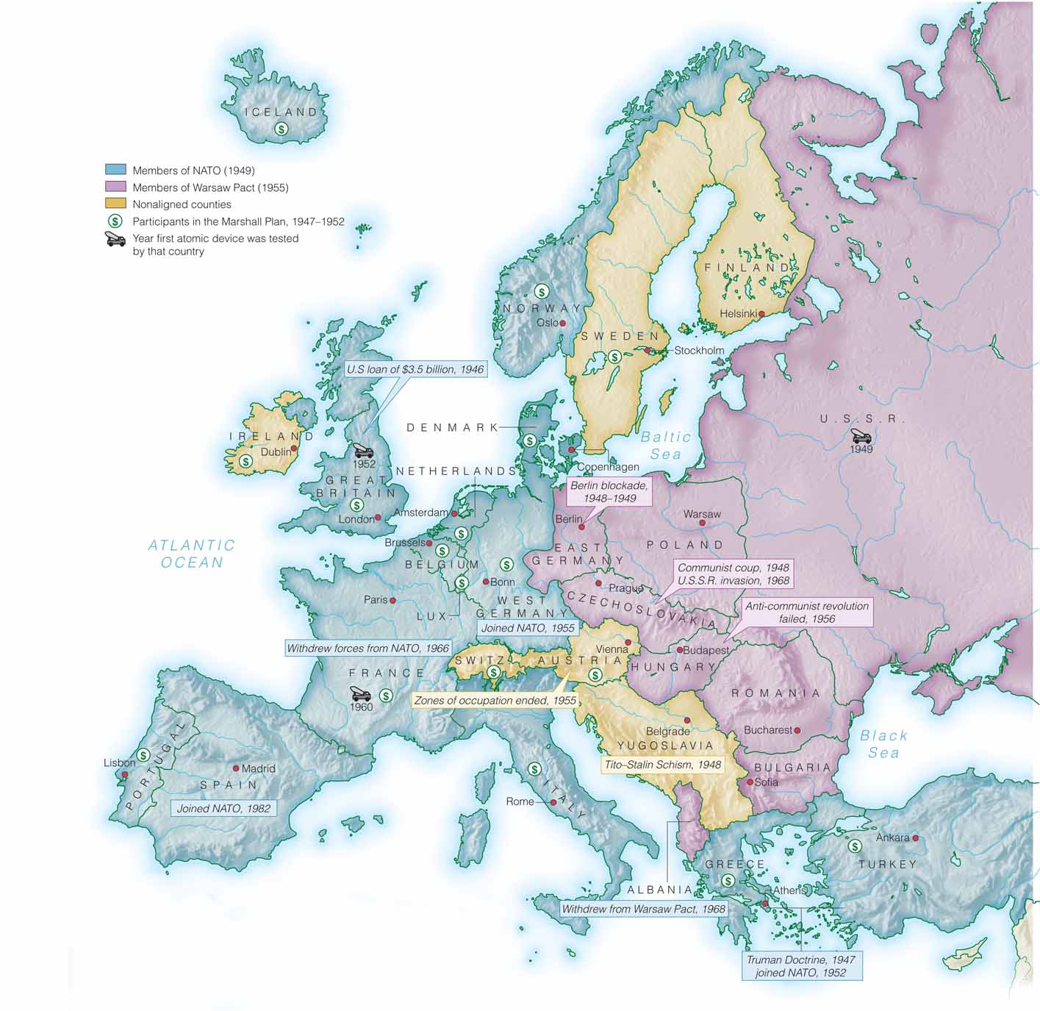
A Divided Europe

Slide 31
The Cold War at Home — Joseph McCarthy and a New Red Scare
House Un-American Activities Committee
1947 - root out Communism within government and society
Hollywood became HUAC’s first target
Sen. Joseph McCarthy – “McCarthyism”

Slide 32
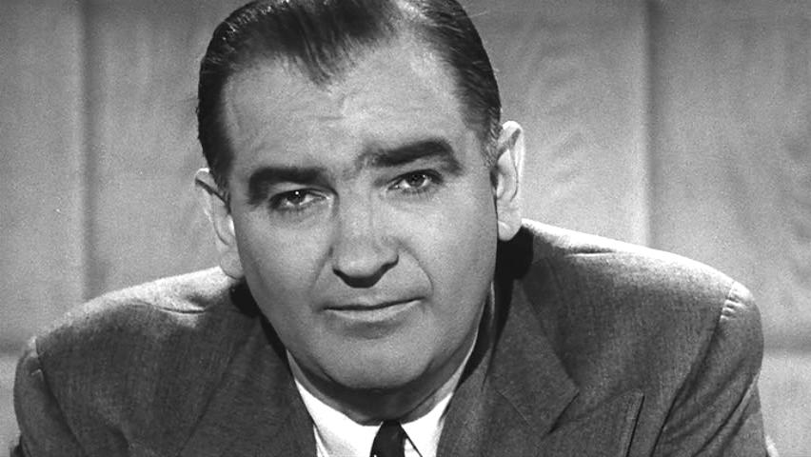
McCarthyism in Action
1950: Senator Joseph McCarthy launched anticommunist campaign
Innocent overwhelmed by accusations
Attacks on privileged bureaucrats
Supported by Midwest Republicans
Attracted Irish, Italian, Polish workers to Republicans
Notes:
19
19

Slide 33
War in Korea
North Korea invades South on June 25, 1950.
U.S. sees this as an act of aggression of world Communism.
Counterattack by Douglas MacArthur at Inchon
Chinese pour across border
Eventual stalemate at 38th parallel

Slide 34
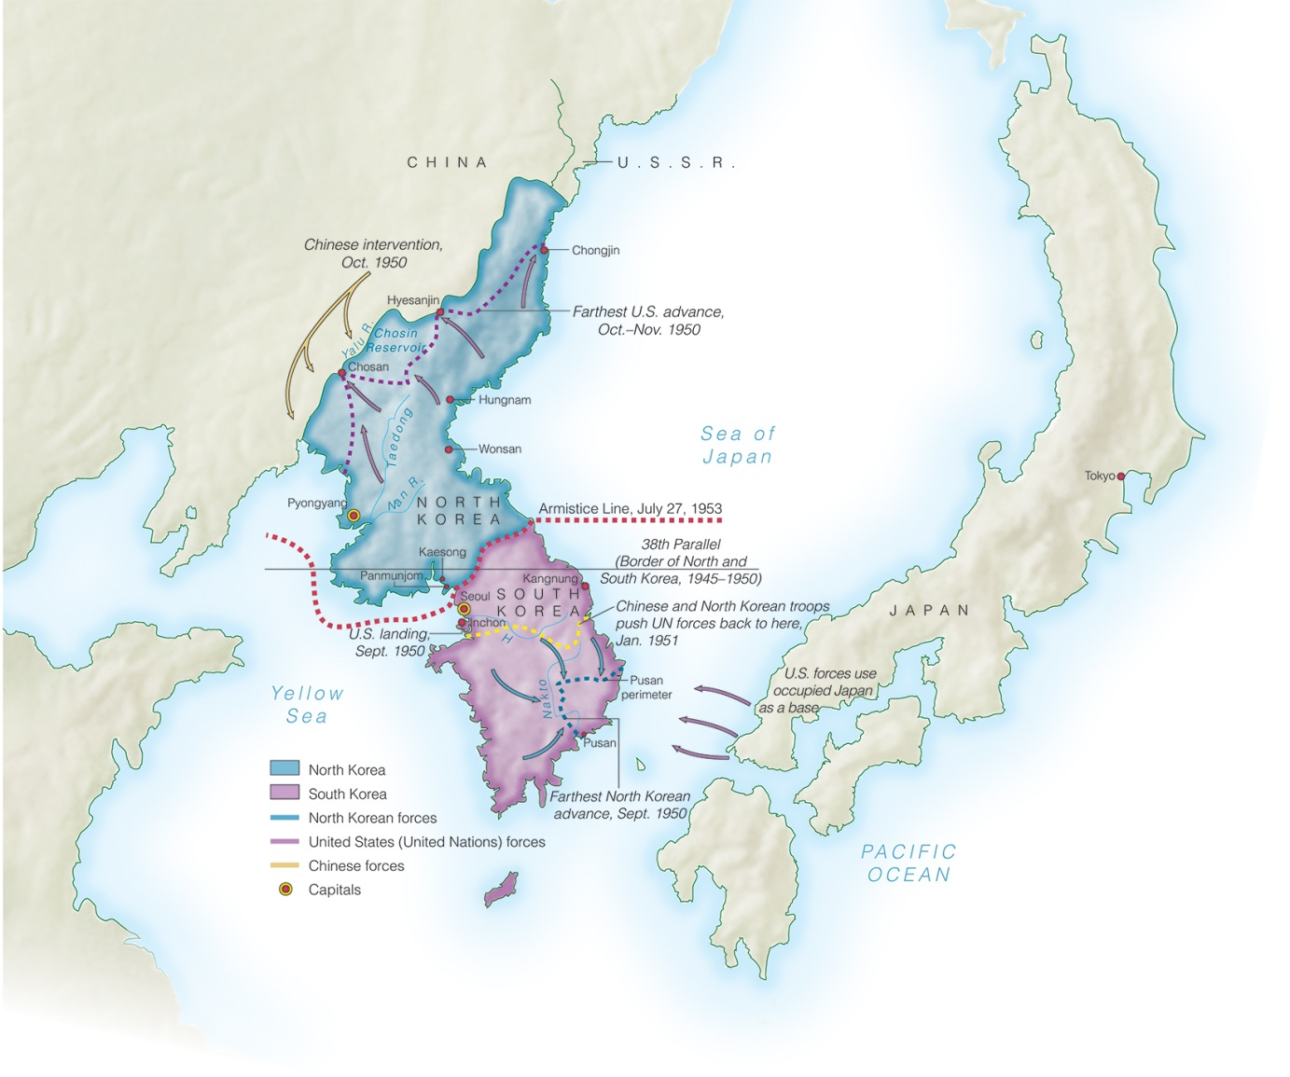
The Korean War
MAP 24-4, The Korean War

Slide 35
Riding a Tiger — Truman’s First Term
Truman proposed legislation that would implement FDR’s Economic Bill of Rights
Offered Social Security benefits to more people
Made the Fair Employment Practices Commission permanent

