Slide 1
TRANSITION TO MODERN AMERICA
Chapter 21

Slide 2
Ann Hagedorn’s
Savage Peace 2007

Slide 3
Old People
Young People

Slide 4
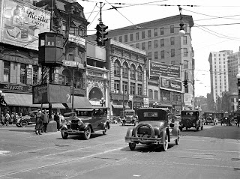
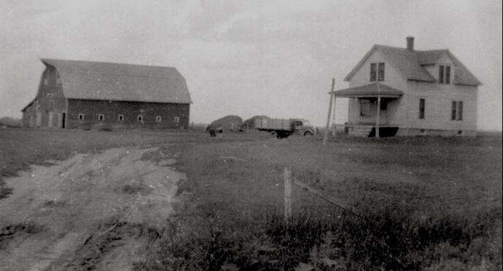
Rural vs. Urban
For the first time more Americans lived in the cities than in the country.
With city life came many changes that worried older, rural people
City dwellers help different views on drinking, gambling, and casual dating.

Slide 5
The Rural Counterattack
Rural Americans identified urban culture with Communism, crime, immorality
Progressives attempted to force reform on the American people

Slide 6
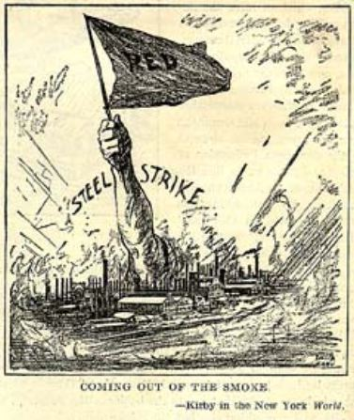
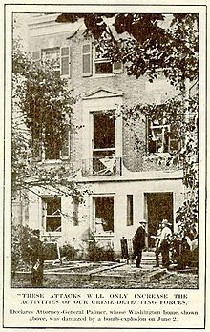
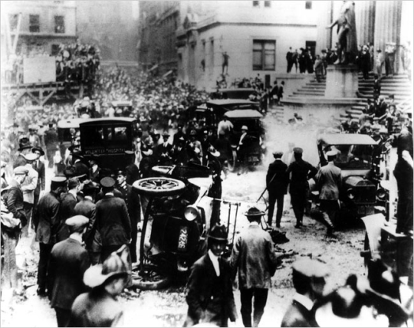
The Prelude — The Red Summer of 1919
Fear of communism in the U.S.
Communist parties form in U.S.
Bombs
Attorney General A. Mitchell Palmer launches a series of Palmer Raids in 1919-1920
American Legion formed - 100% American

Slide 7
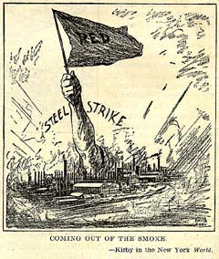
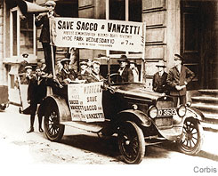
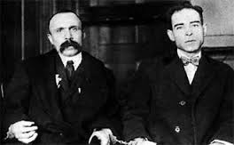
The Fear of Radicalism
1919: “Red Scare”
Illegal roundups of innocent people
Forcible deportation of aliens
Terrorism against “radicals,” immigrants
1927: Sacco and Vanzetti executed

Slide 8
The Steel Strike and Coal Miners Strike
In Sept 1919, steel mill workers struck for higher wages and shorter work days.
The steel companies called the strikers communist.
Coal miners struck in 1919. They got a big raise and a lot of negative attention.

Slide 9
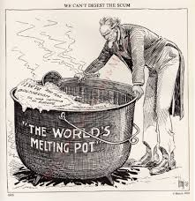
Immigration Restriction
1924: National Origins Act
150,000 person quota on immigration
Quotas favored northern Europeans
Mexican immigrants exempted from quota

Slide 10
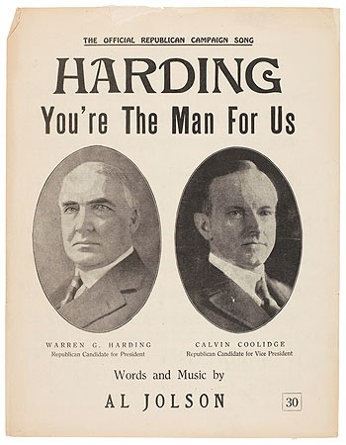
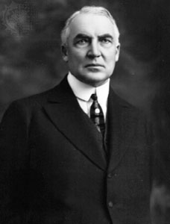
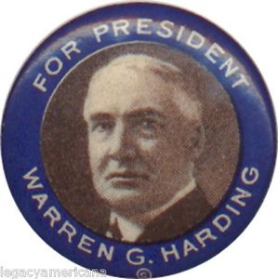
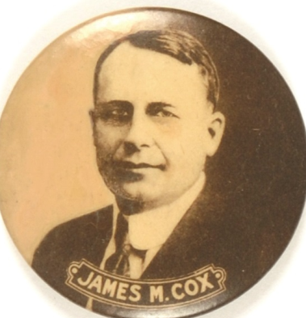
The 1920s — The Exuberance of Prosperity
Harding’s normalcy
People were as tired of Roosevelt-era reforms as they were of Wilson’s internationalism.
Many wanted to enjoy themselves, take part in the growing national prosperity, and keep the reformers and the government out of their lives.

Slide 11
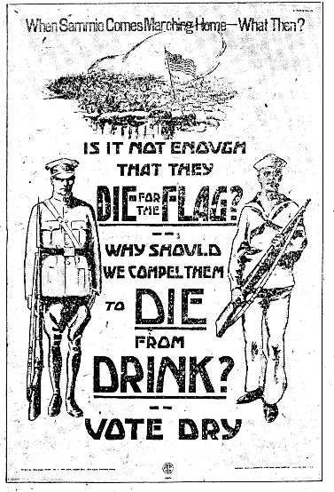
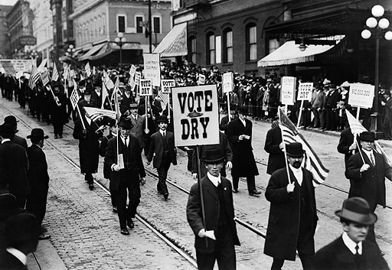
Prohibition
WTCU – Women’s organization
Anti-Saloon League – Male organization, well funded, John D. Rockefeller
Many “Drys” saw prohibition as a way to Americanize immigrants
Usually most supported by Protestant Evangelists

Slide 12
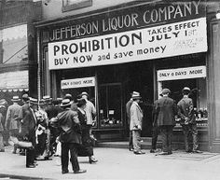
Prohibition
18th Amendment gave federal government power to pass Volstead Act of 1920 that prohibits production, sale, or transport of alcoholic beverages
Consumption of alcohol reduced
Prohibition resented in urban areas
Bootlegging became big business
1933: 18th amendment repealed

Slide 13
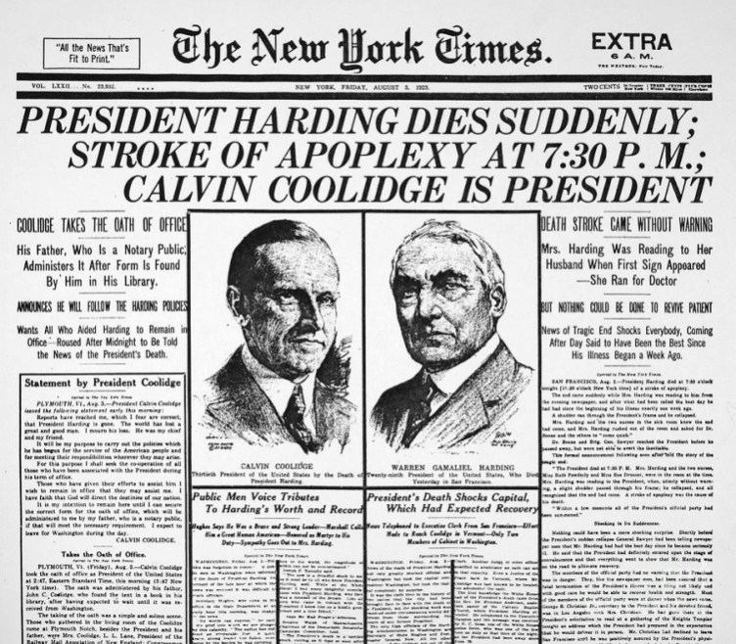
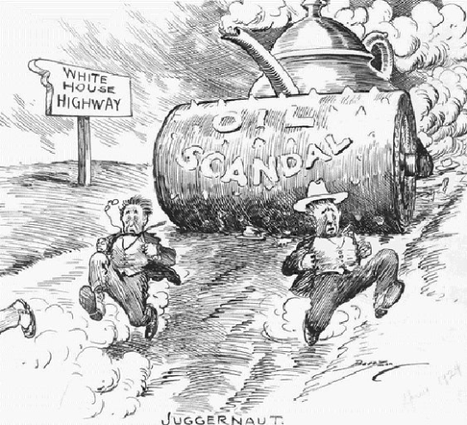
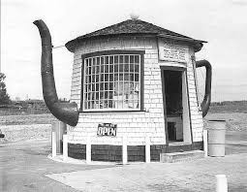
A Scandalous Age — Bootleg, Ponzi, and Teapot Dome
Prohibition-related crime
Harding’s Secretary of Interior accepts huge bribes from oil companies for leases on government oil reserves.
Harding dies in 1923, before scandals become public.

Slide 14
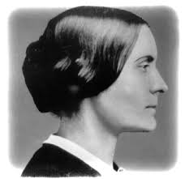
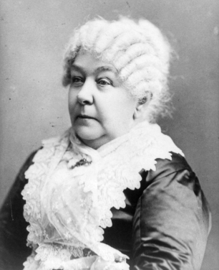
The Vote for Women
Susan B. Anthony
Elizabeth Cady Stanton
Carrie Chapman Catt
Jeannette Rankin
19th Amendment – women gain right to vote

Slide 15
A Revolution in Culture — Manners, Morals, and Automobiles
Exercise individual freedom
“Flapper” culture
Margaret Sanger
1895 - 4 cars; 1917 - 5 million
Made possible by Henry Ford and the assembly line

Slide 16
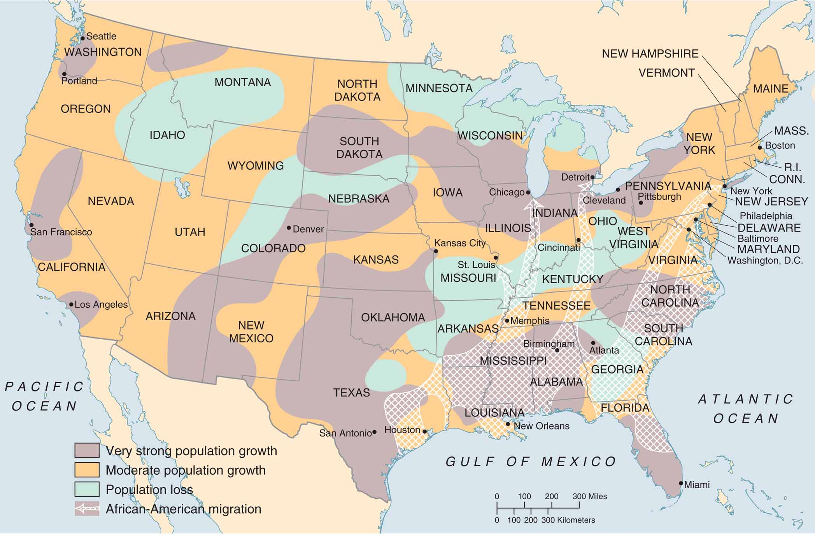
People Moving in the 1920s
MAP 21-1, People Moving in the 1920s

Slide 17
The Harlem Renaissance and Marcus Garvey
1920s literary and artistic movement centered in Harlem
Celebrated African-American life
Marcus Garvey, 1914 - Universal Negro Improvement Association (UNIA)
Promoted racial pride and solidarity
Garvey established the Black Star Line for his Back-to-Africa movement

Slide 18
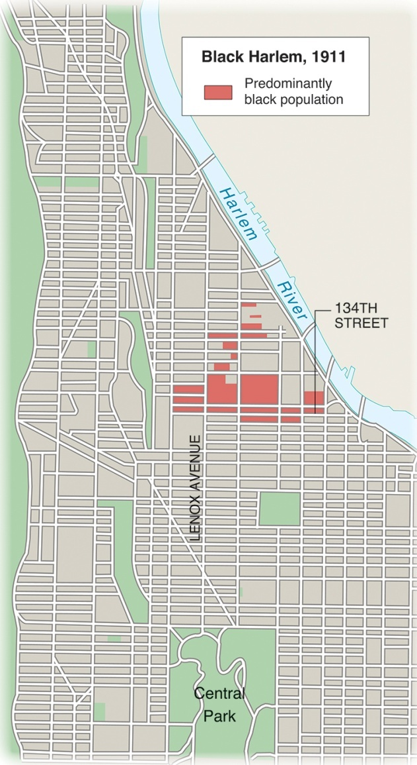
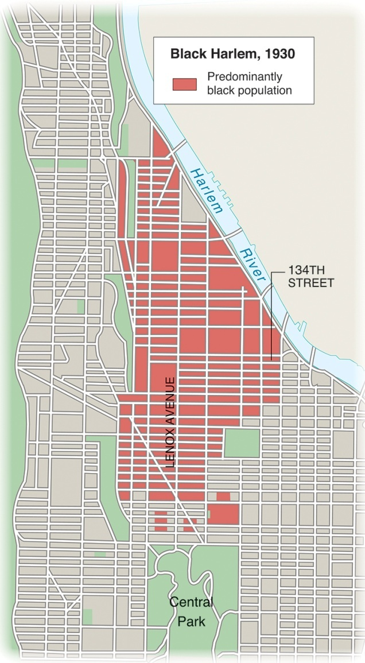
Harlem in the 1920s
MAP 21-2, Harlem in the 1920s

Slide 19
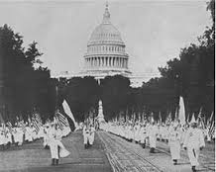
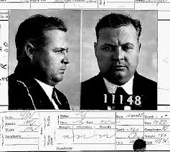
The Ku Klux Klan
1925: Klan membership hit 5 million
Attack on urban culture, inhabitants
Defense of traditional rural values
Klan sought to win U.S. by persuasion
Violence, internal corruption resulted in Klan’s virtual disappearance by 1930

Slide 20
KKK in Indiana
Indiana had one of the biggest Klan organizations in the nation.
The Klan was less violent and more political in Indiana.
They ran state politics in the 1920’s

Slide 21
Eugenics and I.Q. Tests — The Science of Discrimination
The eugenics movement used ideas from evolutionary biology, derived loosely from Charles Darwin, to “prove” that some ethnic groups were more highly evolved than others.
Included various efforts to limit possibilities for those with disabilities such as deafness or limited intelligence— the “unfit”—to procreate.

Slide 22
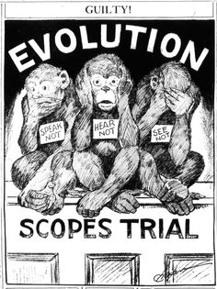
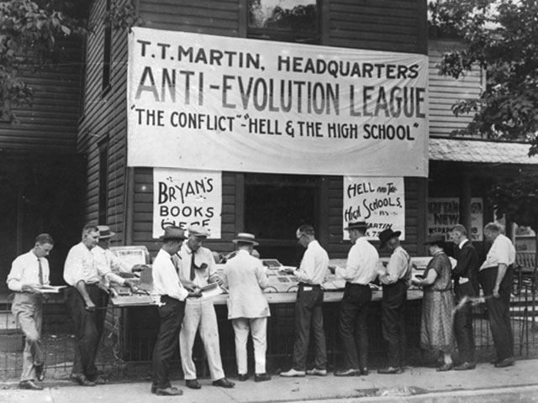
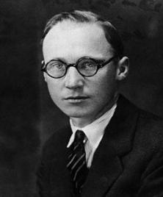
The Fundamentalist Challenge
Fundamentalism: Stress on traditional Protestant orthodoxy, biblical literalism
1925: Scopes Trial discredited fundamentalism among intellectuals
“Modernists” gained mainline churches
Fundamentalists strengthened grassroots appeal in new churches

Slide 23
The Second Industrial Revolution
U.S. developed the highest standard of living in the world
The 1920s and the second revolution
Electricity replaced steam
Modern assembly introduced

Slide 24
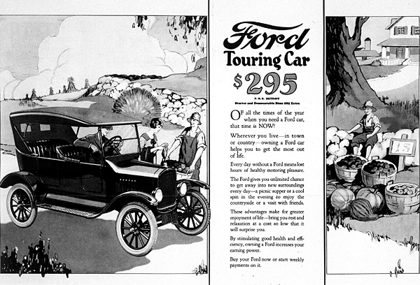
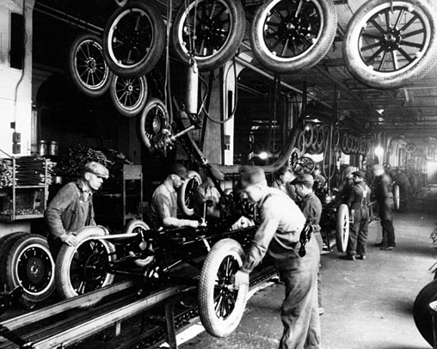
The Automobile Industry
Auto makers stimulated sales through model changes, advertising
Auto industry fostered other businesses
Autos encouraged suburban sprawl

Slide 25
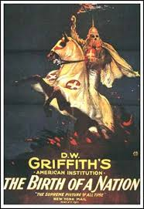
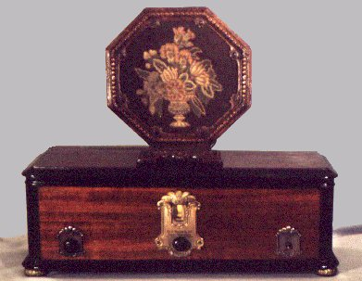
Patterns of Economic Growth
New technologies meant new industries: radio and motion pictures
Structural change
Professional managers replaced individual entrepreneurs
Corporations became the dominant business form
Marketing and national brands spread
Big business weakened regionalism, brought uniformity to America

Slide 26
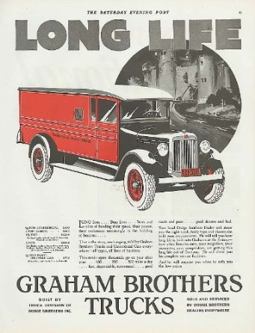
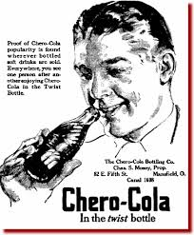
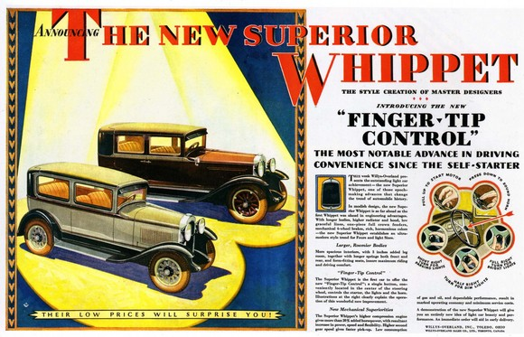
National Advertising

Slide 27
Economic Weaknesses
Railroads poorly managed
Coal displaced by petroleum
Farmers faced decline in exports, prices
Growing disparity between income of laborers, middle-class managers
Middle class speculated with idle money

Slide 28
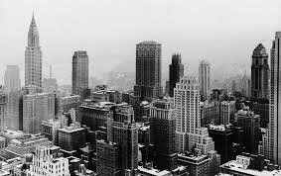
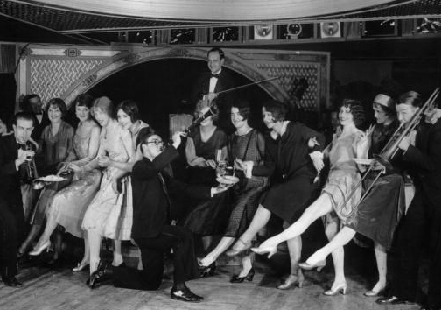
City Life in the Jazz Age
Rapid increase in urban population
Skyscrapers symbolized the new mass culture
Communities of home, church, and school were absent in the cities

Slide 29
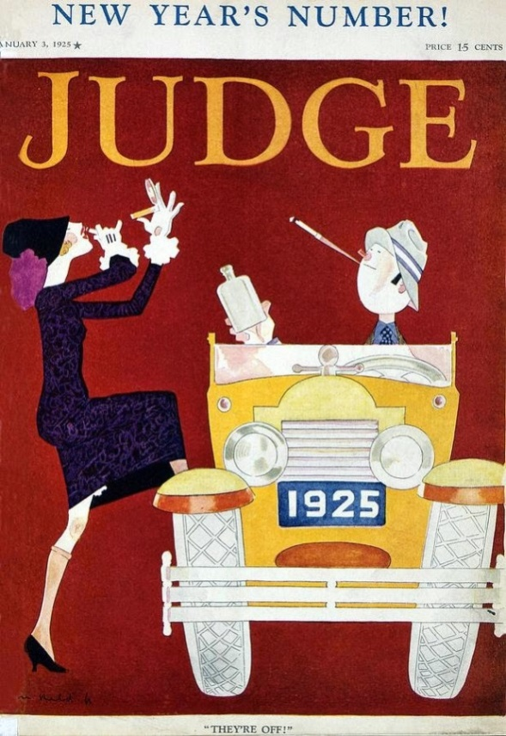
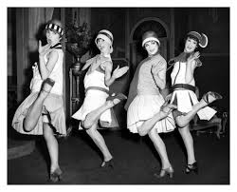
Women and the Family
Ongoing crusade for equal rights
“Flappers” sought individual freedom
Most women remained in domestic sphere
Discovery of adolescence
Teenaged children no longer needed to work
Indulged their craving for excitement

Slide 30
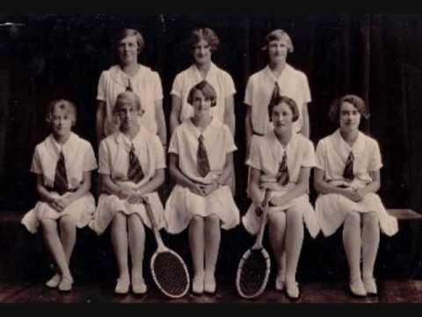
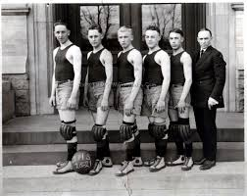
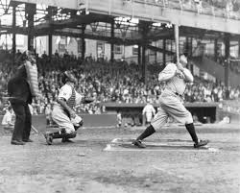
The Roaring Twenties
Sports, like golf and baseball, became much more part of national popular culture
Decade was notable for obsessive interest in celebrities like Charles Lindbergh & Gertrude Ederle
Sex became an all-consuming topic of interest in popular entertainment

Slide 31
The Flowering of the Arts
Alienation from 20s’ mass culture
"Exiled" American writers put U.S. in forefront of world literature
T.S. Eliot
Ernest Hemingway
F. Scott Fitzgerald
Writers like Sinclair Lewis and H.L. Mencken criticized flaws and contradictions of 1920s
Harlem Renaissance: African Americans prominent in music, poetry

Slide 32
Politics of the 1920s
Republican party apparently dominant
Urban wing of the Democratic party emerged as the most powerful force

Slide 33
Harding, Coolidge, and Hoover
Republican presidents appealed to traditional American values
Harding scandals brple after his death
Coolidge represented America in his austerity and rectitude
Hoover represented the self-made man

Slide 34
Republican Policies
Return to "normalcy"
Tariffs raised
Corporate, income taxes cut
Spending cut
Coolidge blocked Congressional aid to farmers as unwarranted interference
Government-business cooperation

Slide 35
The Divided Democrats
1924: Urban-rural split weakened Democrats
Major shift in political loyalties
Democrats gained more Congressional seats than Republicans after 1922

Slide 36
The Election of 1924

Slide 37
The Election of 1928
Democrat Al Smith carried urban vote
Governor of New York
Roman Catholic
Republican Herbert Hoover won race
Midwesterner
Protestant
Religion the campaign’s decisive issue

Slide 39
The Old and the New
Old historical view: The Depression ended the spirit of the twenties
New historical view: The twenties laid the foundations of modern America

