Slide 1
Columbian Exchange
From the Old World
Small Pox (Disease)
Horses
Cattle
Wheat
Pigs
Sugar cane
Sheep
Goats
From the New World
Tobacco
Corn
Potatoes
Syphilis
Turkeys
Beans
Peppers
Tomatoes

Slide 2
Chapter 2
Contact and First Conquest

Slide 3
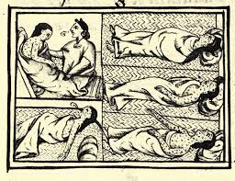
Today’s Topics
Columbian Exchange
Encomienda System
Bartolome’ de Las Casas
Protestant Reformation

Slide 4
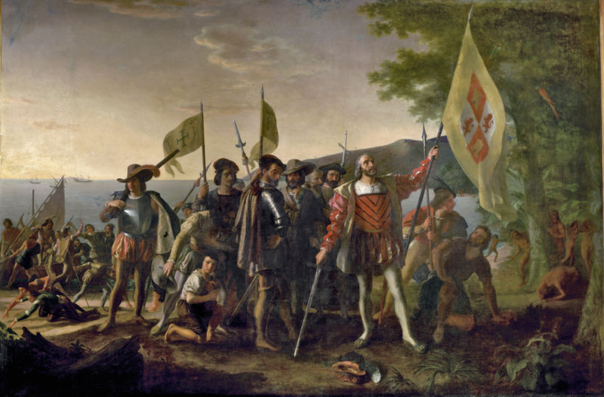
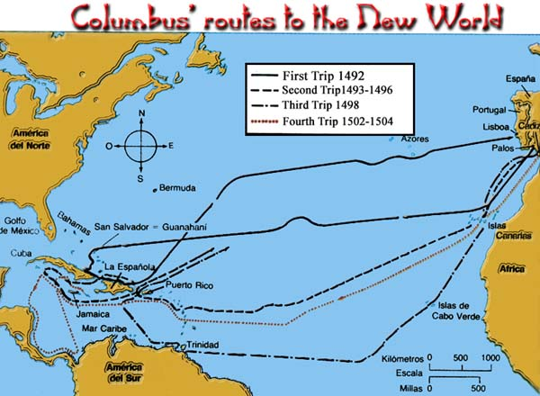
The Four Voyages of Christopher Columbus
Columbus and his crew of 90 men left Spain in August 1492.
They reached land on October 12, 1492.
They made four voyages to the New World between 1492 and 1504.
Treaty of Tordesillas – 1494 the Pope split the new world between Spain and Portugal

Slide 5
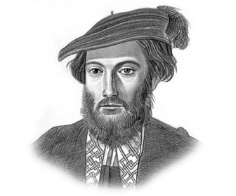
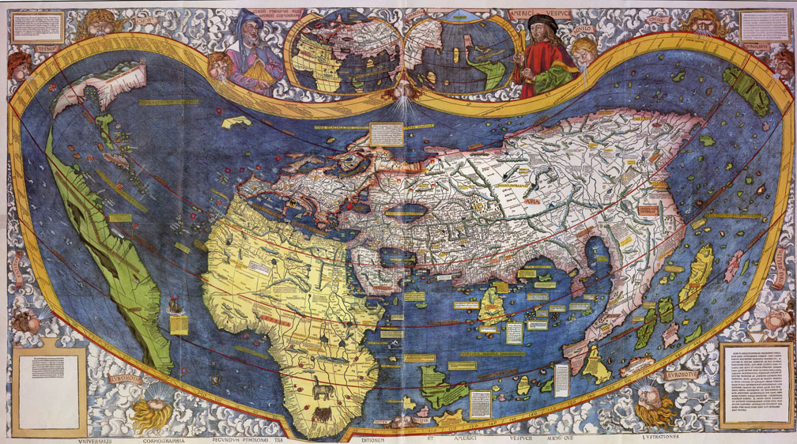
Amerigo gets the naming rights
America is named after explorer Amerigo Vespucci.
Vespucci made three or four trips to the New World.
A German mapmaker named the continent after Amerigo.

Slide 6
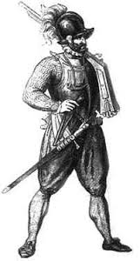
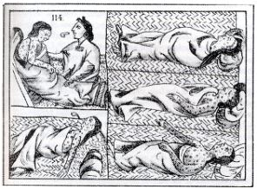
The Impact of European Arms and Disease
The Spanish presence had a devastating effect.
Mexico’s native population decreased from 25 million in 1519 to 1 million in 1619.

Slide 7
The Making of an Ocean World—The Atlantic and Columbian Exchange
The Atlantic Ocean became the great highway connecting known and previously unknown continents.
The Columbian Exchange—the interchange of diseases, plants, animals, and human cultures between New and Old Worlds after 1492.

Slide 8
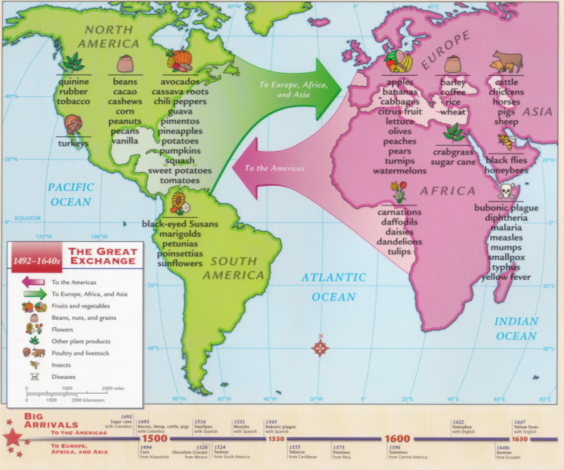

Slide 9
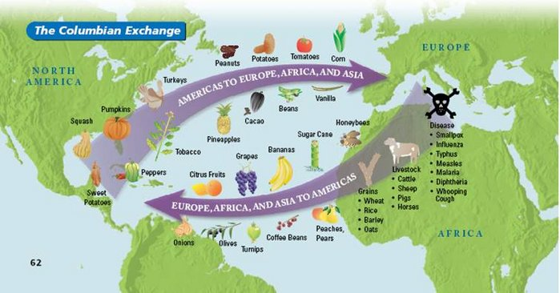

Slide 10
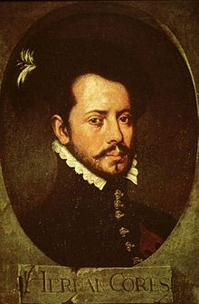
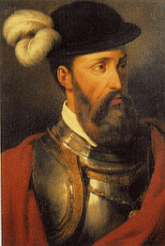
The Conquest of the Aztec and Inca Empires
Hernán Cortés – (1519 and 1522) conquered the Aztec empire
Francisco Pizarro - (1531-1532) wiped out the Inca Empire

Slide 11
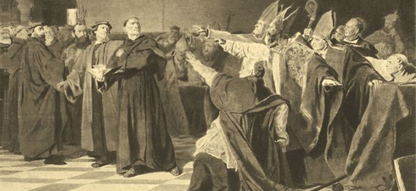
A Divided Europe: The Impact of the Protestant Reformation
The Protestant Reformation changed the way Europeans thought about the world, whether they became Protestant or remained Catholic.

Slide 12
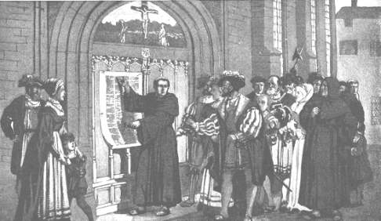
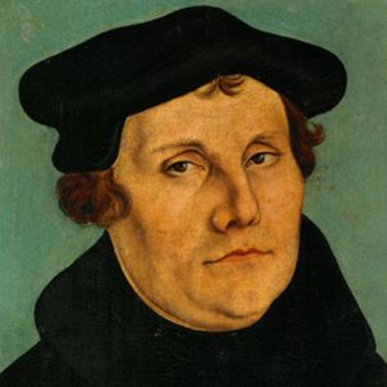
The Birth of Protestantism
Martin Luther (1483–1546)
1517 – Luther posts the 95 Theses on the door of a church in Wittenberg
His action quickly led to a religious split, first in Germany, and then across Europe

Slide 13
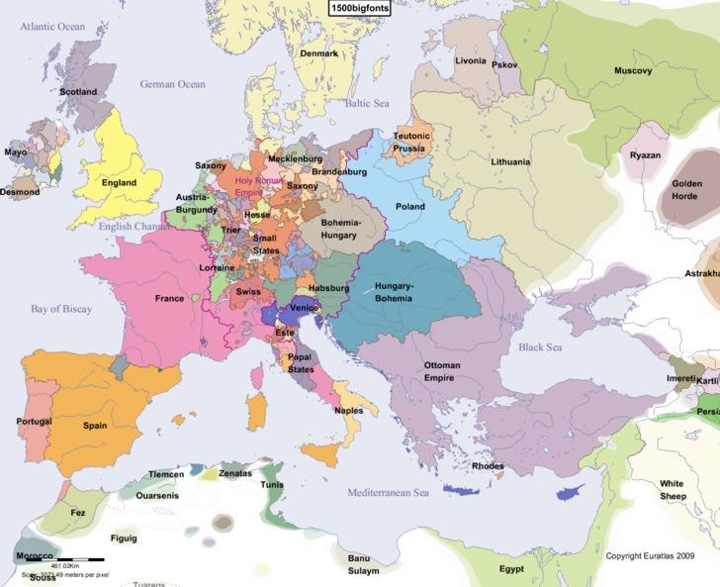
Religion and the Nation-State
The idea of the nation-state developed more or less at the same time as the Protestant–Catholic split.
The modern idea that the world should be governed by nation-states was new in the Europe of the 1500s.

Slide 14
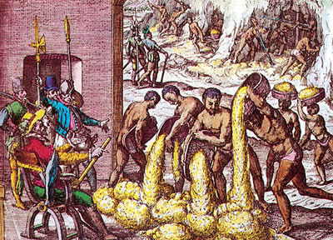
Encomienda System and the shift to Slavery
The Encomienda System was a Spanish system of control over natives.
Royal land grants were given to the Spanish and they got the natives who were on the land.
The Spanish would protect and Christianize the natives in exchange for their forced labor.
Resulted in Spanish getting rich and terrible treatment of the natives
Was eventually replaced by African Slaves. One reason was that Africans were less susceptible to European disease.

Slide 15
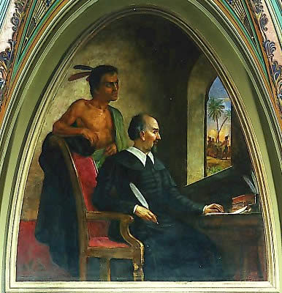
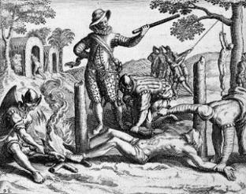
Bartolomé de Las Casas –The Natives Friend
Bartolomé de Las Casas (1484–1566) documented in detail the cruelty of the Spanish conquerors
Las Casas also left an important record of the life and customs of the first peoples of the Americas.

Slide 16
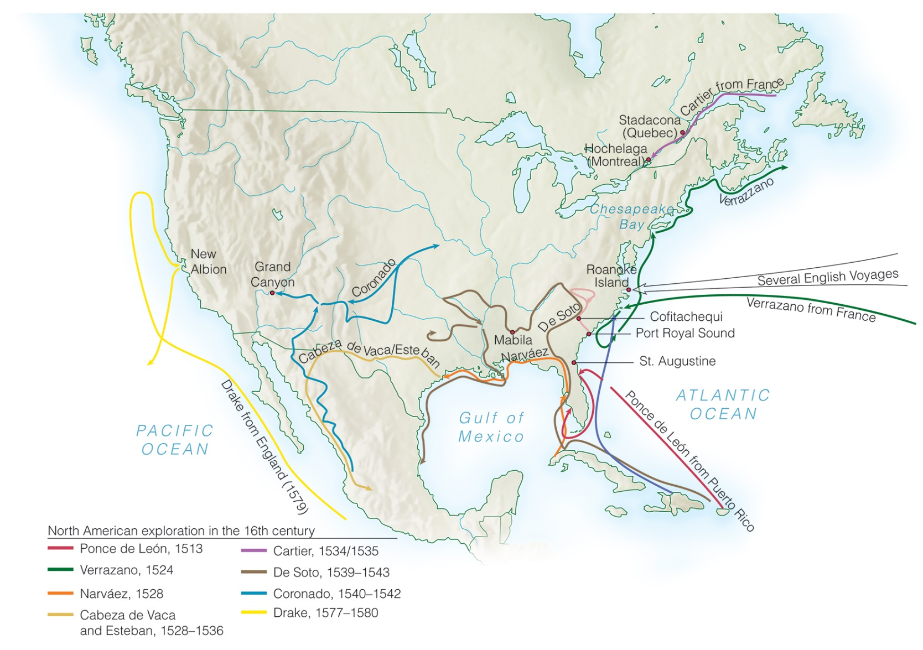
Exploration and Encounter in North America: The Spanish

Slide 17
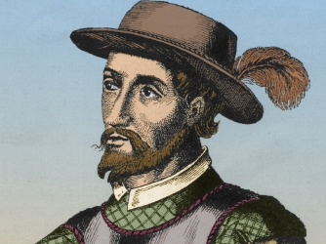
Ponce de León in Florida, 1513–1521
Juan Ponce de León, who had been part of the Spanish army that conquered Muslim Granada in 1492, led the first known European expeditions to Puerto Rico and Florida.
Explored Florida searching for a fabled “Fountain of Youth”

Slide 18
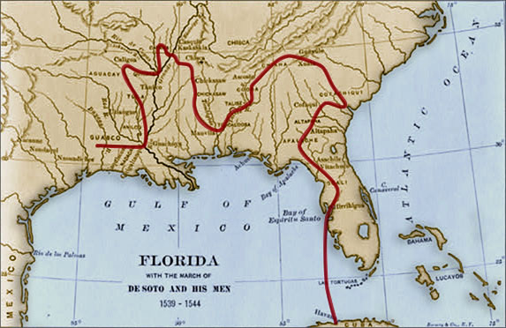
Exploring the Mississippi River Valley: The De Soto Expedition, 1539–1542
In 1539, De Soto sailed to Florida with some 500 to 600 Spaniards and about 100 captive American Indians and Africans
Explored the Southeastern United States and in 1541 crossed the Mississippi River

Slide 19
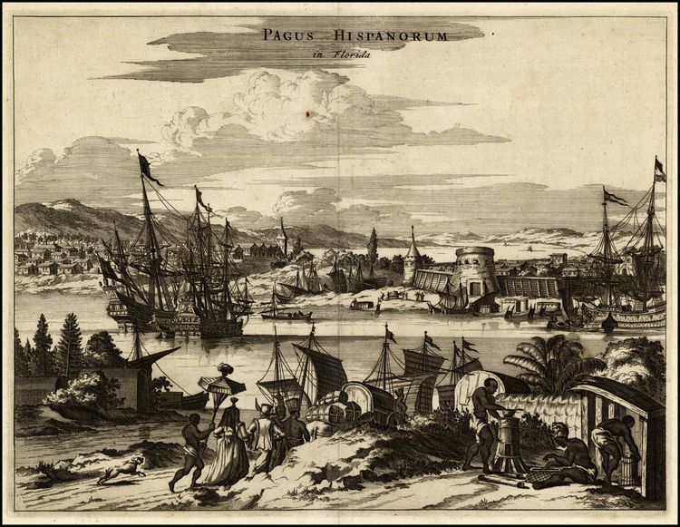
Early Settlements in Florida: Fort Caroline and St. Augustine, 1562–1565
Established St. Augustine, Florida in 1565
The oldest permanently occupied European settlement in what would become the U.S.

Slide 20
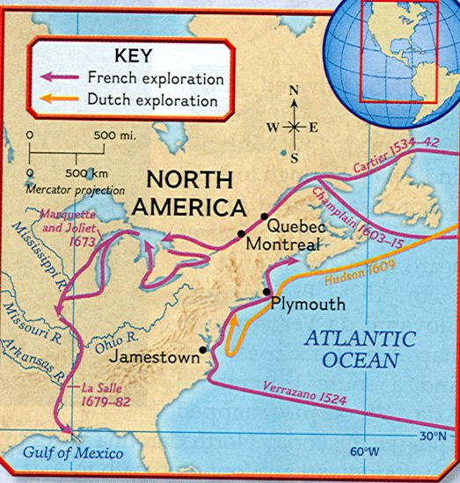
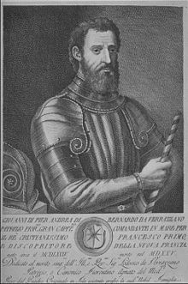
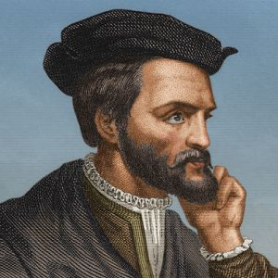
Exploration and Encounter in North America: The French
King Francis I of France (r. 1515–1547) did not want to leave the Americas to Spain or Portugal, which was quickly developing its own empire in Brazil.
1524 - French king sends Giovanni da Verrazzano to America to search for a northwest passage
Verranzano sails along the Atlantic coast
France tries again to find a northern sea route to Asia
1534 - Jacques Cartier sails up the St. Lawrence River to present-day Montreal

Slide 21
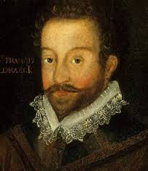
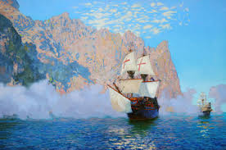
Elizabethan Explorers and Pirates
Francis Drake, perhaps the most famous pirate, was commissioned by Queen Elizabeth.
Drake was an explorer; he voyaged around the globe from 1577 to 1580.
His exploits brought considerable wealth to Queen Elizabeth’s England.

Slide 22
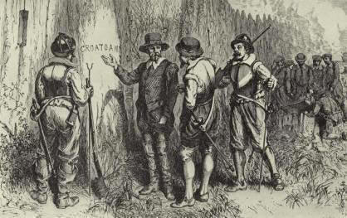
Walter Raleigh and the “Lost Colony” of Roanoke
1587 – Sir Walter Raleigh sends an expedition to settle Roanoke Island off the Carolina coast
Help was not able to return until 1590
When they returned, the colony was gone, vanished.
Only the word “Croatoan” was left, carved in a tree, becomes the “lost colony”

