Slide 1
Chapter 19
Progressive Movements,
Progressive Politics
1879-1917
© 2015 Pearson Education, Inc. All rights reserved.

Slide 2
The Revolt of the Intellectuals
Numerous people in the United States were thinking about how best to respond to the extraordinary changes brought about by immigration, urbanization, and the rapid industrialization of the country.
These upper-class reformers, newspaper reporters, ministers, writers, and college professors proposed new ways of ordering economic and political life.

Slide 3
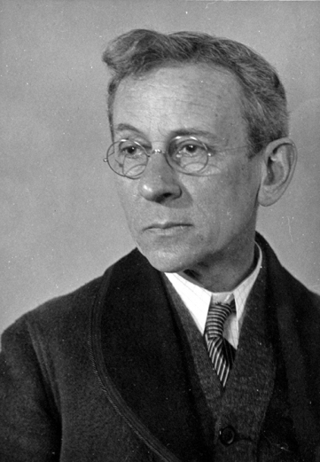
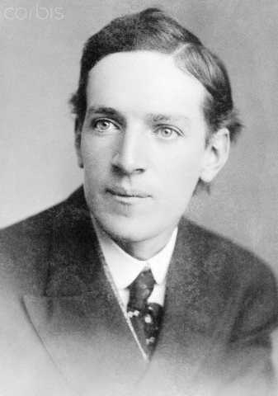
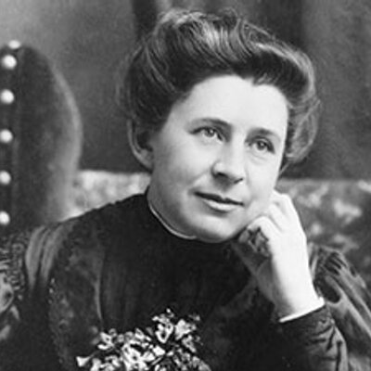
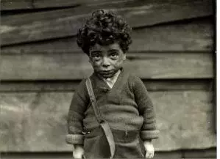
The Muckraking Journalists
Muckrakers – raking through filth
Upton Sinclair – The Jungle (1906)
Ida Tarbell – The History of the Standard Oil Company (1904)
Lewis Hine – child labor Photos

Slide 4
Utopian Idealists
Henry George - Progress and Poverty in 1879
Edward Bellamy - published Looking Backward in 1888
Ignatius Donnelly wrote Caesar’s Column in 1891

Slide 5
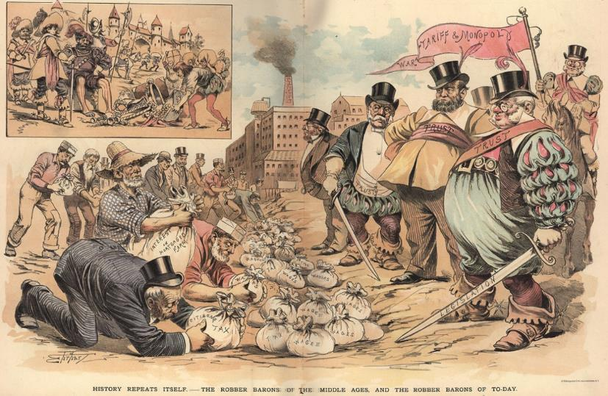
Inequality is Natural
Some opposed the idea of reform.
Supporters of Social Darwinism.
“Survival of the Fittest”
Attempts to reform society were harmful - tampered with the laws of nature

Slide 6
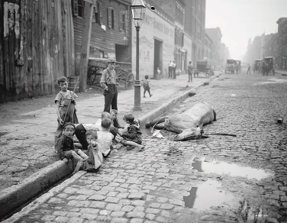
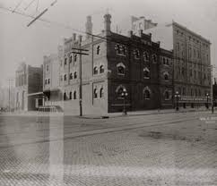
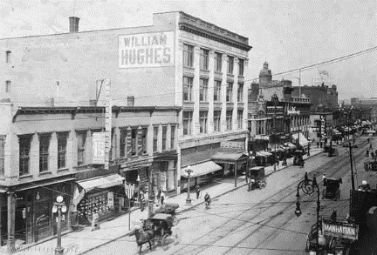
The Transformation of the Cities
Number of people living in cities increases sevenfold from 1860 to 1910.
Department stores, electricity, indoor plumbing, telephones
Immigration & Industrial Development
1920 - the city the center of economic, social, and cultural life

Slide 7
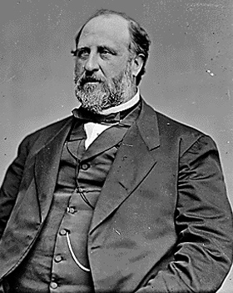
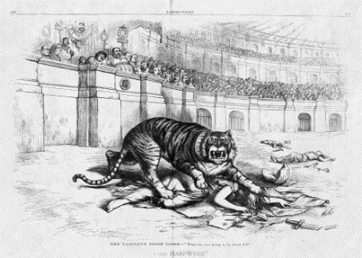
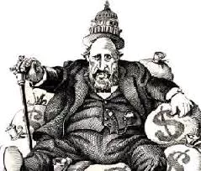
The Rise of Machine Politics and the Progressive Response
Many city governments were incapable of meeting the demands of a growing population.
Machines traded services for votes
Best known was Tammany Hall in New York City
William M. “Boss” Tweed

Slide 8
The Progressive Challenge to City and State Government
Grover Cleveland – From reform mayor of Buffalo to President
Samuel M. Jones, known as “Golden Rule Jones”
Initiative, referendum, & recall; secret ballot

Slide 9
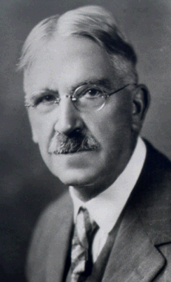
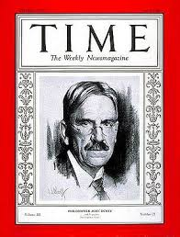
Progressive Education
In 1899, John Dewey wrote The School and Society.
These child-centered progressives wanted to shift the emphasis in schools from the curriculum to the needs of the child.

Slide 10
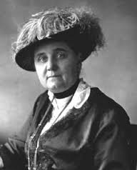
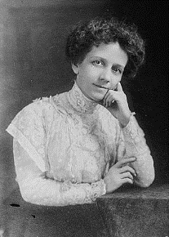
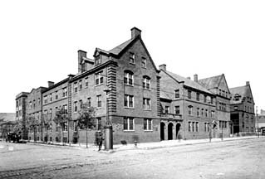
Jane Addams and the Settlement House Movement
Settlement Houses - Jane Addams’ Hull House in Chicago
Professional Social Workers
Hull House did more than provide services to the poor.
It also took the side of the poor in labor and legal disputes.

Slide 11
Religious Responses to the Gilded Age
In the late 1800s, reform movements seeking to improve the lives of working people, bring an end to municipal corruption, and build a just economic order often took on the language and style of evangelical religion.

Slide 12
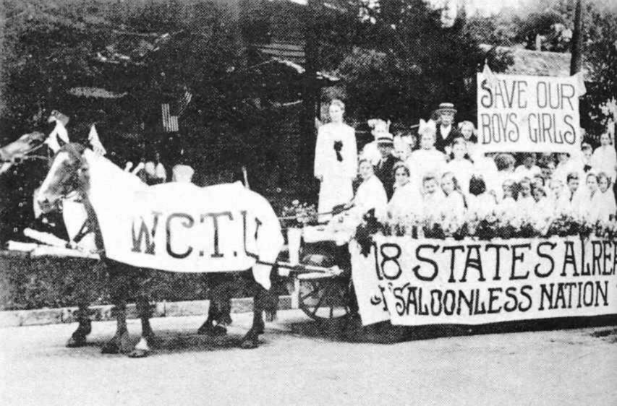
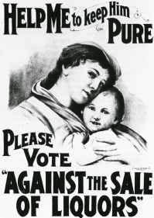
Temperance and the Woman’s Christian Temperance Union
Certainly no political renewal movement was more rooted in Protestant Christianity than the women’s campaign against alcohol that began in the 1870s.
Woman’s Christian Temperance Union (WCTU) – Frances Willard

Slide 13
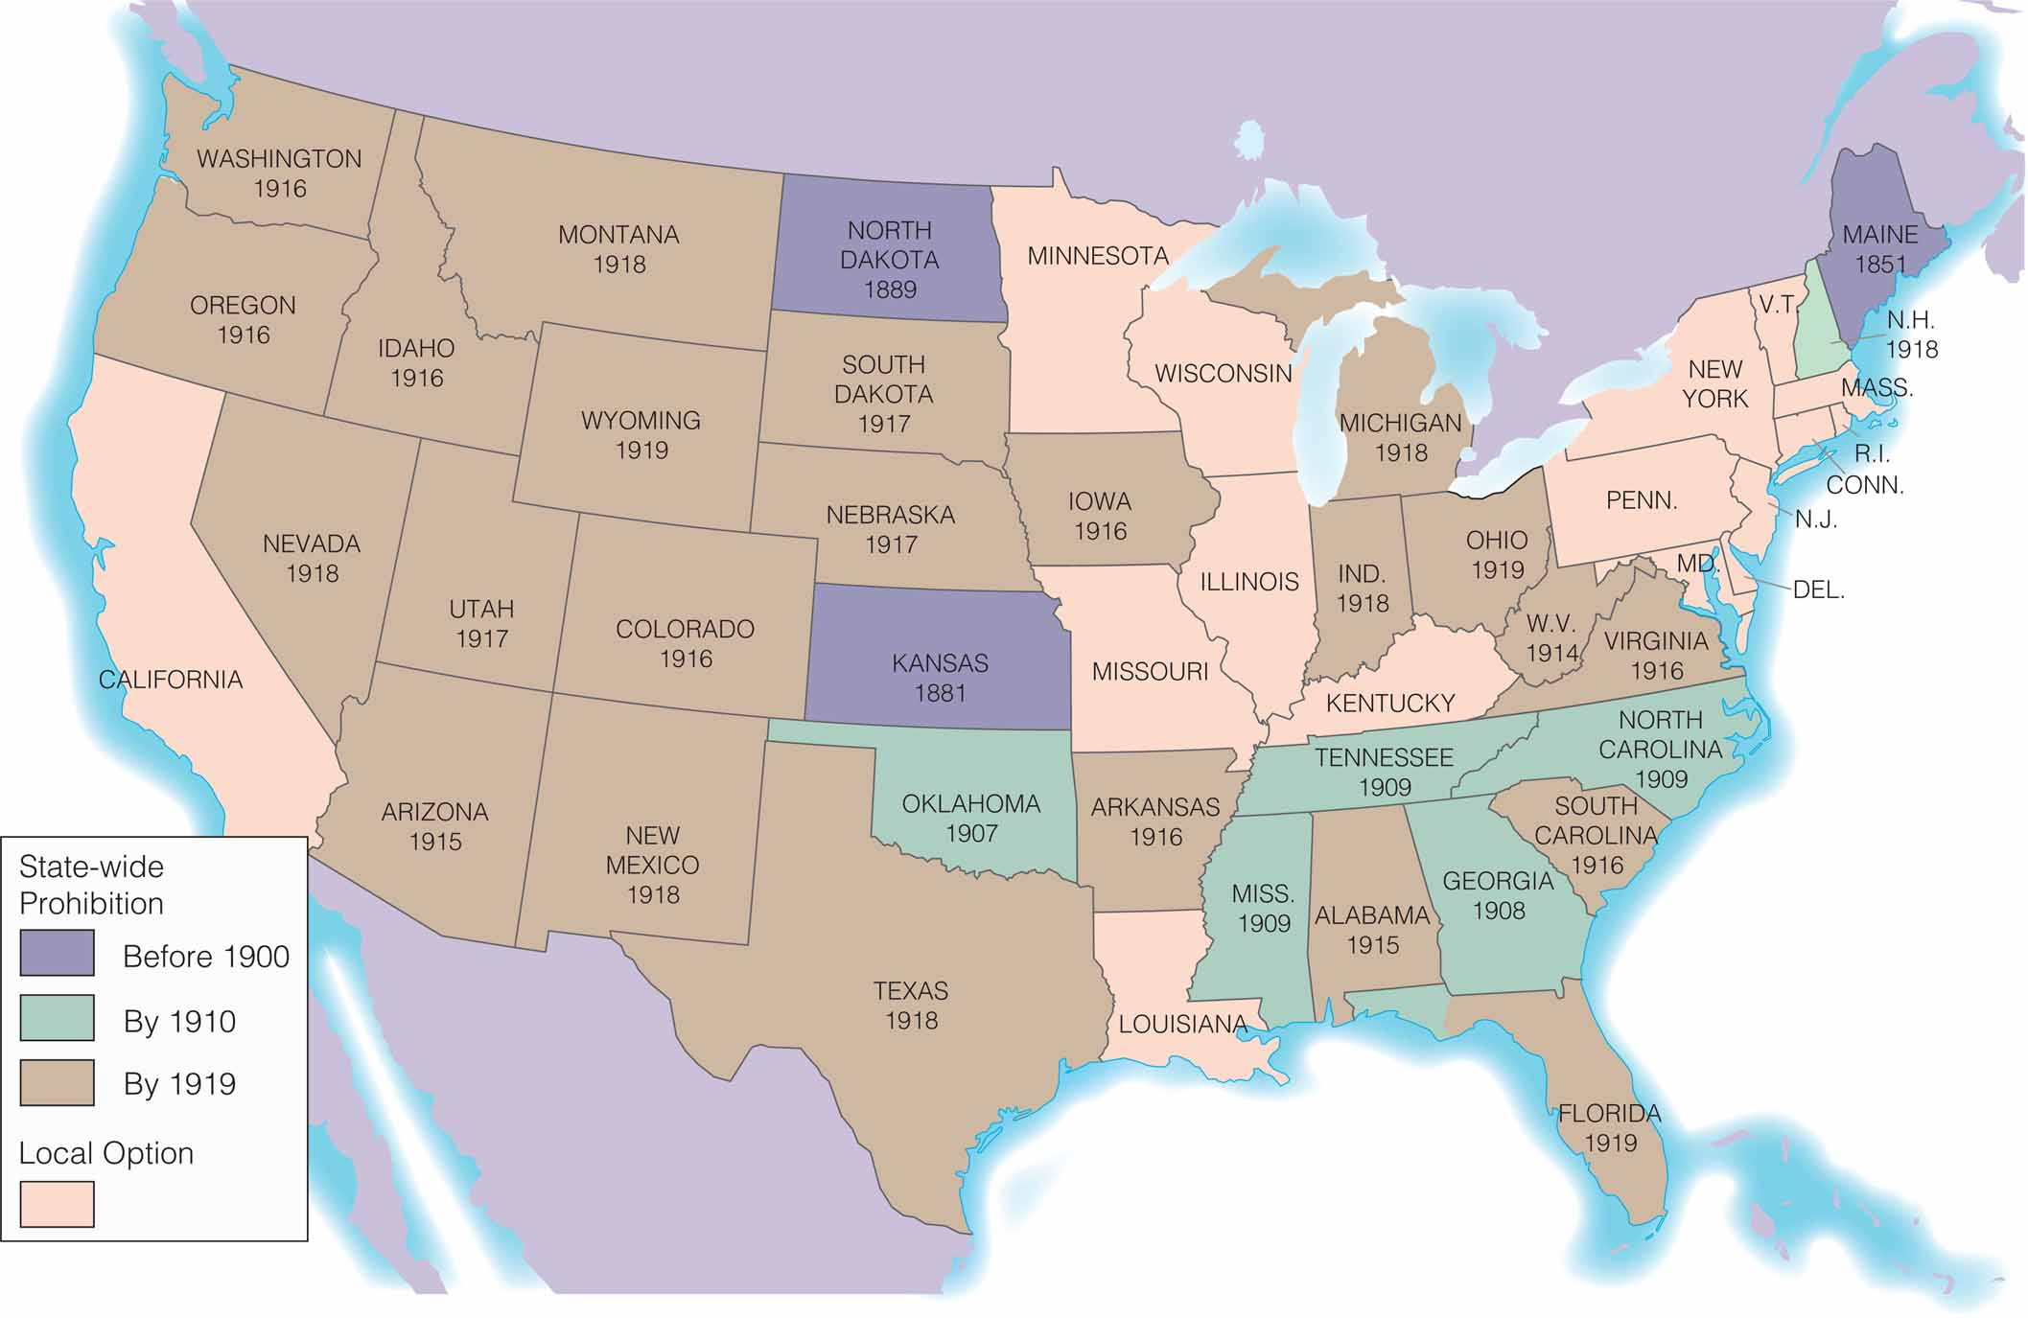
Prohibition in the States

Slide 14
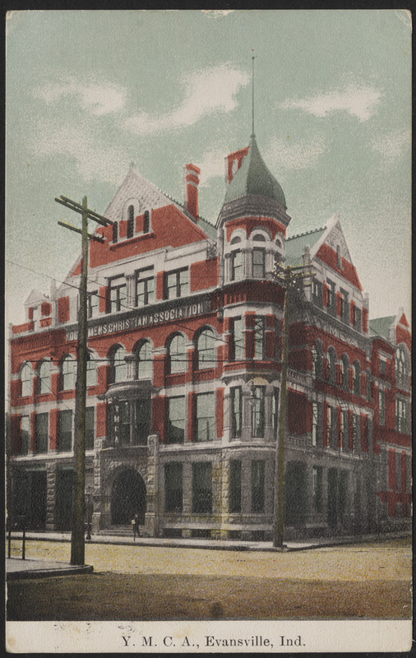
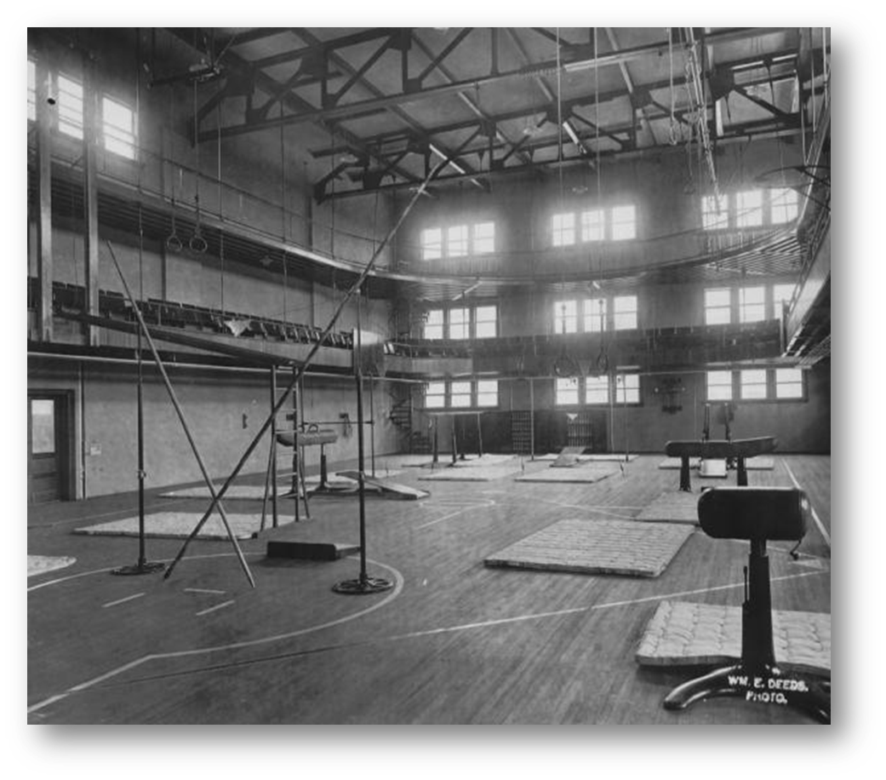
The Social Gospel
Social Gospel,
based on the idea that improving society was both the right thing for religious people to do and God’s will
Josiah Strong - Our Country, pleading for missionary work within American cities and around the world

Slide 15
Progressive Politics on the National Stage
U.S. Presidents from Roosevelt to Wilson would also mould public opinion on Progressivism.
Theodore Roosevelt – becomes the youngest president in American history

Slide 16
Roosevelt Presidency
Became President in 1901
Model of future presidents
Federal responsibility for national welfare
“Bully Pulpit”

Slide 17
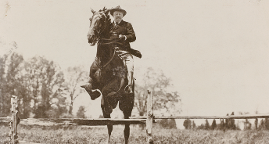
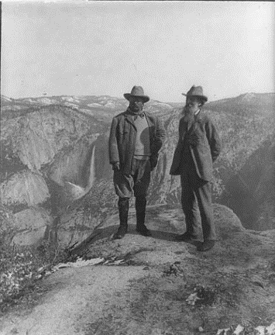
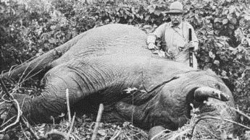
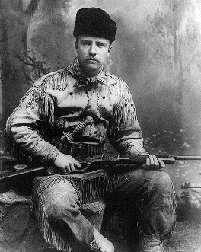
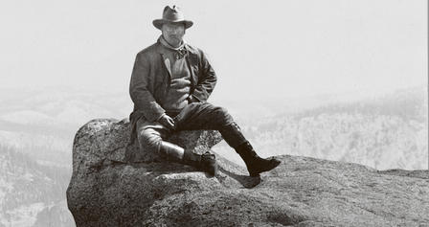
The Republican Roosevelt
Often defied convention
Brought an exuberance to the presidency
Surrounded himself with able associates

Slide 18
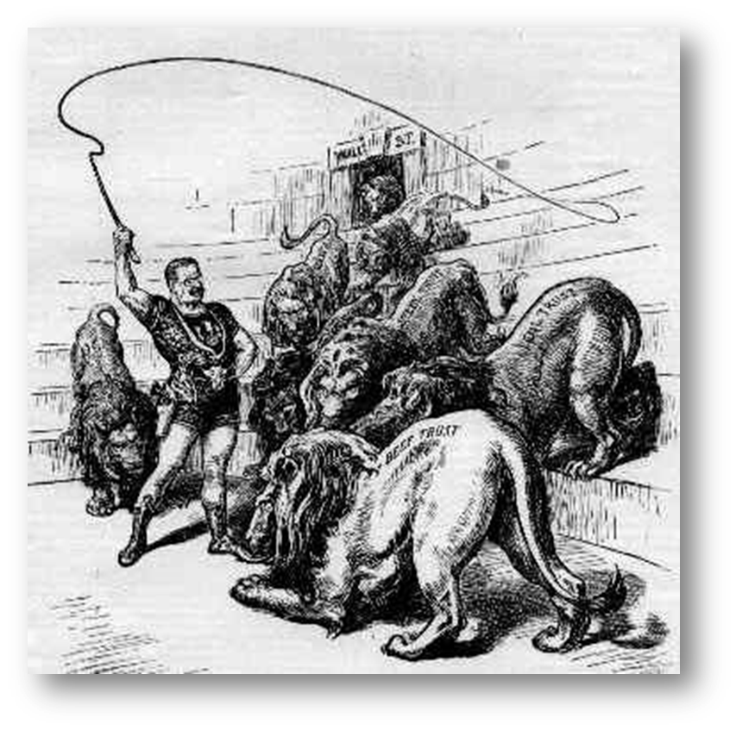
Busting the Trusts
1902: Wave of trust-busting led by suit against Northern Securities Company
1904: Northern Securities dissolved
Roosevelt reputed a "trust-buster"
Comparatively few antitrust cases under Roosevelt, Taft did almost twice as many in half the time

Slide 19
Conserving the Land
First comprehensive national conservation policy
Roosevelt worked with Gifford Pinchot, chief of Forest Service
Policy defined “conservation” as wise use of natural resources
Quadrupled acreage under federal protection

Slide 20
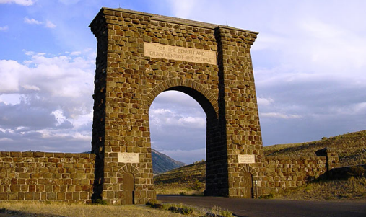
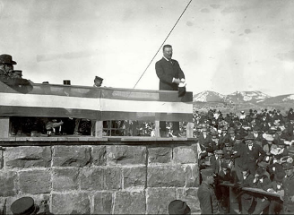
TR’s message about National Parks
http://www.pbs.org/nationalparks/watch-video/#786

Slide 21
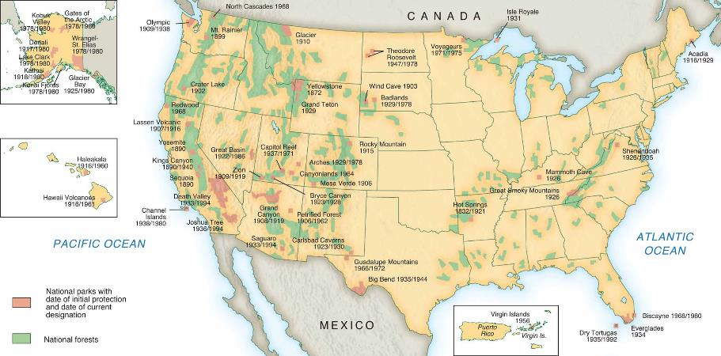
Teddy Roosevelt—Progressive President
Roosevelt added 50 wildlife refuges, 5 national parks, and a system of designating national monuments.

Slide 22
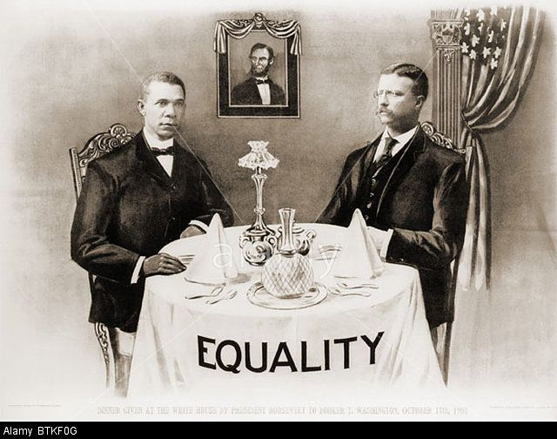
Roosevelt and African-Americans
Invited Booker T. Washington to dinner at the White House.
Roosevelt had a decidedly mixed record on African-American concerns.
In symbolic ways, Roosevelt did more to support African-Americans than several of his predecessors or successors.

Slide 23
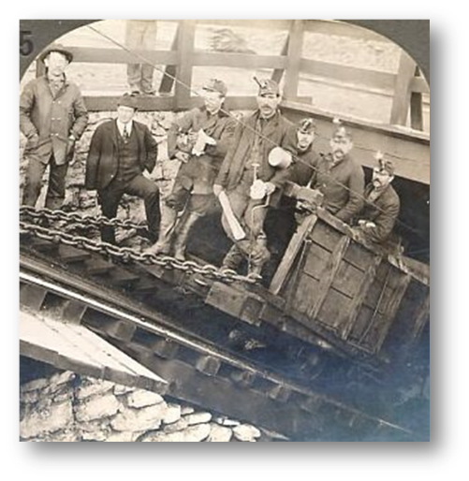
"Square Deal" in the Coalfields
1902: United Mine Workers strike in Pennsylvania threatened U.S. economy
U.M.W., companies to White House
Roosevelt won company concessions by threatening military seizure of mines
Roosevelt acted as broker of interests

Slide 24
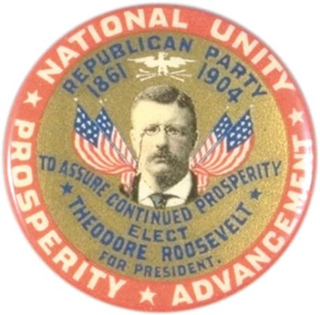
Roosevelt Progressivism at Its Height
1904—A four-way election
Republican—Theodore Roosevelt
Democrat—Alton B. Parker
Socialist—Eugene V. Debs
Prohibition—Silas C. Swallow
Roosevelt won 57% of popular vote, 336 electoral votes

Slide 25
The Election of 1904

Slide 26
Regulating the Railroads
1903: Elkins Act prohibited railroad rebates, strengthened Interstate Commerce Commission
Widespread popular demand for further railroad regulation after Roosevelt’s reelection
1906: Hepburn Act further strengthened Interstate Commerce Commission
Membership from five to seven
May fix reasonable maximum rates
Jurisdiction broadened to include oil pipeline, express, sleeping car companies

Slide 27
Cleaning Up Food and Drugs
Upton Sinclair’s The Jungle (1906) prompted federal investigation of meatpacking industry
1906: Meat Inspection Act
Sets rules for sanitary meatpacking
Requires government inspection of meat products
1906: Pure Food and Drug Act
Required manufacturers to list certain ingredients
Banned manufacture and sale of adulterated drugs

Slide 28
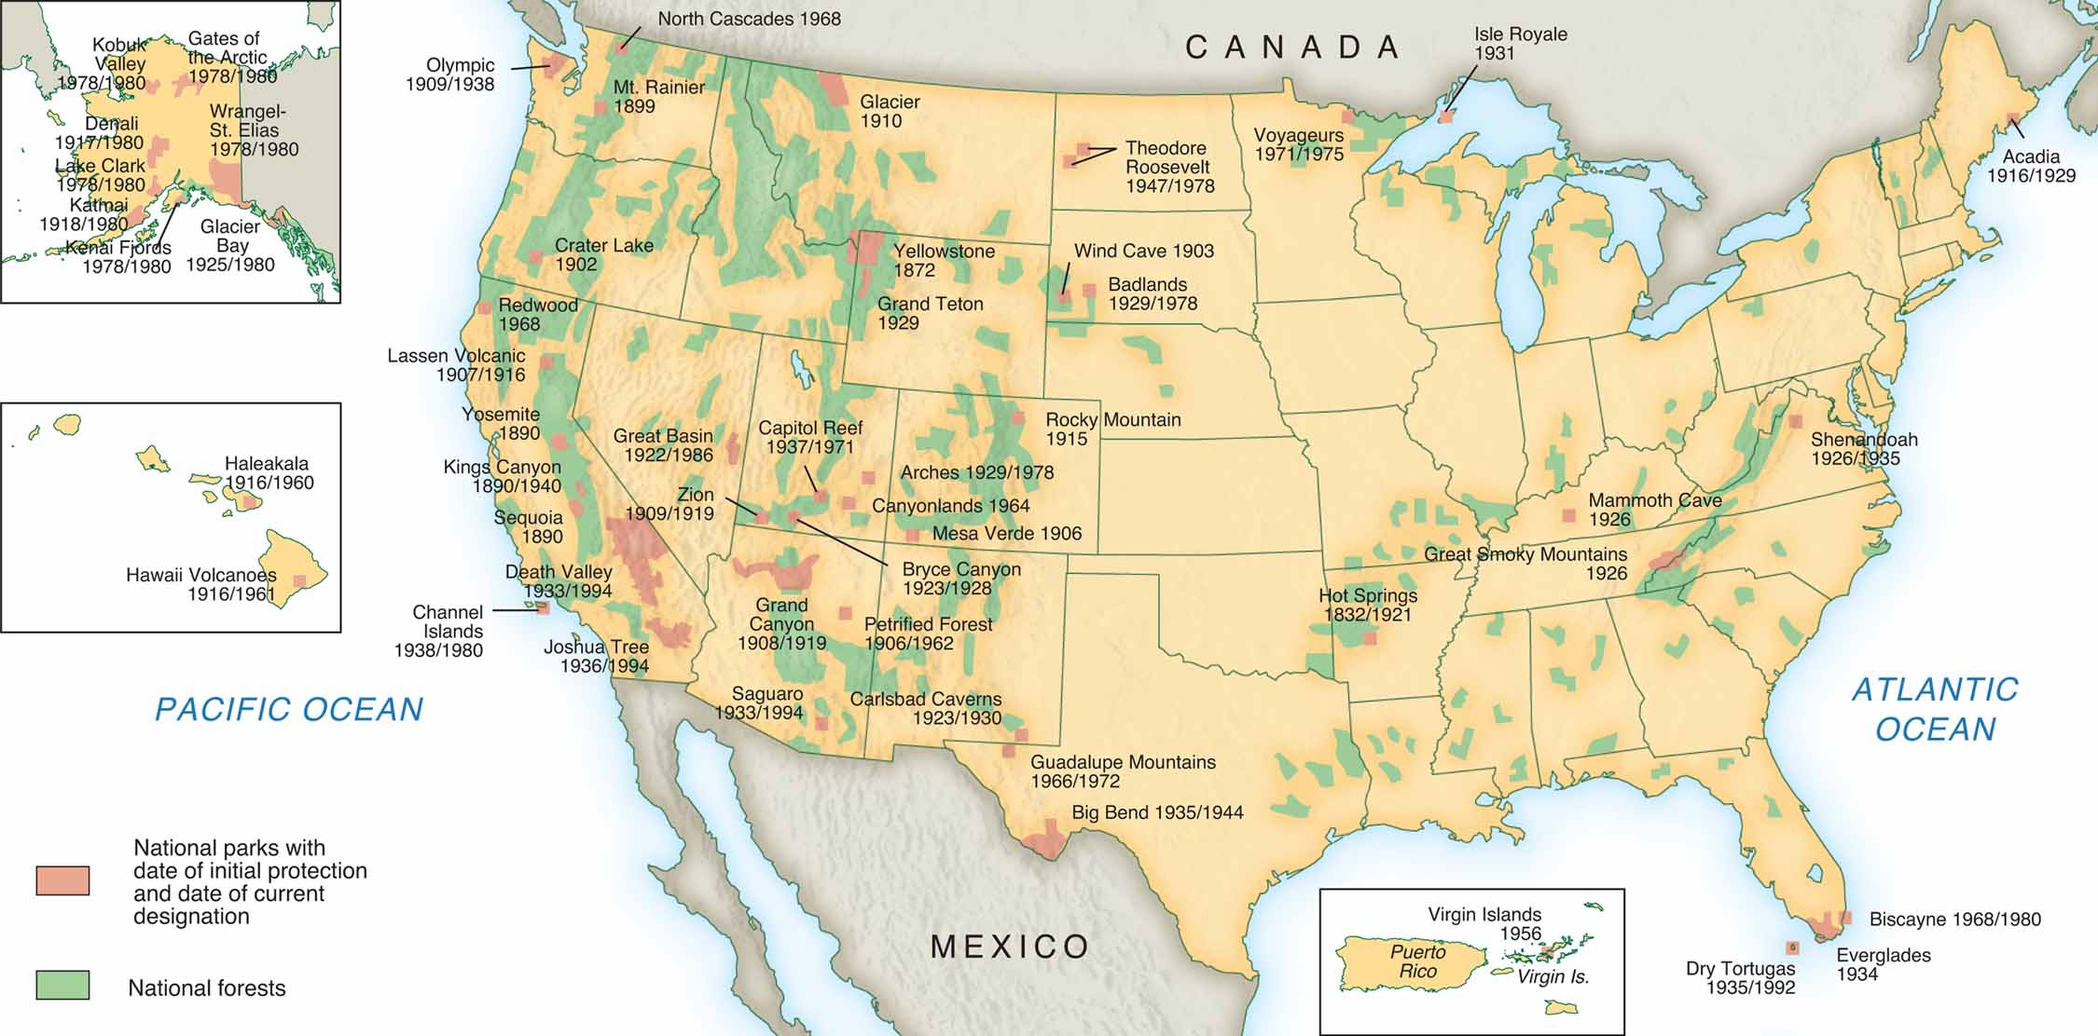
Major National Parks
MAP 19-2, Major National Parks

Slide 29
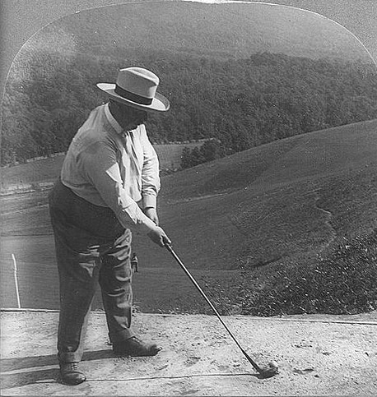
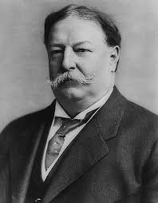
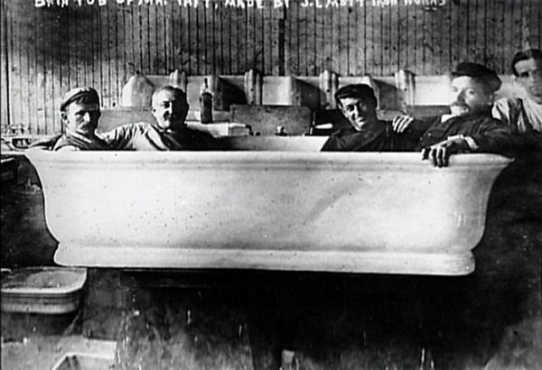
The Ordeal of William Howard Taft
Taft: Abled administrator, poor president
Conservative Republicans resurged
Taft lost support of Progressives

Slide 30
The Election of 1908

Slide 31
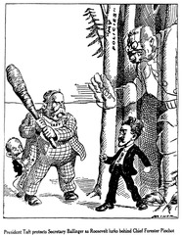
The Ballinger-Pinchot Affair
Gifford Pinchot leading conservationist, Roosevelt appointee
Pinchot accused Interior Secretary Richard Ballinger of selling public lands to friends
Taft fired Pinchot
Progressives antagonized

Slide 32
Taft Alienates the Progressives
1910: Taft successfully pushed Mann-Elkins Act to strengthen ICC
Empowers ICC to fix railroad rates
Progressive Republicans attacked Taft’s plan of a Commerce Court to hear ICC appeals
Progressives obstructed Taft’s negotiations
1910: Taft attacked Progressive Republicans, Democrats gained Congress

Slide 33
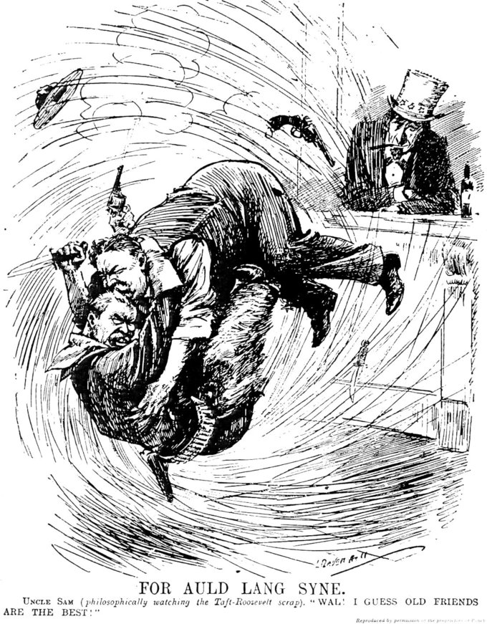
Taft Alienates the Progressives
Legislation protecting laborers
Sixteenth Amendment created income tax
Taft a greater trustbuster than Roosevelt
Taft, Roosevelt attackd one another publicly
1912: Taft renominated by Republicans, little chance for victory

Slide 34
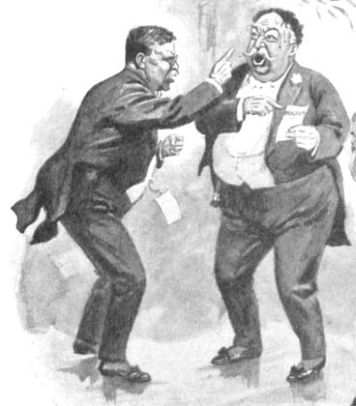
Party Insurgency
Tariff split Republicans
Progressives: high tariff favored trusts
Conservatives: high tariff protected business
1909 Payne-Aldrich Act provoked Progressives to break with Taft
http://archives.nbclearn.com/portal/site/k-12/browse?cuecard=5129

Slide 35
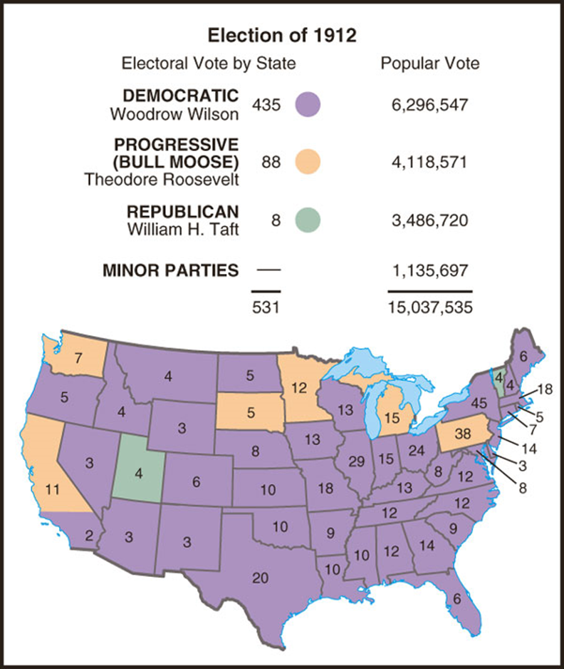
Differing Philosophies in the Election of 1912
Roosevelt: Progressive ("Bull Moose")
“New Nationalism”
Federal regulation of economy
Wasteful competition replaced by efficiency
Woodrow Wilson: Democrat
"New Freedom" for individual
Restrain big business, government

Slide 36
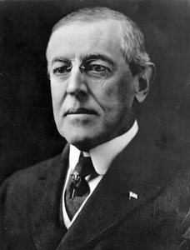
Woodrow Wilson's New Freedom
Woodrow Wilson: Former president of Princeton, governor of New Jersey
Progressive, intellectual, inspiring orator – Wilson Lovers
Arrogant, petty, racist, hopeless romantic – Wilson Haters

Slide 37
Woodrow Wilson’s New Freedom
Implemented his “New Freedom” program
Pledges of antitrust modification, tariff revision, and reform in banking and currency matters
Wilson failed miserably in race relations.
Wilson a staunch white supremacist
Allowed segregation in federal government offices, also anti-immigrant

Slide 38
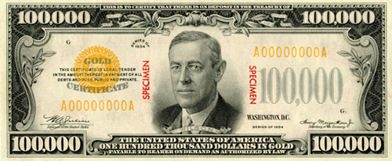
The New Freedom in Action
1913: Underwood Tariff cut duties
1913: Federal Reserve Act reformed banks, established stable currency
1914: Clayton Antitrust Act outlawed unfair trade practices, protected unions
1914: Federal Trade Commission

Slide 39
New Freedom in Action: Retreating from Reform
November, 1914: Wilson announces "New Freedom" has been achieved
It was “a time of healing because a time of just dealing”
Statement stunned many progressives

Slide 40
Wilson Moves Toward the New Nationalism
Reasons for the move
Distracted by the outbreak of war in Europe
Needed conservative Southern support
Republicans seemed to gain by attacking his programs
1916: Presidential election

Slide 41
Wilson Moves Toward the New Nationalism
Wilson renewed reform in reelection bid
Federal Farm Loan Act
Intervened in strikes on behalf of workers
Attempted to ban child labor
Increased income taxes on the rich
Supported women’s suffrage
Program won Wilson a close election

Slide 42
The Fruits of the Progressivism
Reform of government at all levels
Intelligent planning of reform
World War I ends Progressive optimism

Slide 43
Period 6 LEQ
Evaluate the extent to which the Progressive Era (1890–1920) marked a turning point in the history of women in the United States, analyzing what changed and what stayed the same from the period immediately before the Progressive Era to the period during and immediately after it.

