Slide 1
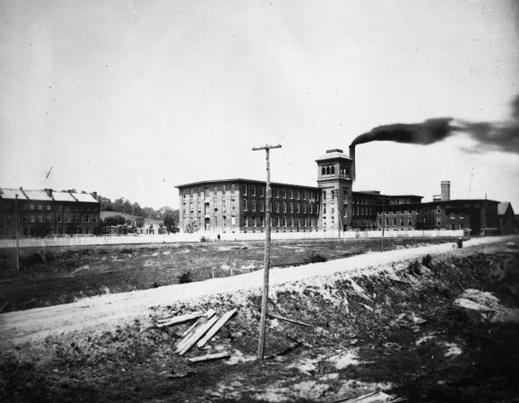
Chapter 17
The Gilded Age: Building a Technological and Industrial Giant and a New Social Order
1876-1913
© 2015 Pearson Education, Inc. All rights reserved.

Slide 2
Steps to an Industrial Power

Slide 3
Industrial Development
Late nineteenth-century U.S. offers ideal conditions for rapid industrial growth
Abundance of cheap natural resources
Large pools of labor
Largest free trade market in the world
Capital, government support without regulation
Rapid growth 1865–1914
Notes:
2

Slide 4
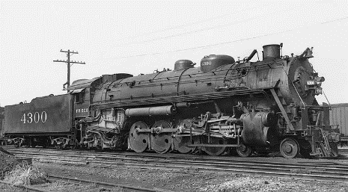
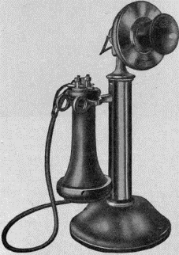
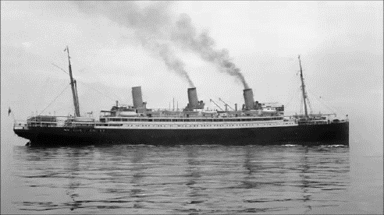
An Empire on Rails
U.S. industrial economy based on expansion of the railroads
Steamships made Atlantic crossings twice as fast
The telegraph and telephone transformed communications
Notes:
3

Slide 5
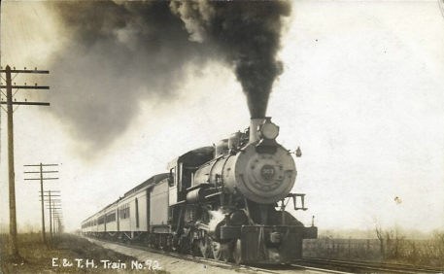
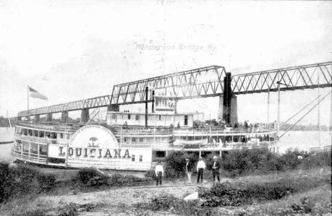
"Emblem of Motion and Power"
Railroads transform American life
End rural isolation
Allow regional economic specialization
Make mass production, consumption possible
Lead to organization of modern corporation
Stimulate other industries
Railroads capture the imagination of the American people
Notes:
4

Slide 6
Building the Empire
1865–1916: U.S. lays over 200,000 miles of track costing billions of dollars
Expenses met by government at all levels
Federal railroad grants prompt corruption
1850–1945: Railroads save government $1 billion in freight costs
Notes:
5

Slide 7
Federal Land Grants to Railroads as of 1871

Slide 8
Railroad Construction, 1830–1920

Slide 9
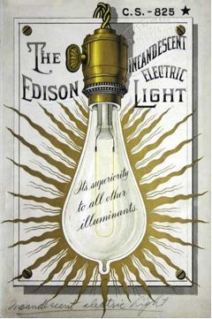
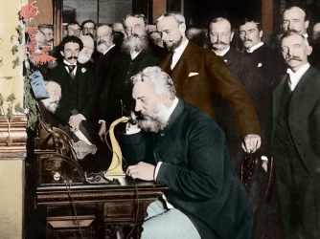
Corporations and Monopolies
Inventions appearing in the 1880s and 1890s, like the earlier railroads and telegraph systems, could not be produced by a family business
New corporate structures emerged

Slide 10
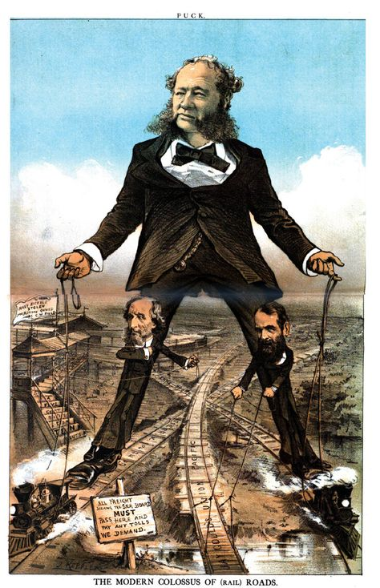
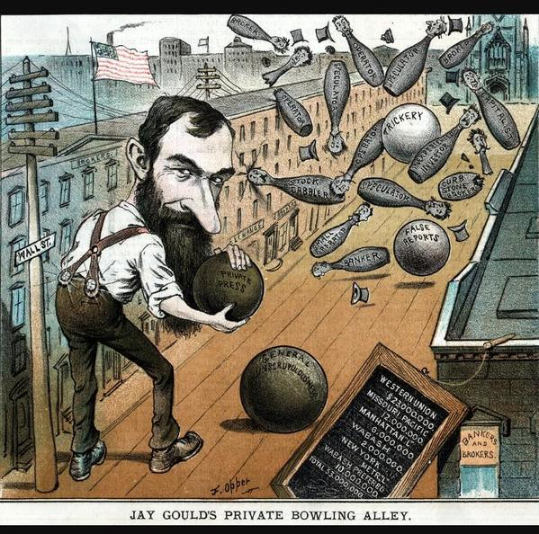
Financing and Controlling the Railroads—Jay Cooke, Cornelius Vanderbilt, and Others
First “big business” - first major corporation
Large scale organization and decision making
Needed to standardize rail networks
Prominent players: Jay Gould and Cornelius “the Commodore” Vanderbilt
New technologies

Slide 11
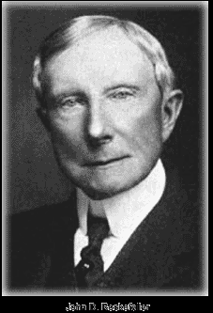
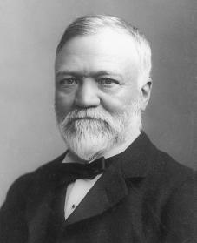
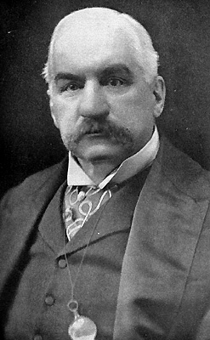
New Industries: Rockefeller’s Oil, Carnegie’s Steel, and Morgan’s Banking
Rockefeller’s Standard Oil gained almost complete control of the oil industry
Andrew Carnegie began buying up steel companies and formed Carnegie Steel Co.
J. P. Morgan - Investment banker, purchased railroads and Carnegie’s steel company

Slide 12
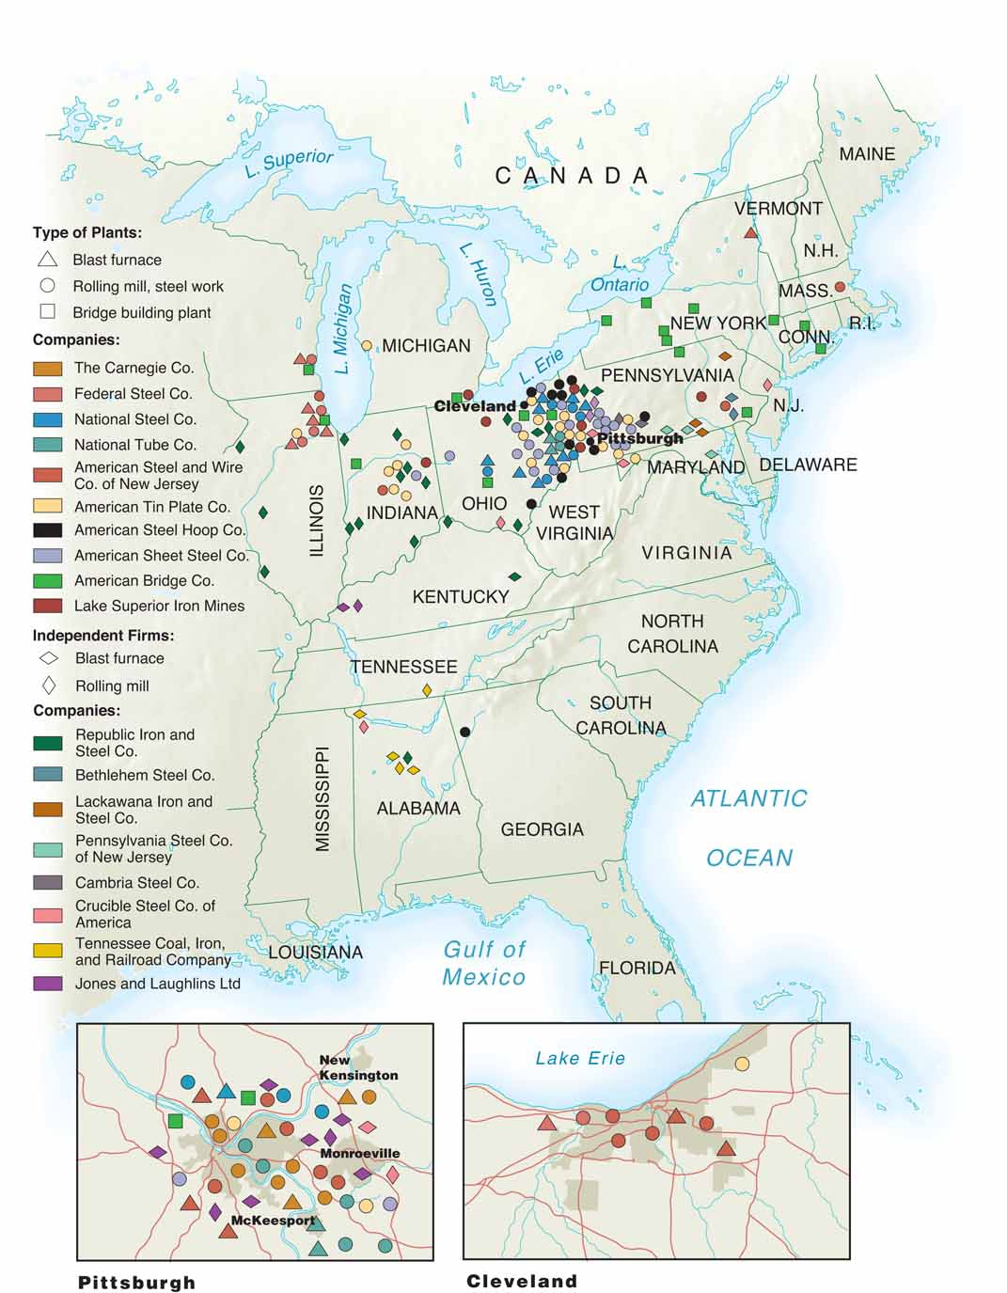
The Nation’s Industrial Heartland

Slide 13
Lives of the Middle Class In the Gilded Age
During the Gilded Age, what came to be known as middle-class values emerged in the United States
Many Americans achieved a level of comfort and social respectability that had never been experienced before

Slide 14
Middle-Class Life and Expectations
Celebrate holidays
Design their own homes
New buildings and parks
Urban planners
Begin to move to the suburbs

Slide 15
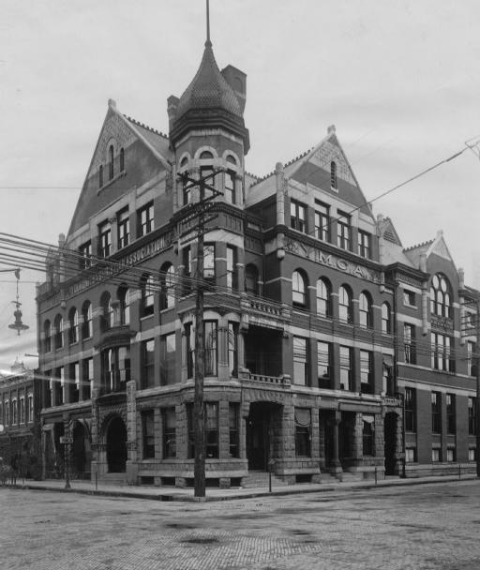
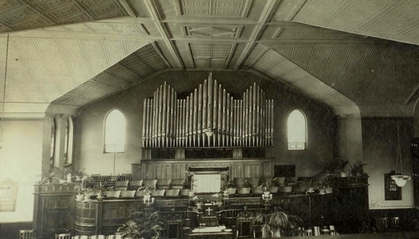
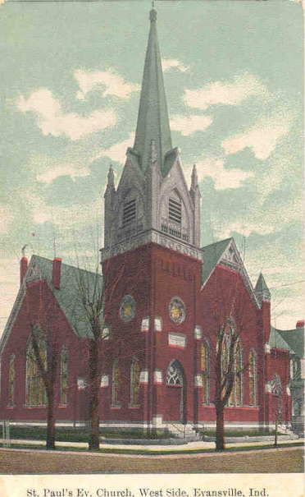
Gilded Age Religion
White and Protestant
YMCA
Bible training schools
Preachers act like businessmen
Popular hymns

Slide 16
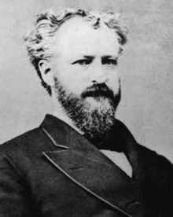
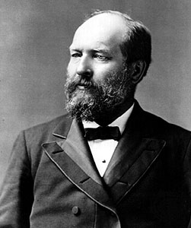
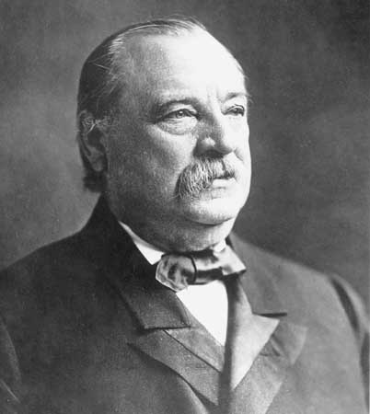
Electoral Politics
“Stalwarts” - keep things the same
“Half-breeds” - wanted change, reform
“Mugwumps” - liberal reformers focused on honest government

Slide 17
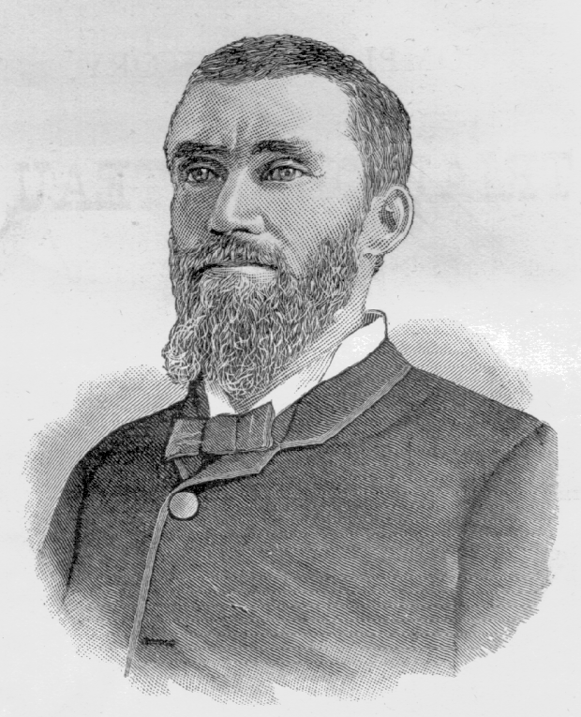
Would you hire this man?

Slide 18
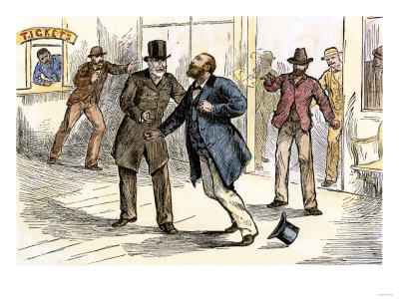
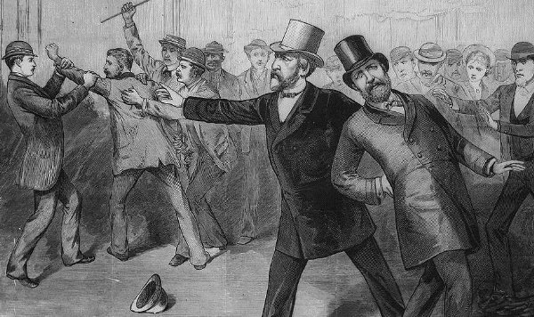
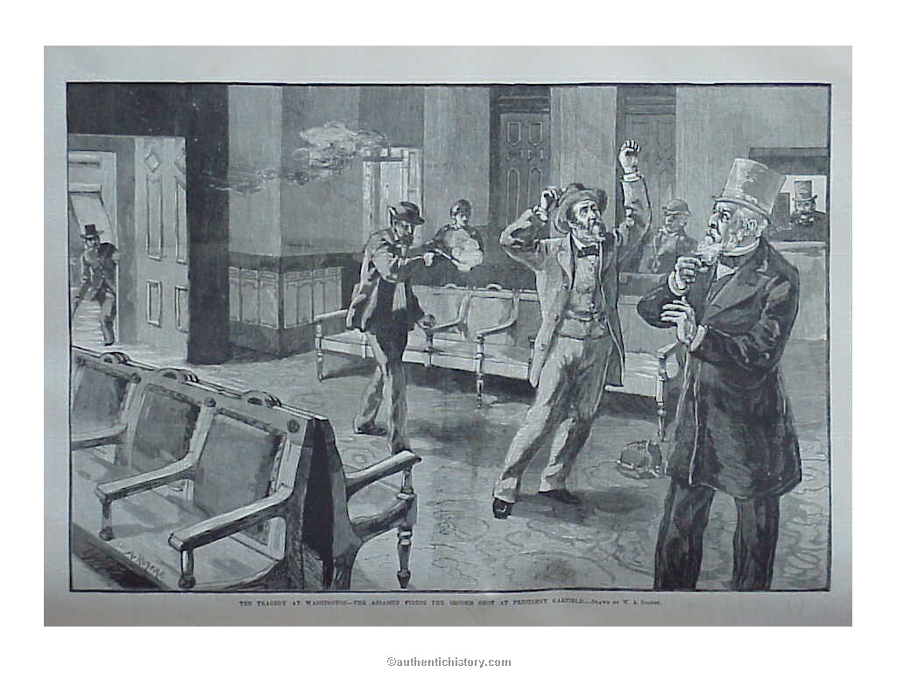
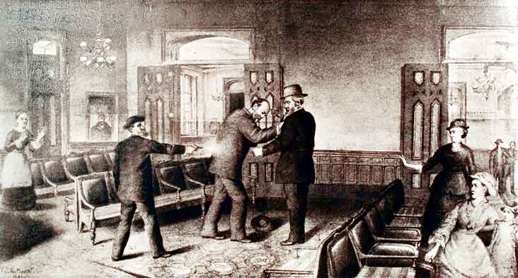
The Assassination

Slide 19
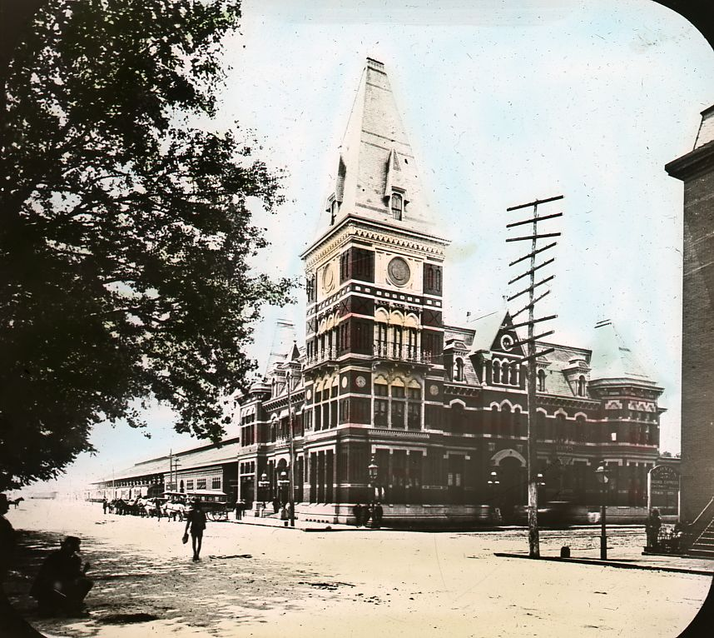
The Train Station

Slide 20
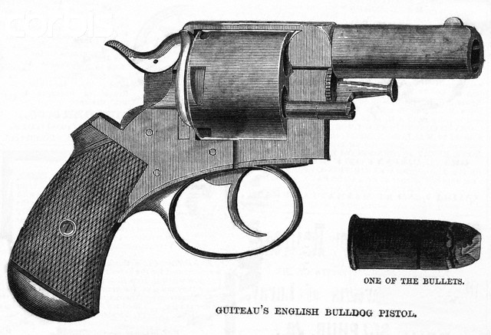
Motive – The Spoils System

Slide 21
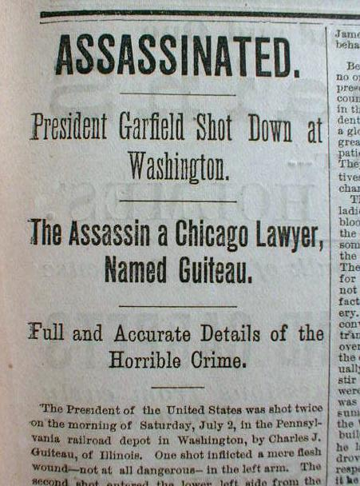
Media Coverage

Slide 22
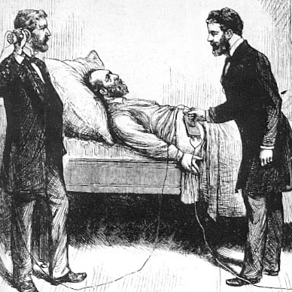
Treatment

Slide 23
Global Connections
American influence around the world grew dramatically during the Gilded Age.
Americans had been sending missionaries to foreign countries since the early 1800s, but far greater numbers went abroad in the 1880s and 1890.
U.S. trade with foreign countries

Slide 24
Technology Changes the Nation
1895 - 4 cars; 1917 - 5 million
Made possible by Henry Ford and the assembly line
14 hours to 1.5 hours
River Rouge plant, every 10 seconds
$25,000 / day in the 1920s
1930 - Americans owned 30 million cars, 20 million were Model Ts

Slide 25
Immigration
In the 75 years between 1815 and 1890, 15 million people immigrated to the U.S.
In the next 25 years, from 1890 until the start of World War I in 1914, 15 million additional immigrants came to the United States.

Slide 26
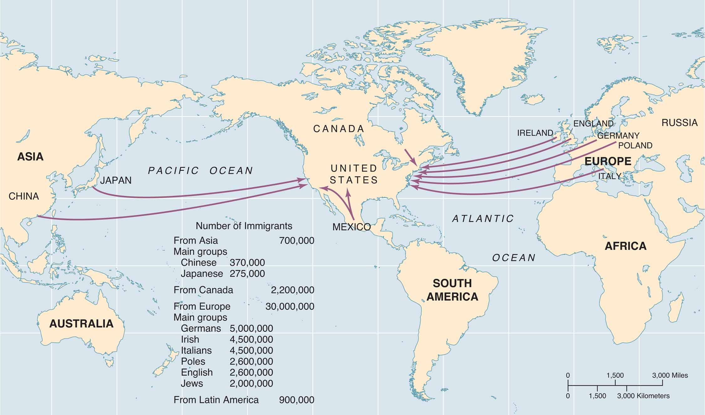
Immigration to the United States
MAP 17-2, Immigration to the United States

Slide 27
The Push From Around the World
“New Immigration” - 1880 to 1920
Southern & Eastern Europe
27 million came, 11 million went back
Orthodox, Catholics, & Jews
Italian, Hungarian, Czech, Polish, Russian, Greek, & Romanian
Chinese Exclusion Act (1882) - lasted until 1943

Slide 28
The Pull from an Industrializing United States
Why? Lured to America by Industrial Revolution and land
Jobs
Opportunities
Advertising
Start a “new life”

Slide 29
The Reality—Jobs, Cities, and Americanization
Ellis Island
“Strange” cultures, customs, & languages
Settled in cities
Heavily illiterate
Came from countries with little democracy
Could they be assimilated?
Foreign language newspapers, churches, and schools

