Slide 1
Chapter 15 RECONSTRUCTION

Slide 2
Important Terms
Carpetbaggers– Northern that moved south after to the war to help freedmen and/or for profit/power (outsiders)
Scalawags – White Southerners that worked to help freedmen and/or worked with northerners. (sell outs)
Redeemers – Southern Democrats that worked to regain power and reestablish the old social structures
Reconstruction – period of rebuilding the country while Freedmen played a role and had some power
Redemption – period when white Democrats reestablished power and oppressed Freedmen

Slide 3
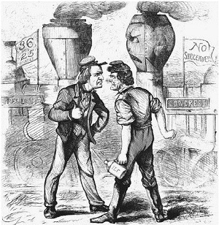
The President Versus Congress
The North split on reconstructing the South
White House seeks speedy reconstruction with minimum changes in the South
Congress seeks slower reconstruction, demands protection for freedmen

Slide 4
Wartime Reconstruction
Lincoln announces lenient policy in 1863
Congress resents Lincoln’s effort to control
Congressmen seek to condition readmission to Union on black suffrage
Congress mistrusts white Southerners

Slide 5
Andrew Johnson at the Helm
Republicans initially support Southern Democrat Johnson as enemy of planter class
Johnson, Republicans split on Reconstruction
Johnson instructs Southern conventions to
Declare secession illegal
Repudiate Confederate debt
Ratify the Thirteenth Amendment

Slide 6
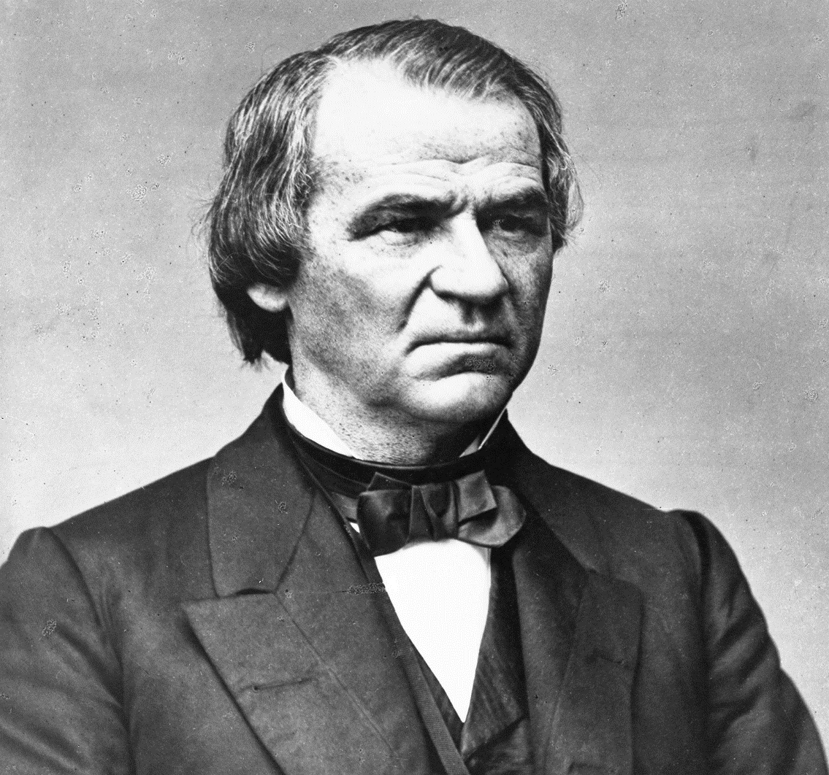
Andrew Johnson at the Helm
Southern conventions reluctantly carry out Johnson’s orders
Conventions pass “Black Codes”
Johnson approves conventions’ actions
Congress condemns conventions

Slide 7
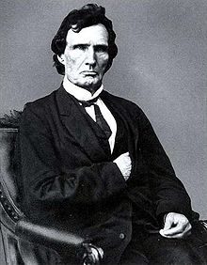
Congress Takes the Initiative
Republicans insists on black suffrage
They expect to get black vote
Ideological commitment to equal rights, even if some did not believe in racial equality
Fear that South would fall under great planter control without black suffrage

Slide 8
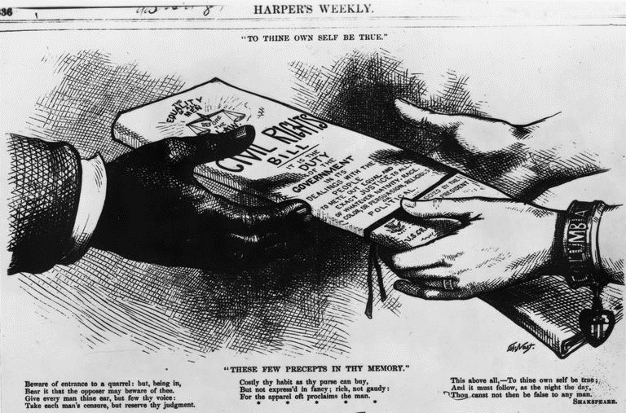
Congress Takes the Initiative
1866: Johnson vetoes two bills
Extension of Freedmen’s Bureau
Civil rights bill to overturn Black Codes
Republicans pass Fourteenth Amendment
Johnson’s National Union party runs against Republican congressmen in elections
Elections of 1866 strengthen Republicans

Slide 9
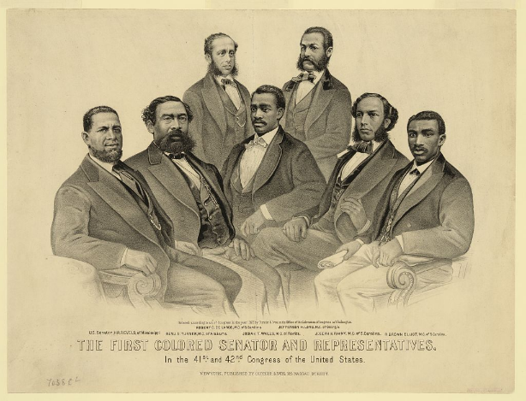
Congressional Reconstruction Plan Enacted
South under military rule until black suffrage fully secured
Split over duration of federal protection
Radicals recognize need for long period
Most wish military occupation to be short
Assumption: black suffrage sufficient to empower freedmen to protect themselves

Slide 11
Reconstruction

Slide 12
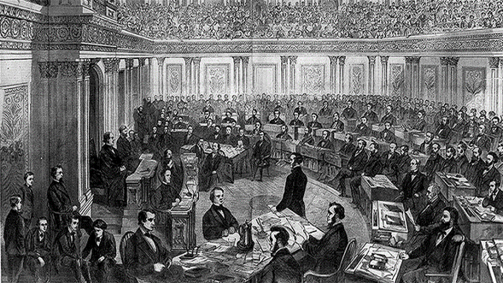
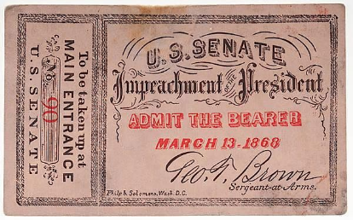
The Impeachment Crisis
Johnson obstructs Congressional Reconstruction
Congress limits Presidential power
Tenure of Office Act
February, 1868: Congress impeaches
Senate refuses to convict Johnson
Radical Republicans seen as subversive of Constitution, lose public support

Slide 13
Reconstructing Southern Society
Three contending interests in South
Southern whites seek to keep newly freed blacks inferior
Northern whites seek to make money or to "civilize" the region
Blacks seek equality
Decline of federal interest in Reconstruction permits triumph of reaction and racism

Slide 14
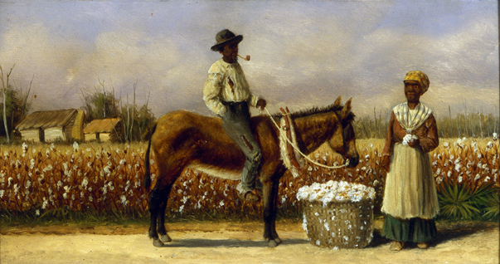
Reorganizing Land and Labor
Ex-slaves wish to work their own land
Federal government sometimes grants land
Land reverts to white owners under Johnson
Slaveowners try to impose contract labor
Blacks insist on sharecropping

Slide 15
Black Codes: A New Name for Slavery?
South increasingly segregated after War
Black Codes designed to return blacks to quasi-slavery
Codes overturned by Congress
Violence and discrimination continued on a large scale

Slide 16
Republican Rule in the South
1867: Southern Republican party organized
Businesspeople want government aid
White farmers want protection from creditors
Blacks form majority of party, want social and political equality
Republican coalition unstable
Republicans break up when whites leave

Slide 17
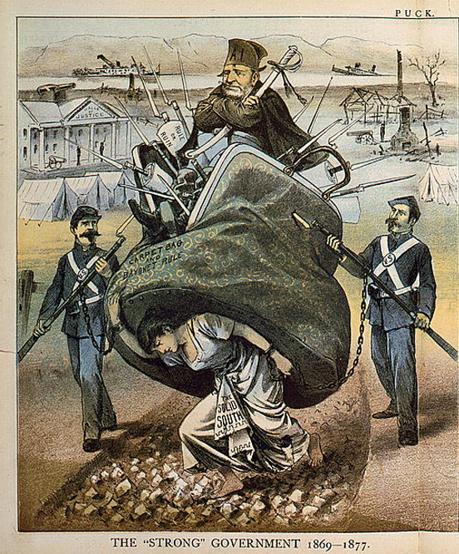
Republican Rule in the South
Republicans improve public education, welfare, and transportation
Republican state legislatures corrupt
Whites control most radical state governments
African Americans given blame for corruption

Slide 18
Claiming Public and Private Rights
Freed slaves viewed legalized marriage as an important step in claiming political rights
They also formed churches, fraternal and benevolent associations, political organizations, and schools
Education for children was a top priority

Slide 19
Retreat from Reconstruction
Enormous problems 1868–1876
Grant’s weak principles contribute to failure

Slide 20
Rise of the Money Question
Panic of 1873 raises “the money question”
Debtors seek inflationary monetary policy by continuing circulation of "greenbacks"
Creditors, intellectuals support hard money
1875: government commits to hard money
1876: Greenback party formed, makes gains in congressional races

Slide 21
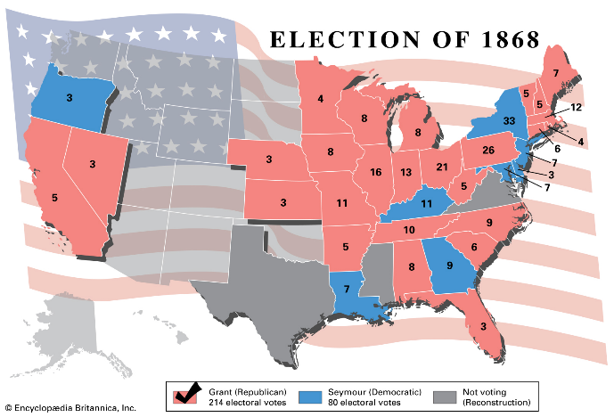
The Election of 1868

Slide 22
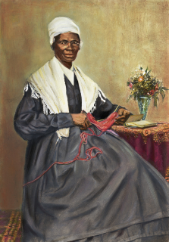
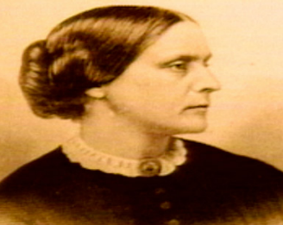
Final Efforts of Reconstruction
1869: Fifteenth Amendment passed
Also enfranchised Northern blacks
Women’s rights group were upset that they were not granted the vote
Northern support for black citizenship waned

Slide 23
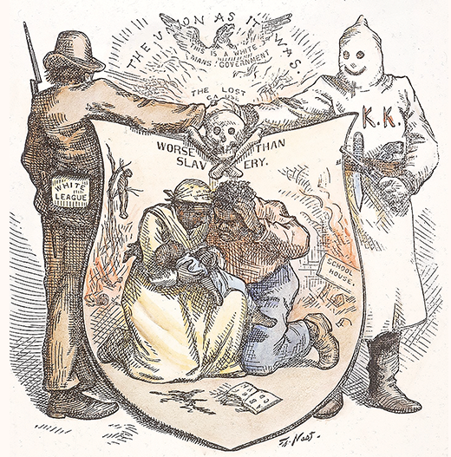
A Reign of Terror Against Blacks
Secret societies used terror tactics to keep blacks out of the political process and near insurrections against state governments
1870s: Congress tries to suppress Ku Klux Klan, other Southern terrorist groups
By 1876 Republicans control only South Carolina, Louisiana, and Florida
Northern support for military action wanes

Slide 24
Spoilsmen Versus Reformers
Rumors of corruption during Grant's first term discredit Republicans
1872: Grant wins reelection over Liberal Republican, Democrat Horace Greeley
Grant’s second term rocked by scandal

Slide 25
The Election of 1872

Slide 26
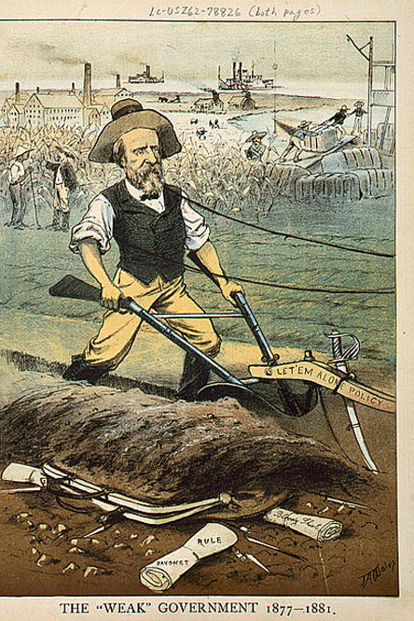
Reunion and the New South
North and South reconcile after 1877
Terms of reconciliation
African Americans stripped of political gains
Big business interests favored over small farmer

Slide 27
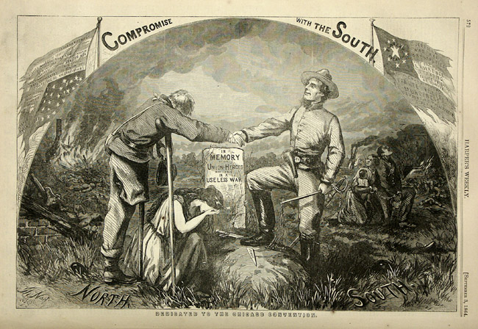
The Compromise of 1877
Election of 1876 disputed
Special Congressional commission gives disputed vote to Rutherford B. Hayes
Southern Democrats accept on two conditions
Guarantee of federal aid to the South
Removal of all remaining federal troops
Hayes’ agreement ends Reconstruction

Slide 28
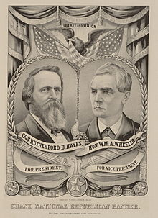
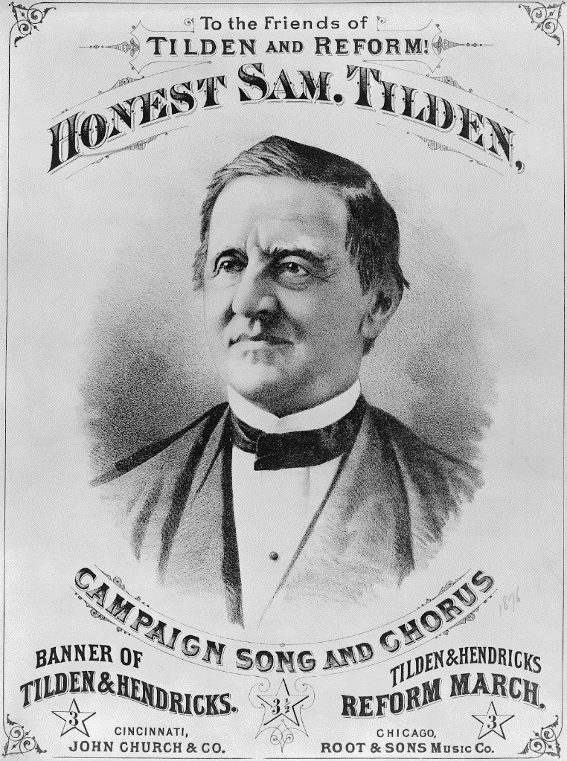

Slide 29
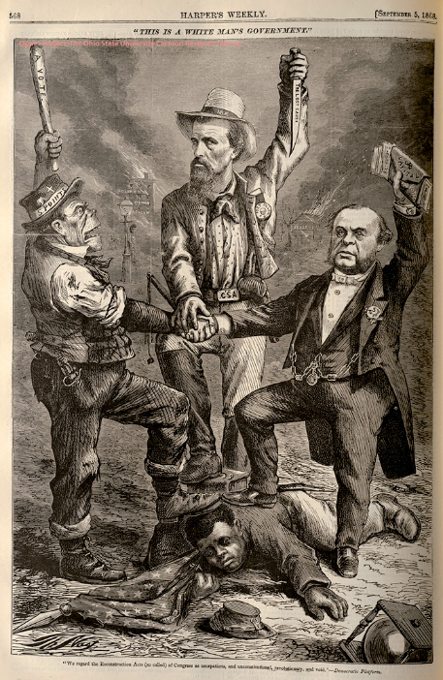
“Redeeming” a New South
Southern "Redeemers" not ideologically coherent, more power brokers between major interest groups commerce, manufacturing, and agriculture
Gain power by doctrine of white supremacy
Neglect problems of small farmers

Slide 30
The Rise of Jim Crow
Redeemer Democrats systematically exclude black voters
Jim Crow laws legalize segregation and restrict black civil rights
By 1910 the process was complete
The North and the federal government did little or nothing to prevent it

Slide 31
The Rise of Jim Crow
Lynching—187 blacks lynched yearly 1889–1899
U.S. Supreme Court decisions gut Reconstruction Amendments 1875–1896
“Reunion” accomplished as North tacitly acquiesces in Southern discrimination

Slide 32
Henry McNeal Turner and the “Unfinished Revolution”
Henry McNeal Turner’s career summarized the Southern black experience during and after Reconstruction
He supported the Union during the war and was elected to GA legislature in Reconstruction
“Redeemed” GA legislature expels him, exemplifying Northerners tacit approval of oppression of Southern blacks
Turner becomes A.M.E. bishop and major proponent of black emigration to Africa

