Slide 1
Chapter 13
The Politics of Separation
1850-1861
© 2015 Pearson Education, Inc. All rights reserved.

Slide 2
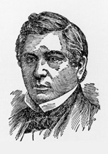
From Union to Disunion
Wilmot Proviso
Aug. 8, 1846 - David Wilmot declares slavery should be barred from any territory gained in the Mexican-American War
Approved by the House
Rejected by the Senate

Slide 3
California, the Compromise of 1850, and the Fugitive Slave Act
California enters the Union as a free state
New Mexico becomes a territory; set the boundary of Texas at its current location
Utah another territory
Fugitive Slave Act
Abolished the slave trade in Washington, DC

Slide 4
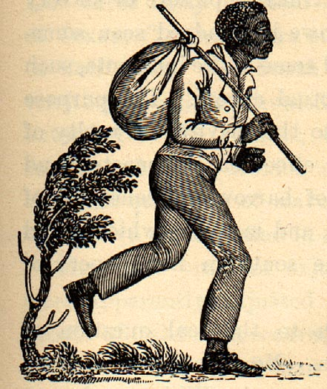
Enforcing the Fugitive Slave Act
The new Fugitive Slave Act went much further than any previous law.
It created a new corps of federal agents to help capture runaway slaves.
Court-appointed federal commissioners would determine whether a person claimed by a slave catcher was truly a slave or actually a free person.

Slide 5
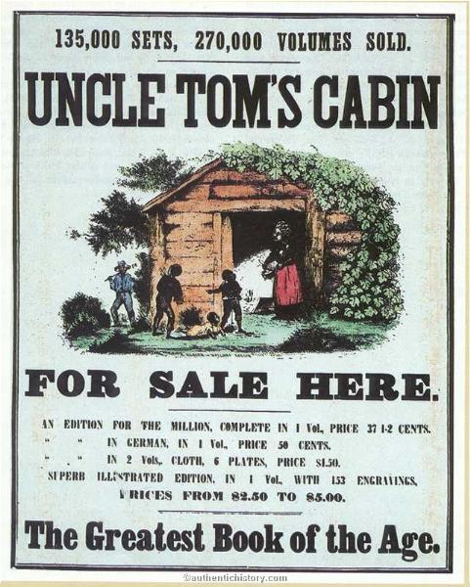
Uncle Tom’s Cabin
Harriet Beecher Stowe
Anti-slavery novel
Tells the story of Uncle Tom, the ever-patient and kind slave, his evil owner Simon Legree, and heroic Eliza Harris, the slave mother.
Caused outraged in the South

Slide 6
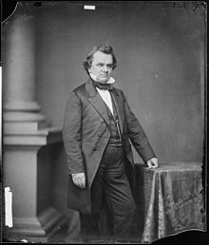
The Kansas-Nebraska Act of 1854
The debate over the route of a transcontinental railroad reopened the slavery issue
Northern or Southern route?
Stephen A. Douglas
To get southern support, however, he had to make concessions on slavery
Popular sovereignty

Slide 7
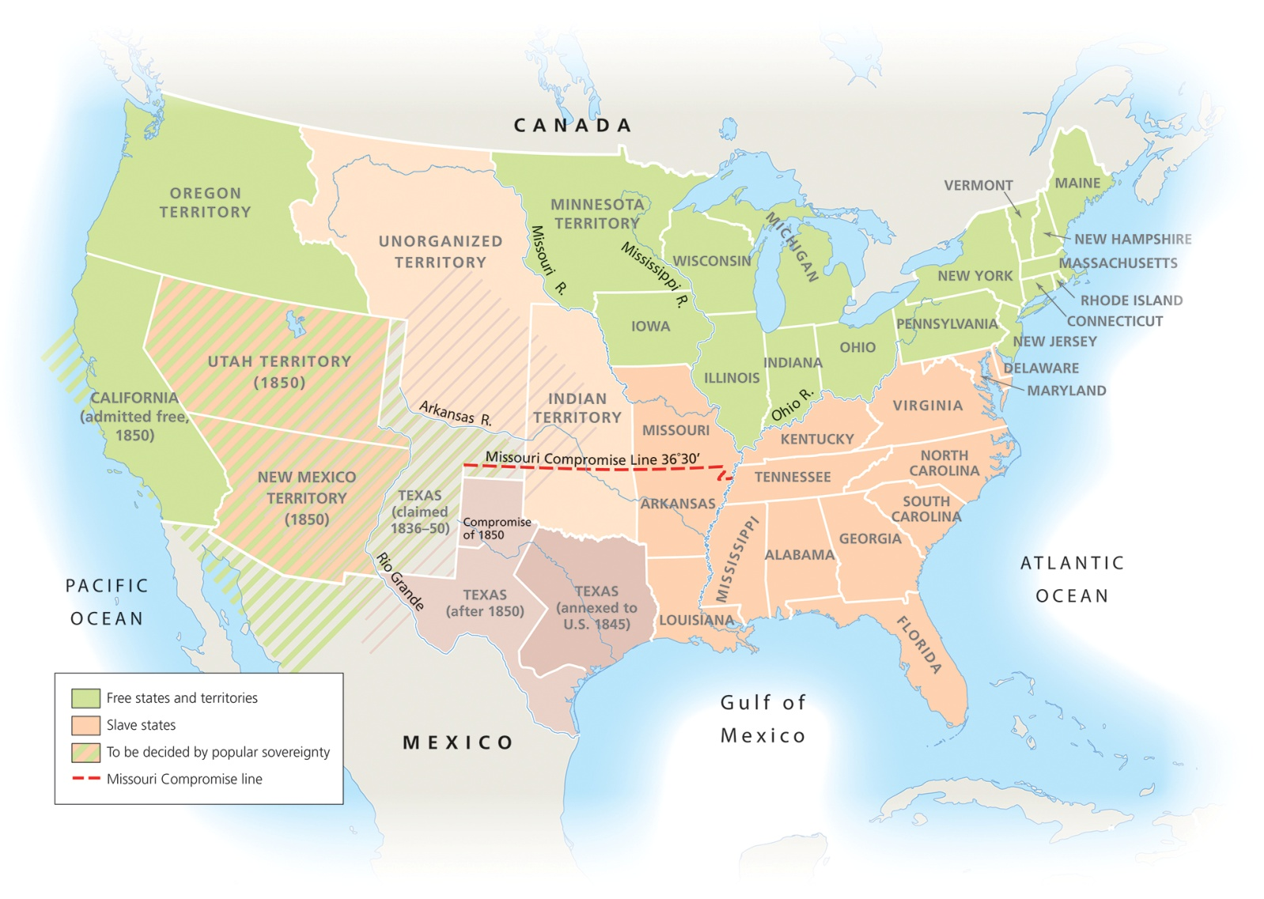
The Compromise of 1850 and the Kansas-Nebraska Act

Slide 8
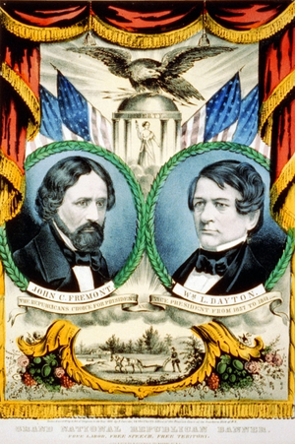
The Congressional Elections of 1854 and the Birth of the Republican Party
Opponents of the Kansas-Nebraska Act formed a new political party - the Republican Party
1856 - 1st presidential candidate - John C. Frémont

Slide 9
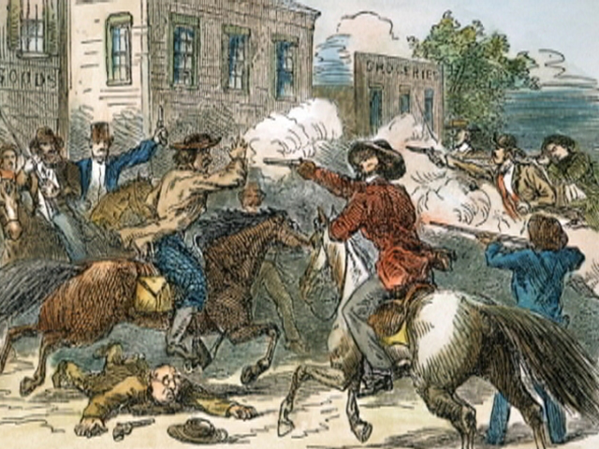
Bleeding Kansas And Dred Scott v. Sandford
“Free Soilers” vs. pro-slavery forces
Rehearsal for civil war
By 1856, there were two governments in the state
Topeka - “free”
Lecompton - “pro slave”

Slide 10
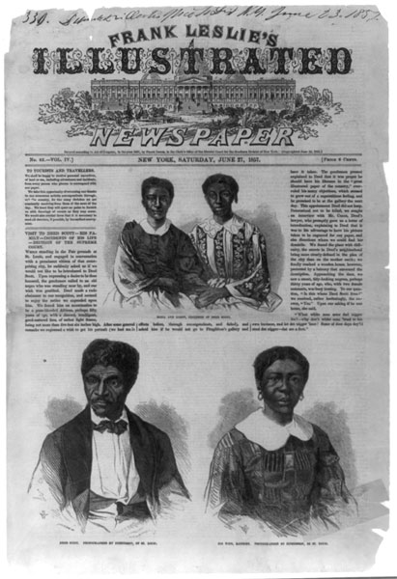
The Supreme Court and Dred Scott
Mar. 6, 1857
Slaves were not citizens of the U.S.
Congress had no authority to prohibit slavery in the territories
Missouri Compromise line - unconstitutional
The decision rocked Free Soilers

Slide 11
The Economy, the Panic of 1857, and the Lincoln-Douglas Debates
Slavery and economic factors caused the Civil War.
The Panic of 1857 exacerbated the economic split between the regions.
It was much more severe in the North than in the South.

Slide 12
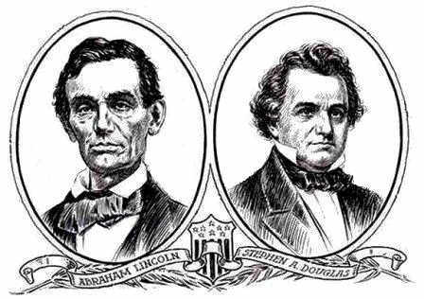
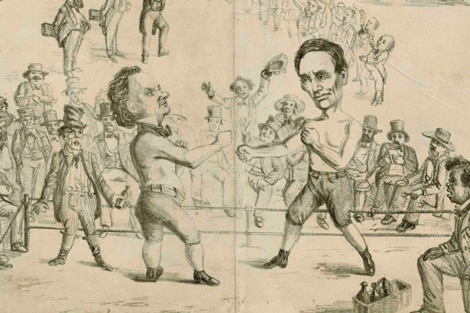
The Lincoln-Douglas Debates Define the Political Parties
1858 - Senate contest in Illinois
Aug.-Oct. 1858 - 7 debates focused on the issue of slavery
Lincoln gains a national following

Slide 13
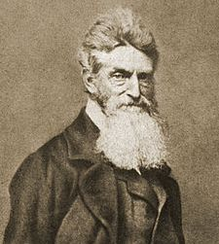
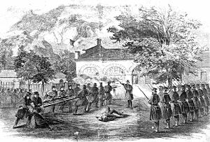
John Brown at Harper’s Ferry
Oct. 16, 1859 - Harpers Ferry, Virginia
Brown & 21 men (5 black men & 3 of his sons) made the supreme gesture
Federal arsenal

Slide 14
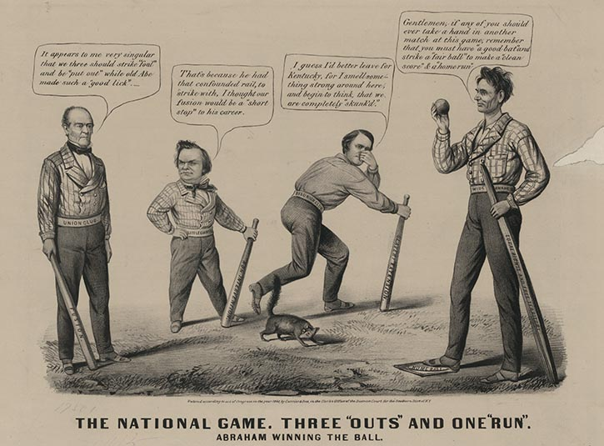
The Election of 1860 and the Secession of the South
The Republican party was still very new.
Democrats were split over the issue of slavery.
The Kansas situation was the death knell of the Whig party.

Slide 15
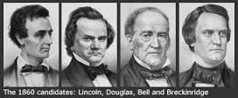
The Election of Abraham Lincoln
Northern Democrats - Stephen A. Douglas
Southern Democrats - John C. Breckinridge
Constitutional Union - John Bell
Republicans - Abraham Lincoln

Slide 16
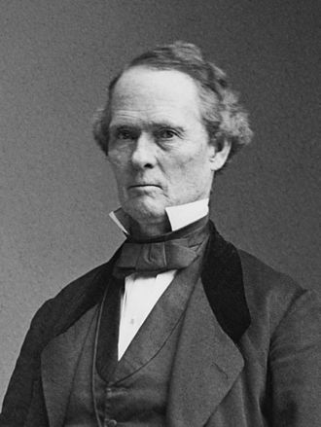
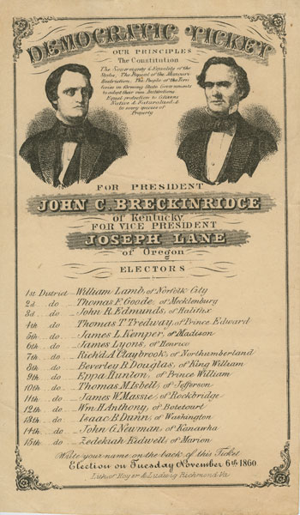
Evansville Connection
The southern Democrat Vice Presidential Nominee was Joseph Lane lived in outside of Evansville from 1820 – 1848
He served in the Indiana Legislature and lead troops under Zackary Taylor in the Mexican War.
Appointed Governor of Oregon Territory by Polk in 1848.

Slide 17
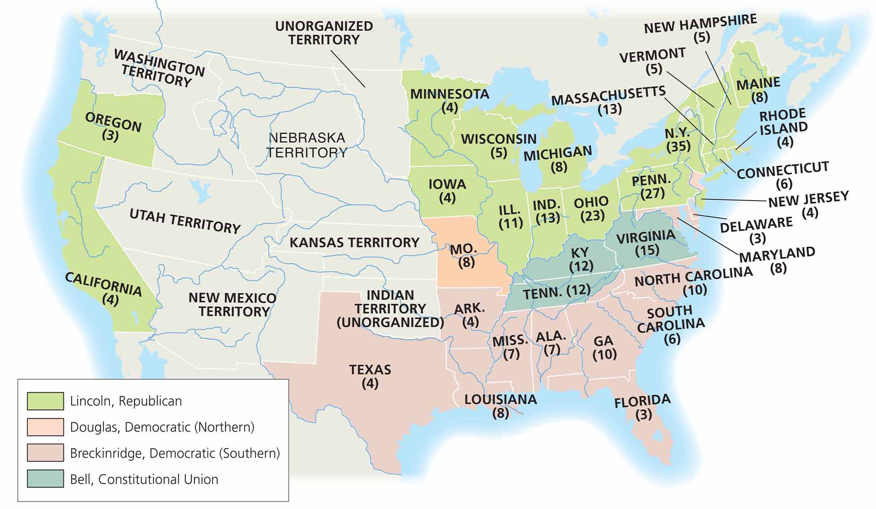
The Election of 1860
MAP 13-2, The Election of 1860

Slide 18
Creating the Confederate States of America
Before Lincoln was even inaugurated secession began
Dec. 20, 1860 - South Carolina secedes
By Feb. 1, 1861 - Mississippi, Florida, Alabama, Georgia, Louisiana, Texas
Feb. 7 - Confederate States of America
Lincoln’s Inauguration March 4, 1861
Civil War begins - April 12, 1861

