Slide 1
Chapter 11 Manifest Destiny: Expanding the Nation
1830-1853

Slide 2
Manifest Destiny—The Importance of an Idea
John L. O’Sullivan: “Our manifest destiny is to overspread the continent”
By 1860, some 4.3 million people had settled in the trans-Mississippi West

Slide 3
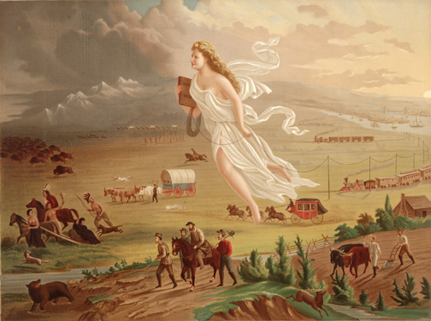
America’s Progress
What do you see in the painting?
The Women is heading west. What do you think she represents? How is the symbolized in the painting?

Slide 4
America 1872

Slide 5
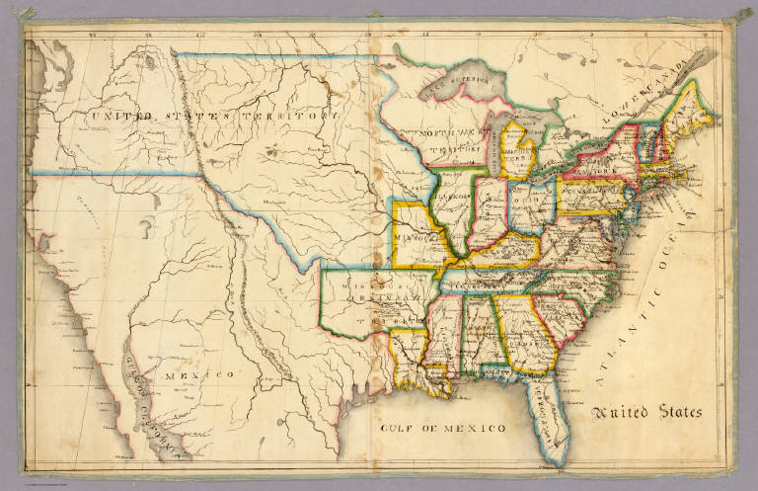
America 1816

Slide 6
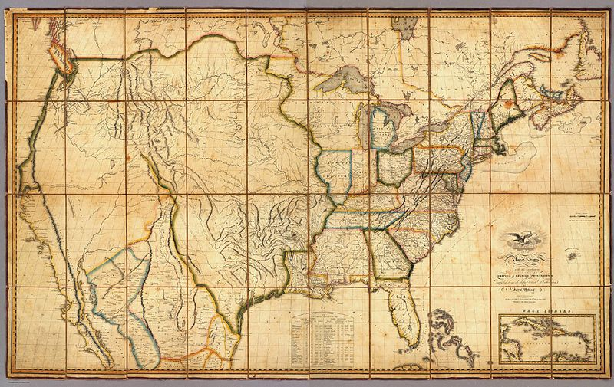
John Melish Map 1816

Slide 7
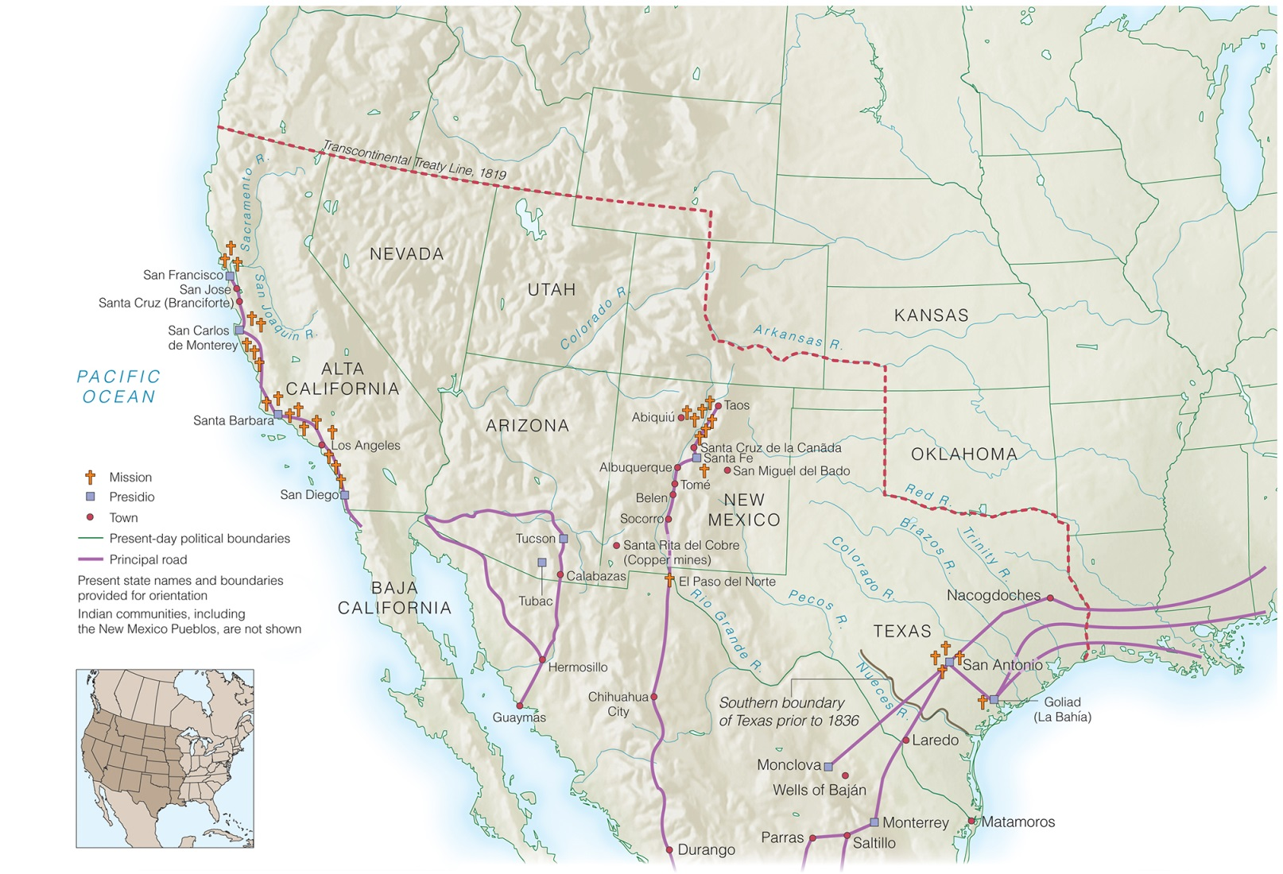
Trade Networks Between Mexico, Texas, and the United States
Map 11-1, Trade networks between Mexico, Texas, and the United States

Slide 8
Movement to the Far West
American settlement reaches Pacific in 1830s and 1840s
Settlement encroaches on lands claimed by Mexico and England

Slide 9
Borderlands of the 1830s
1842: Webster-Ashburton Treaty settles the northeast U.S.-Canadian boundary
Americans begin settling in
Oregon territory (joint U.S., English claim)
New Mexico territory (owned by Mexico)
California (owned by Mexico)

Slide 10
Territorial Expansion by the Mid-Nineteenth Century

Slide 11
The Texas Revolution
1820s: Americans encouraged to move into Texas
"Anglos" never fully accept Mexican government rules on slavery and Catholicism
1830: Mexico bans immigration from U.S. and importing slaves
1835: Armed rebellion breaks out after Santa Anna seems bent on using military to enforce Mexican government policy

Slide 12
The Republic of Texas
March, 1836: Texans declare independence and the Alamo under siege
April, 1836: Santa Anna defeated at San Jacinto
May, 1836: Santa Anna’s treaty recognizes Texas' claim to territory (Mexico repudiates)
Texas offers free land grants to U.S. settlers
Annexation to U.S. refused by Jackson

Slide 13
Texas Revolution

Slide 14
Trails of Trade and Settlement
Santa Fe Trail closed to U.S. travelers as a result of Mexico’s war with Texas
Oregon Trail conduit for heavy stream of settlers to the Oregon country
Oregon settlers demand an end to joint U.S.-British occupation

Slide 15
The Mormon Trek: Westward Flight
Church of Jesus Christ of the Latter Day Saints founded by Joseph Smith, 1830
Mormon church seeks revival of pure aboriginal American Christianity
Mormons persecuted for unorthodoxy
Flee New York for Nauvoo, Illinois
Murder of Joseph Smith 1844
Brigham Young becomes Mormon leader
Mormons move to Great Salt Lake in Utah

Slide 16
The Mormons Trek: Mormons in Utah
1847: State of Deseret established, technically in Mexican territory
Desert transformed into farmland
1848: U.S. gets Utah and Mormons at first resist U.S. governance
1857: Brigham Young accepts post as territorial governor of Utah

Slide 17
Western Trails

Slide 18
Manifest Destiny and the Mexican-American War
Widespread call for annexation of newly settled lands
“Manifest Destiny” a slogan of those believing the U.S. divinely ordained to encompass Mexico and Canada

Slide 19
Tyler and Texas
1841: John Tyler assumes presidency after William Henry Harrison’s death
Tyler breaks with Whigs
1844: Tyler negotiates annexation with Texas for re-election campaign issue
Senate refuses to ratify because of expansion of slavery
Tyler loses Whig nomination to Henry Clay
Annexation by joint resolution

Slide 20
The Triumph of Polk and Annexation
Democrats nominate James K. Polk
Polk runs on expansionist platform
Annexation of Texas for Southern vote
U.S. jurisdiction of Oregon for Northern vote
James Birney and Liberty Party take votes away from Clay over the expansion of slavery
Polk, Congress interpret his election as mandate for expansion
Texas annexed by joint resolution shortly before Polk inaugurated

Slide 21
The Liberty Party Swings an Election

Slide 22
The Election of 1844

Slide 23
The Doctrine of Manifest Destiny
"Manifest Destiny" first used in 1845 by John O’ Sullivan
God wants the U.S., His chosen nation, to become stronger
Americans make new territories free and democratic
Growing American population needs land
Limits to American expansion undefined

Slide 24
Polk and the Oregon Question
“54’ 40” or fight”
1846: Polk tells British that joint occupation no longer acceptable
England prepares for war, proposes division of the area
Senate approves division of Oregon along 49º north latitude, Treaty of 1846
U.S. gains ownership of Puget Sound
Northern expansionists condemned Polk for division

Slide 25
Northwest Boundary Dispute

Slide 26
War with Mexico: Outbreak
Texan claim to area between Nueces and Rio Grande Rivers not recognized by Mexico
After Texas annexation, this causes conflict between U.S. and Mexico
Polk orders General Zachary Taylor into disputed area
April 24 1846 Mexicans attack Americans in disputed area
May 13, 1846: War on Mexico declared

Slide 27
War with Mexico: Course
General Zachary Taylor wins campaign in northern Mexico
Colonel Stephen Kearney captured New Mexico and joined John C. Frémont in taking California by early 1847
September, 1847: General Winfield Scott occupies Mexico City

Slide 28
The Mexican-American War

Slide 29
Settlement of the Mexican-American War: Terms
Nicholas Trist, the negotiator with Mexico, disobeys Polk’s orders to return to Washington
February, 1848: Treaty of Guadalupe Hidalgo
Rio Grande becomes southern border
New Mexico, California ceded to U.S.
U.S. pays Mexico $15 million

Slide 30
Settlement of the Mexican-American War: Aftermath
Why the U.S. did not annex all of Mexico
Merk Thesis: racism and anti-colonial heritage
Graebner: U.S. only wanted west coast ports, no need for rest of Mexico
Mexican War politically contentious
Whigs constantly criticized war effort
Northerners view war as aimed at increasing slavery and Southern power
Wilmont Proviso
Manifest Destiny ultimately limited by racism and slavery question

Slide 31
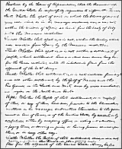
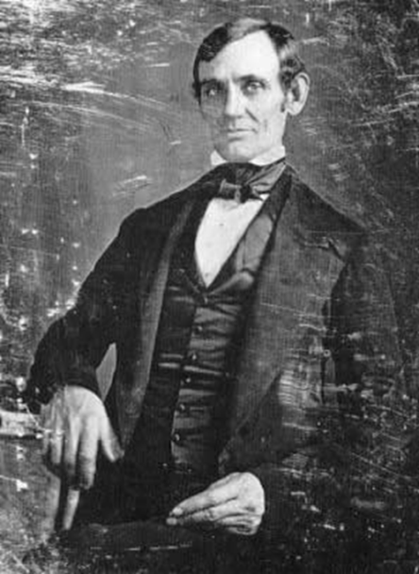
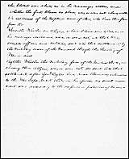
Congressman Lincoln
The “Spot Resolution” criticized President Polk and challenged that “American blood had been spilled on American Soil”

Slide 32
Internal Expansionism
“Young Americans” link territorial growth to other material achievements
Technological innovation—e.g. telegraph
Transportation improvements
Growth of trade
Mass immigration
Discovery of California gold inspires transcontinental projects
Territorial expansion wanes after 1848, economic, population growth continues

Slide 33
The Triumph of the Railroad
1840s: railroad begins displacing canals
Rail construction stimulates iron industry
Railroads stimulate new forms of finance
Bonds
Preferred stock
Government subsidies

Slide 34
Railroads, 1850 and 1860

Slide 35
The Industrial Revolution Takes Off
Mass production, the division of labor makes production more efficient
Factory system emerges
Gather laborers in one place for supervision
Cash wages
“Continuous process" of manufacturing
Agriculture becomes mechanized
Northern economy based on interaction of industry, transportation, agriculture

Slide 37
Mass Immigration Begins
1840-1860: 4 million Irish, Germans immigrate to U.S.
Most come for higher wages
Immigrants fill low-paying jobs in port cities
Low immigrant wages contribute to slums
Urban reform movement results from poverty of slums
Working class experience unifies different ethnicities into an American working class

Slide 38
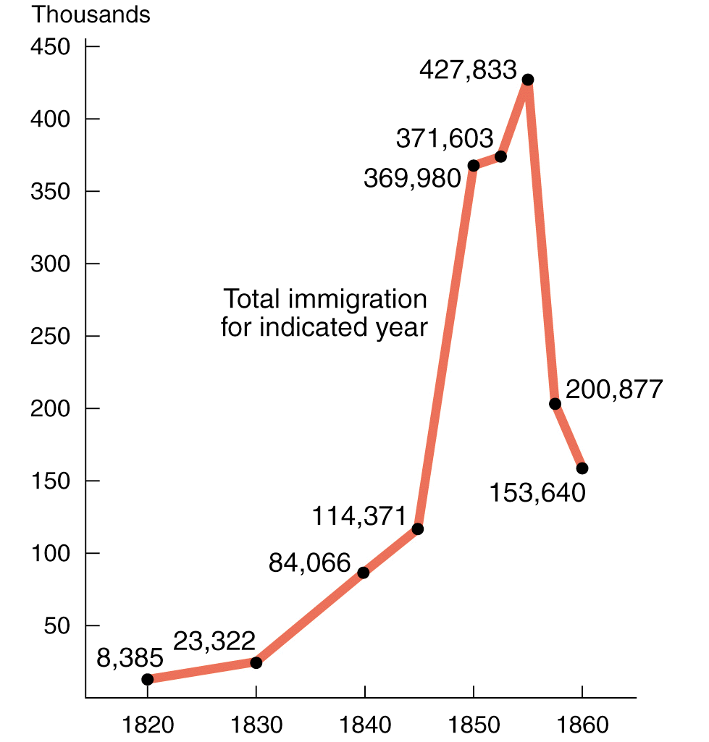
Immigration to the United States, 1820–1860

Slide 39
The New Working Class
1840s: Factory labor begins shifting from women, children to men
Immigrants dominate new working class
Employers less involved with laborers
Post-1837 employers demand more work for less pay
Unions organized to defend worker rights

Slide 40
The New Working Class
Wage laborers resent discipline, continuous nature of factory work
Workers cling to traditional work habits
Adjustment to new work style was painful and took time

Slide 41
The Costs of Expansion
Working class poses problem for ideals
Working for wages was assumed to be the first step toward becoming one’s own master
New class of permanent wage-earners conflicted with old ideal
Economic expansion creates conflicts between classes
Territorial expansion creates conflicts between sections
Both sets of conflicts uncontrollable

