Slide 1
Democracy in the Age of Andrew Jackson 1828-1844
Chapter 10

Slide 2
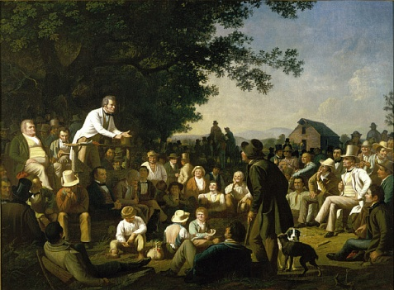
Democracy in Theory and Practice Rise of the Common Man
Democracy became preferred description of American politics in 1820s and 1830s
In democracy, the people were sovereign and could do no wrong
Traditional ideas of deference declined further
Equality of opportunity all important; the resulting inequalities of reward not really considered
America became society of winners and losers

Slide 3
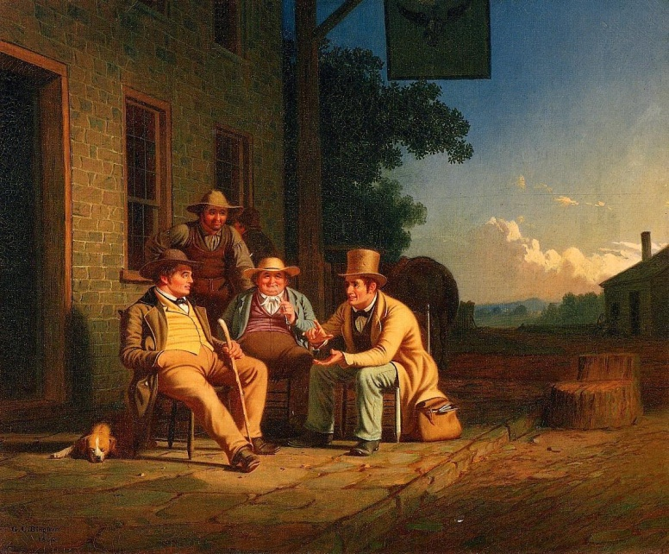
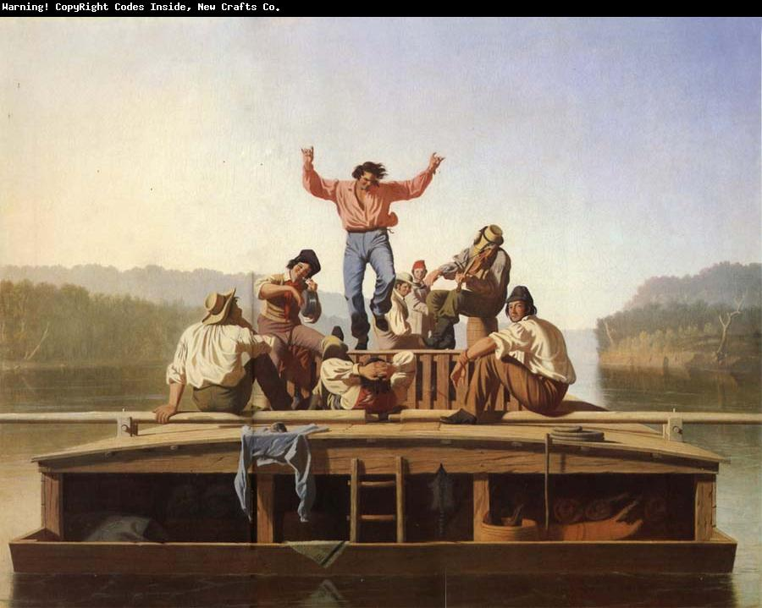
Democratic Culture
Artists’ audience was broad citizenry of democracy, not refined elite
Romanticism in America appealed to feelings and intuitions of ordinary Americans

Slide 4
Democratic Political Institutions: Politics of Universal Male Suffrage
Most states adopted universal white male suffrage by the 1820s
Many appointed offices made elective
Professional politicians and stable, statewide party organizations emerged
Politicians like Martin Van Buren promoted benefits of two-party system
Concept of loyal opposition accepted
Democracy spread to presidency
Most presidential electors chosen by popular vote rather state legislature by 1828
Participation rates rose from 27% in early 1820s to high of 78% in 1840

Slide 5
Economic Issues
Interest in government economic policy intensified after 1819
Political activity and debate around economic issues foreshadowed rise of parties based around economic programs
Republican ideology from Revolution made people suspicious of groups they did not identify with or benefit from
Jacksonians fear of “the money power”
Debate over role of federal government in the economy

Slide 6
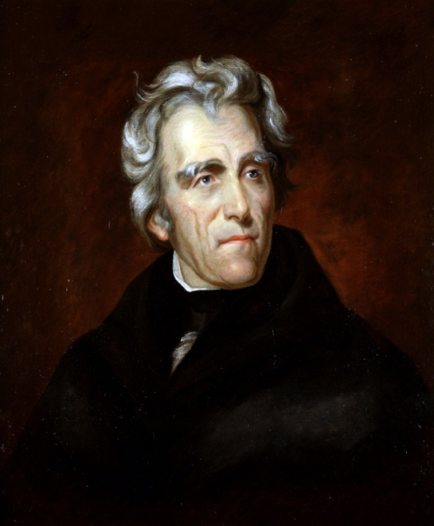
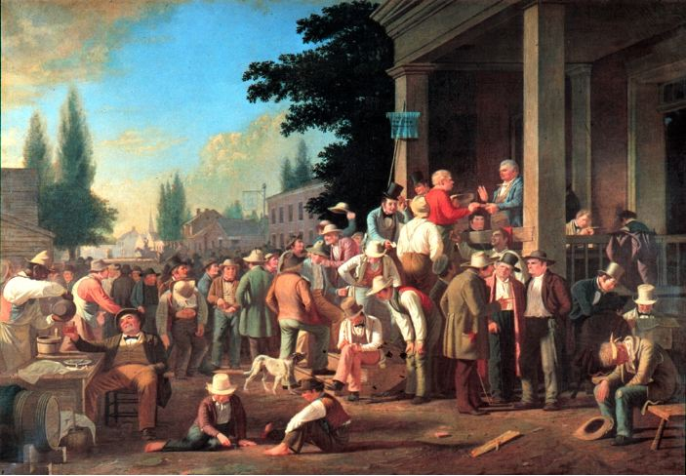
Jackson and the Politics of Democracy
Jackson became a symbol of democracy’s triumph
Actions of Jackson and his party re-fashioned national politics in a democratic mold
Era known as Jacksonian Democracy

Slide 7
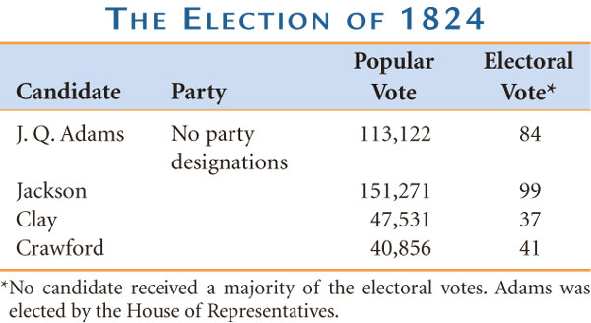
The Election of 1824 and J. Q. Adams’s Administration
The election of 1824 a five-way race
Jackson appealed to slaveholders and rural people opposed to Clay’s economic nationalism
Jackson got plurality of popular and electoral vote, but not a majority
Adams won in House of Representatives with Henry Clay’s support

Slide 8
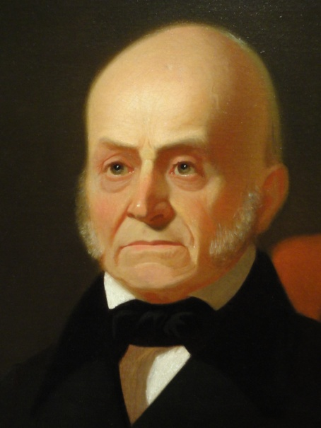
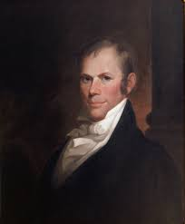
The Election of 1824 and J. Q. Adams’s Administration
Clay’s appointment as Secretary of State led to charges of a “corrupt bargain” between Clay and Adams
Adams rejected anti-economic nationalism sentiment in his policies
Mid-term election of 1826 gave Jackson forces control of Congress
Tariff became key issue and logrolling produced “Tariff of Abominations” in 1828

Slide 9
Jackson Comes to Power
“Corrupt Bargain” set motivation for 1828 election
Influential state leaders supported Jackson
Calhoun in South Carolina, Van Buren in New York
Their efforts led to formation of Democratic party, first modern American party
New electioneering techniques of mass democracy born
Parades, picnics, public rallies, etc.

Slide 10
Jackson Comes to Power
Campaign dominated by personal attacks and mudslinging
Jacksonians won by portraying Jackson as authentic man of the people
Jackson unclear about his stands on policy issues of the day other than Indian removal
Jackson’s democratic stamp on his administration
Defended “spoils system” as democratic
Replaced most of cabinet because of Peggy Eaton affair

Slide 11
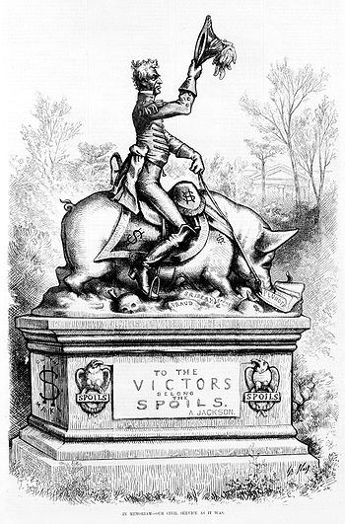
Jacksonian Democracy, Jacksonian Government
Jackson planned a clean sweep of senior federal office holders, some of whom had served under several presidents.
Jackson believed in what came to be called the “spoils system,” which was a patronage system.

Slide 13
Indian Removal
Indian removal policy inherited from prior administrations
Jackson agreed with state complaints that federal government had not removed Indians quickly enough
Some southern states asserted authority over Indians in their borders
Jackson got federal government approval for state removal initiatives with Indian Removal Act of 1830
1838—U.S. Army forced Cherokee west along the Trail of Tears

Slide 14
Indian Removal

Slide 15
Indian Removal Documents Activity
Write a summary paragraph for Document A-C.
- Compile a list of words that you needed to look up to understand the passages.

Slide 16
The Nullification Crisis
South opposed tariff because it increased prices for manufactured goods and endangered their access to foreign markets
In wake of 1828 Tariff, John C. Calhoun anonymously spelled out Doctrine of Nullification—right of an individual state to set aside state law
Personal relations between Jackson and Calhoun soured
1830—Jefferson Day Dinner
Jackson “to the union—it must be preserved”
Calhoun “to the union—next to our liberty, the most dear”

Slide 17
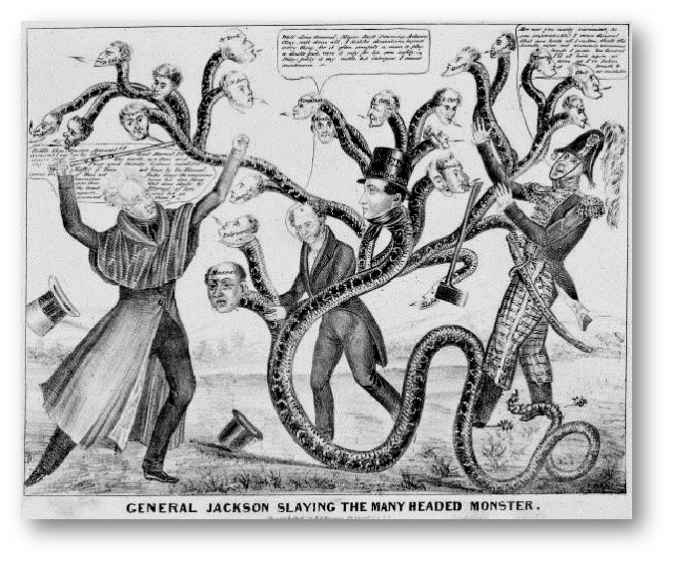
The Bank War and the Second Party System
“The Bank War” a symbolic defense of Jacksonian concept of democracy
Led to two important results
Formation of opposition party to Jackson— the Whigs
Economic disruption

Slide 18
Mr. Biddle’s Bank
Bank of the United States unpopular, blamed in South and West for 1819 Depression
1823 Biddle took over and restored confidence
Jeffersonians opposed bank on principle as unconstitutional and preserve of corrupt special privilege
Bank possessed great power and privilege with no public accountability

Slide 19
The Bank Veto and the Election of 1832
Jackson vaguely threatened bank in first term
On advice of Clay, Biddle sought new charter four years early in 1832
Congress passed, but Jackson vetoed
Claimed the bank was unconstitutional
Defended veto as a blow for equality
Jacksonian victory in 1832 spelled bank’s doom

Slide 20
The Election of 1832

Slide 21
Killing the Bank
Jackson destroyed bank by removing federal deposits
Funds transferred to state (“pet”) banks
Biddle used his powers to cause recession, attempted to blame Jackson
Clay got censure of Jackson through Senate for abusing his power (Jackson’s withdrawal of deposits from bank)
Destruction of bank provoked fears of dictatorship, cost Jackson support in Congress

Slide 22
Crash Course #14
1. How did voting rights change in the early 1800’s? What economic development caused this change?
2. What were the main components of the American System?
3. How/Why could the first 6:30 of the Age of Jackson video not be about Andrew Jackson?
4. What was Jackson’s most appealing attributes? - Describe his supports and the issues they cared about most.
5. What did the Whigs stand for?
6. Outline the Nullification Crisis.
7. Outline Indian Removal under Jackson.
8. How did Jackson affect the economic policy of the US
9. What caused the Panic of 1837? How did it affect political party membership in America?

Slide 23
Support, Refute or Modify the following statement:
Jacksonian Democracy and the expansion of suffrage was a benefit for America in the short and long term.
Support
Refute

Slide 24
The Emergence of the Whigs
Whig party a coalition of forces, first united in censure of Jackson
Clay and National Republicans
Webster and New England ex-Federalists
States-rights southerners
Anti-Masonic party
Whigs defended activist government in economics, enforcement of “decency”
Democrats opposed government regulation of morality
Democrats weakened by
Defection of Loco-Focos faction upset over pet banks
Specie Circular led to the Panic of 1837

Slide 25
The Rise and Fall of Van Buren
Martin Van Buren Jackson’s handpicked successor
Whig strategy in 1836 was to run four candidates and force election to House of Representatives; it failed
Term began with Panic of 1837
Panic caused more by complex changes in global economy than Jackson’s fiscal policy

Slide 26
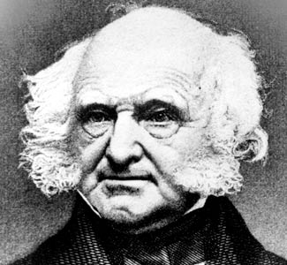
The Rise and Fall of Van Buren
Laissez-faire philosophy prevented Van Buren from helping to solve the problems of economic distress
Van Buren attempted to save government funds with independent sub-treasuries
Whigs blocked sub-treasuries until 1840

Slide 27
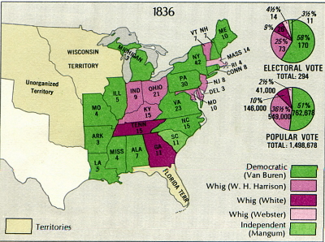
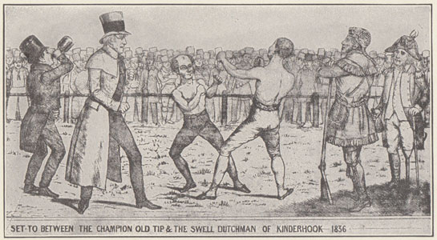
The Election of 1836

Slide 28
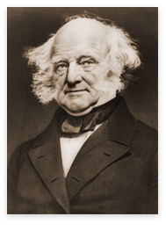
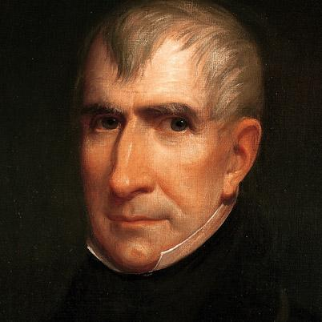
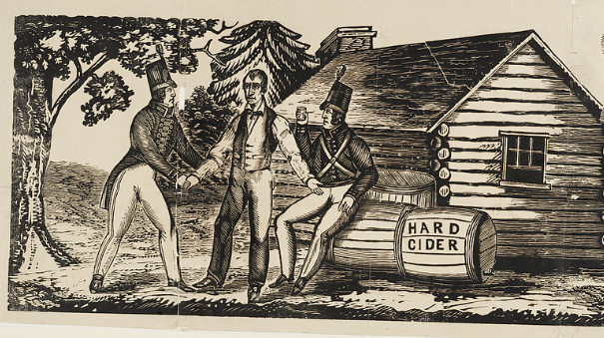
The Rise and Fall of Van Buren
Whigs fully organized by 1840
Whig candidate William Henry Harrison
Image built of a common man who had been born in a log cabin
Running mate John Tyler chosen to attract votes from states-rights Democrats
Harrison and Tyler beat Van Buren because their revival of the American system seemed like a good response

Slide 30
Heyday of the Second Party System
Election of 1840 marked rise of permanent two-party system in the U.S.
Whigs and Democrats evenly divided the electorate for next two decades
Parties offered voters a clear choice
Whigs supported a “positive liberal state”: government should support and protect industries that help economic growth
Democrats supported “negative liberal state”: government should not interfere in economy

Slide 31
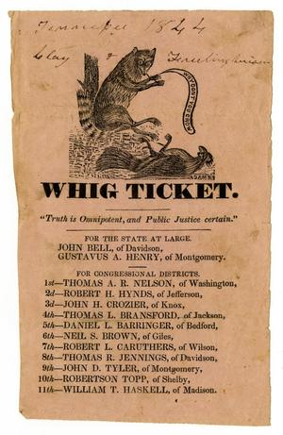
Heyday of the Second Party System
Whigs
Industrialists, merchants, successful farmers, more likely Protestant
Democrats
Small farmers, manufacturing, more likely Catholic

Slide 32
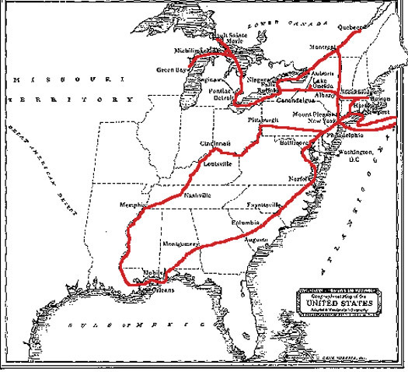
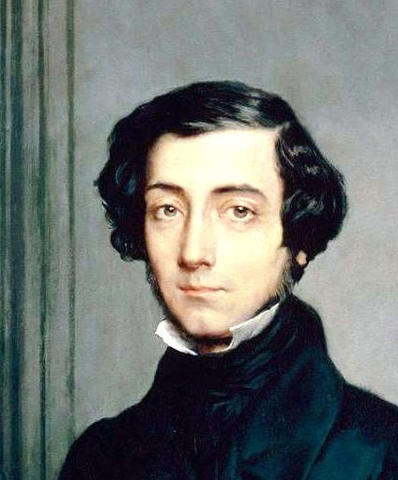
Tocqueville’s Wisdom
Alexis de Tocqueville praised most aspects of American democracy
Warned of future disaster if white males refused to extend liberty to women, African Americans, and Indians

Slide 33
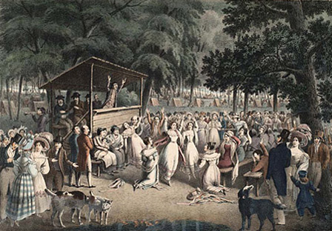
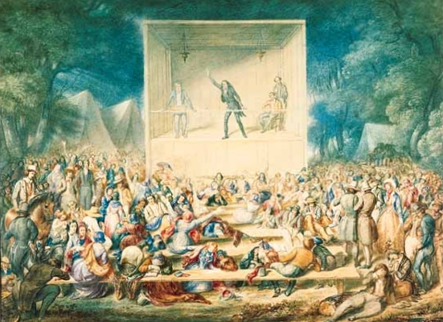
Democratized Religion: The Second Great Awakening
No popular movement was more powerful than the upsurge in religious activity that took place in Jacksonian America.
In the early 1830s, the Second Great Awakening was in full swing.

Slide 34
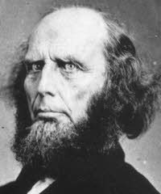
Charles G. Finney and New York’s “Burned-Over District”
Charles Grandison Finney, a Presbyterian minister
1830 - Finney led the largest religious revival ever seen in Rochester, New York.
By the late 1830s, the area where Finney preached had become known as “the burned-over district” because of the fires of religious enthusiasm there.

Slide 35
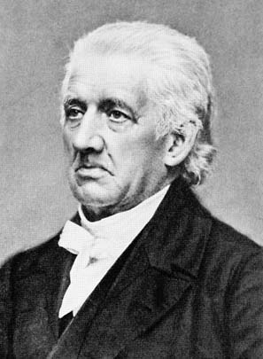
Lyman Beecher and the Growth of Voluntary Societies
Lyman Beecher helped to launch the growth of religious volunteer societies.
The goal was to strengthen the moral sway of Congregational-Presbyterian Protestantism against the individualism of Jacksonian Democrats, Catholics, and other Protestants who disagreed with them.

Slide 36
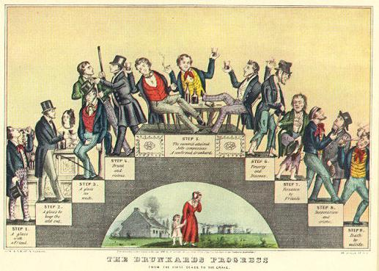
Revivalism and Moral Reform Movements
The rights of women and opposition to slavery were not the only reform causes to spring from the revivalism of the Second Great Awakening.
Treatment of prisoners, the mentally ill, temperance movements, and rescuing prostitutes were also focuses of reform.

Slide 37
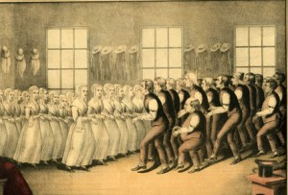
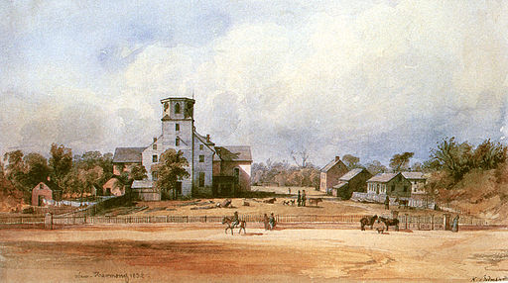
Utopian Religious Communities
Mother Ann Lee and the Shakers
John Humphrey Noyes and the Oneida Community
Robert Owen and the New Harmony Community
Joseph Smith and the Church Of Jesus Christ of the Latter-Day Saints

Slide 38
Transcendentalism
Extreme form of Romanticism
Centered in New England
a spiritual state that “transcends” the physical
Margaret Fuller, Henry David Thoreau, and Ralph Waldo Emerson

Slide 39
Democratized Education: The Birth of the Common School
The years during which Andrew Jackson dominated American politics were also years in which the nation’s public school system was radically transformed.
Various individuals with their own agendas contributed to what came to be known as the Common School Crusade.

Slide 40
Women Become Teachers
Catherine Beecher argued that women were much better equipped than men to be teachers.
In 1837, Mary Lyon founded Mount Holyoke Female Seminary in Massachusetts to give future female teachers a college education.

Slide 41
New Structures for Schooling
Horace Mann helped create a state Board of Education in Mass.
Mann believed in state standards for the schools.
Mann started “normal schools” to train teachers.
Mann believed in moral education.

Slide 42
The Nation’s Textbook: McGuffey’s Reader
Began 1836, by 1920, 122 million copies had been sold
Designed to create a literate and patriotic society
Included ethical instruction
Portrayed the U.S. as white, middle class, hard working, and sacrificing for the common good

